Slide 1
Lesson 23
The Giant (Ⅱ)
WWW.PPT818.COM

Slide 2
Think About It!
1. What did the giant see when he jumped out of his bed?
2. What happened to the garden in the end?

Slide 3
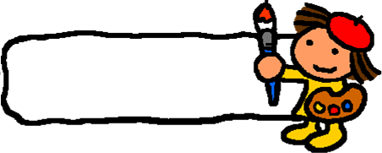
New words
knock v. 敲
spread v. 张开
neck n.脖子
peek v. 偷看
softly adv. 轻轻地
scene n. 景色
crawl v. 爬行
selfish adj. 自私的
wicked adj. 邪恶的

Slide 4
Listening Task: write it is true or false.
( ) 1. The giant saw something wonderful after he jumped out of his bed.
( ) 2. The children entered the garden by way of the gate.
( ) 3. The giant let only one little boy play in his garden.
( ) 4. Along with the children came the spring.
T
F
F
T

Slide 5
Language Points
1. I will knock down the wall! 我一定要把墙拆毁！
knock down撞倒，拆毁
The little boy was knocked down by bike. 这个小男孩被自行车撞倒了。
knock at/on敲（门/窗）等
Listen, someone is knocking at the door. 听，有人在敲门。

Slide 6
2. Ever since then, the giant’s garden has been a children’s playground. 从那时起，巨人的花园就成了孩子的游乐场。
ever since then从那时起，相当于since then，常和现在完成时连用。
Ever since then I have worked in that factory. 从那时起，我就在这个工厂工作。

Slide 7
Practice
根据句意及提示补全单词。
1. Yesterday I k______ at your door, but nobody answered.
2. We all know that giraffes have long n_______.
3. The illness ______ (扩展) quickly because of the flood.
4. The wind blew ______ (温和地) .
5. I don’t like Tom. He is a _____ (自私的) boy.
nocked
ecks
spread
softly
selfish

Slide 8
THANK YOU

