Slide 1
Module 5 Shopping
Unit 2 You can buy everything on the Internet.
WWW.PPT818.COM

Slide 2
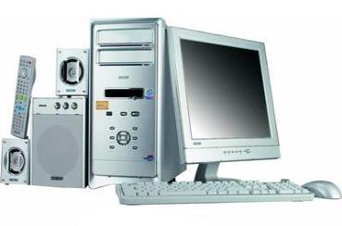
The computer is very useful in our everyday life.
talk to friends
play games
buy things online
computer
send emails
…
…
…
We can use the computer to…
Notes:
本资料来自于资源最齐全的２１世纪教育网www.21cnjy.com

Slide 3
Fast-reading
Match each paragraph(段) with its main idea.
Para. 1 The advantage of online shopping.
Para. 2 The disadvantage of online shopping.
Para. 3 The changes of our lives.
Para.4 The ways of online shopping.

Slide 4
WHILE-READING
Match each paragraph with its main idea.
Para 1 The advantage of online shopping.
Para 2 The disadvantage of online shopping.
Para 3 The changes of our lives.
Para 4 The ways of online shopping.

Slide 5
Careful reading
Read the passage and check (√) the true sentences and correct the wrong ones.
1. Online shopping is a new way of shopping.
2. You pay for online shopping before you receive it.
3. Online shopping is very difficult.
4. It’s very safe to shop over the Internet.
5. Our way of life is changing because of onlineshopping.
√
√
easy
not safe
√

Slide 6
WHILE-READING – Para 1
First, choose/ pay for
many new ways of shopping
Online shopping
Then, receive by post
buy almost everything

Slide 7
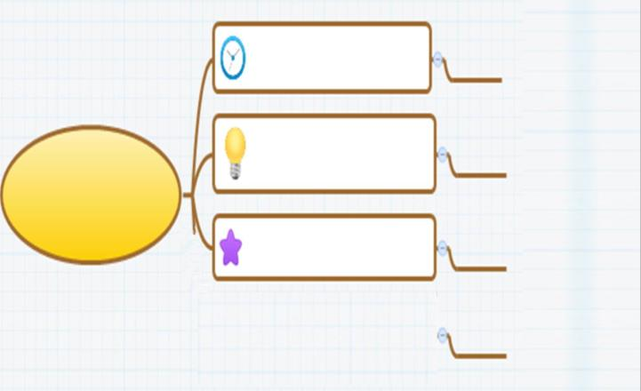
WHILE-READING – Para 2
Shop at any time
First …
Save time
Shopping takes…
Only need …
Second …
advantages
… also…
Compare the prices of the same product

Slide 8
WHILE-READING – Para 3
But many people like … because they can’t see or try on…
1.
disadvantages
2.
Also paying over … isn’t always safe.

Slide 9
Online shopping
(a new way of shopping)
Para 1
Para 2
advantages
Para 3
disadvantages
compare the prices the same product
paying over the Internet is not safe
shop at any time
save time
can’t see the products or try them on
Changing our way of life
Para 4

Slide 10
complete the table in A4 on page 29.
Shopping online
Advantages（优势） | Disadvantages（劣势）
but
First, shop at any time.
Why people don’t like…
Can’t see…
always (open.)
Second, you can save lots of money .
2.can’t try… on.
(take a lot of time. only need)
3. over
isn't safe.
通过
Third, Compare…., spend…. ,save…

Slide 11
太多
半价
特卖会
半斤
一斤的
其他什么
看起来新鲜
其中之一
网上购物
通过邮寄
支付
几个优势
too much/many
half price
on sale
half a kilo
a kilo of
What else
look fresh
one of
online shopping/shop on the Internet
by post
pay for
several advantages

Slide 12
13. 在任何时候
14. 门是关着的
15. 花费太多时间
16. A与B相比
17. 将A比作B
18. 出去/ 外出
19. 通过互联网支付
20. 试穿衣服
21. 总有一天
22. 生活方式
23. 到学校的路
24. 在回家的路上
at any time
The door is closed.
take a lot of time
compare A with/to B
compare A to B
go out
pay over the Internet
try on the clothes
one day
the way of life
the way to school
on the way home

