Slide 1
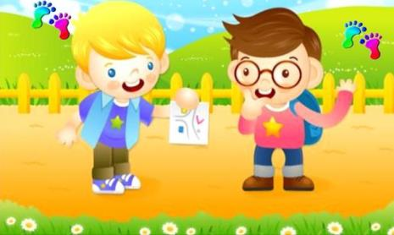
Unit 3
Asking the way
第二课时
WWW.PPT818.COM

Slide 2
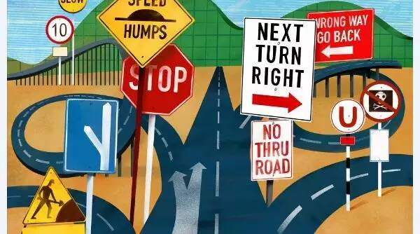
Introduce
-- How do I get to the...?
-- Go along this street. Turn left / right at...Get on / off at the...
You can see...on your left / right.

Slide 3
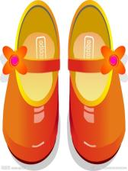
Words
shoe [ʃu:]
作名词，意为“鞋子”
eg：magic shoes 魔法鞋子
小练习：用所给词的适当形式填空：
There____ (be) a pair of shoes behind the door.
is
拓展：shoe都是以复数形式出现，可以和a pair of搭配即。
a pair of shorts 一条短裤 shorts 短裤
a pair of jeans一条牛仔裤 jeans牛仔裤

Slide 4
Words
many [ˈmeni]
作形容词，意为“许多”。
eg：There are many birds in the tree. 树上有许多的鸟。
小练习：选择合适的词填空：
There are so______(many, much) boys in the music room.
many
拓展：many后跟复数名词。
much后跟不可数名词。
a lot of ( lots of ) 后可接可数名词也可接不可数名词

Slide 5
Words
which [wɪtʃ]
作疑问代词，意为“哪一个”。对人和事的特征提问。
eg: Which season do you like? 你喜欢哪个季节？
小练习：The boy in the white shirt is my brother.（对划线部分提问）
Which boy is your sister？
拓展：which +动词不定时为定语从句 意为：该做哪个
如：which to buy 该买哪一个？
和 which用法相同的还有how ,when ,where, what
如： How to do？该怎样做? When to do? 何时做？

Slide 6
Expression
She doesn’t know which to choose! 她不知道该选哪一个.
一般现在时的否定句的构成形式：
（1）当主语为第三人称单数时，否定句的结构为：
主语+ doesn’t +动词原形+其他。
（2）当主语为非第三人称单数单数时，否定句的结构为：
主语+don’t+动词原形+其他

Slide 7
Expression
eg：I don’t know how to do. 我不知道该怎么做。
He doesn’t go to school at the weekends. 他周末不去学校。
小练习：句型转换：
Linda goes shopping at the weekends(改成否定句)
_____________________________________
Linda doesn’t go shopping at the weekends.

Slide 8
Expression
Where’s the toilet. 厕所在哪里?
由where引导的特殊疑问句，询问某人或者某物在哪里？
Where + is +单数名词 / 不可数名词？
主语+ is +in / on /under...+ 地点。
eg：Where is my key? It’s under your bed.
小练习：My purse is on the ground. (对划线部分提问)
Where is your purse?
拓展：由where引导的特殊疑问句其复数结构为：
Where + are +复数名词？ 主语+ are +in / on /under...+ 地点。

Slide 9
Dialogue
Sharon is in the shoe shop.
莎伦在鞋店里。
She likes shiny shoes.
她喜欢有光泽的鞋子。
But there are so many.
但是有许多。
She doesn’t know which to choose!
她不知道该选哪一个.
In the UK,we ask “Where’s the toilet? ”
在英国，我们问厕所在哪里？
In the US, we ask “Where’s the restroom?”
在美国，我们问休息室在哪里？

Slide 10
Expand
经典小故事
The lecturer on evolution had been going on for nearly two hours. Then he started again, and said he:” Let me ask the evolutionist a question --- if we had tails like a baboon, where are they?"
"I'll venture an answer, “said an old lady.” We have worn them off sitting here so long.”

Slide 11
Expand
教进化论的老师已经滔滔不绝地讲了快两个小时，他的话题又来了：“让我向进化论者提个问题--如果我们曾经像狒狒那样长着尾巴，那么现在尾巴到哪里去了？”
“我来试试看，”一位老太太说。
“该是我们在这里坐这么久把它们磨掉了吧。”

Slide 12
Summary
shoe
many
which
She doesn’t know which to choose!
Where’s the toilet.

Slide 13
Exercise
1.喜欢闪亮的鞋子_______________ 2. 如此多的玩具_______________
3.该选择哪个__________________ 4. 该怎么做__________________
5.在美国 __________________ 6. 在英国__________________
like shiny shoes
so many toys
which one to choose
how to do
in the US
in the UK

Slide 14
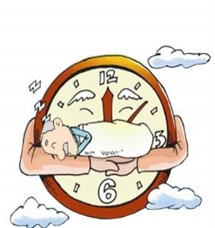
Exercise
A: Mike, _____do you go to bed?
B: I_______ to bed at_______.
A:_____you watch TV?
B: No, I___________.
A: What do you do?
B:I_____my sister with her homework.
A:What about your__________?
B:They read newspapers.
A:You ______all busy (忙碌的).
when
go
nine
Do
don't
help
parents
are

Slide 15
Exercise
a. Oh, that’s too bad!
b. Because My schoolbag is wet.(湿的)
c. Why are you sad?
d. What’s the matter?
e. My brother put the book in the water.
______________________________
c b e f a

Slide 16
Homework
Make up a conversation about locations.

