Slide 1
Unit 7 Know Our World
North America
WWW.PPT818.COM

Slide 2
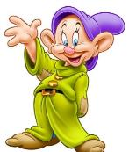
Learning aims:
1. Will/ Would/ Could you please…?
2. Learn about the rhythm of the foreign songs.
3. Know more about the world’s geography.
Learning important points:
1. Travel around the world.
2. How to look up words in a dictionary.
3. The way we travel around the world.

Slide 3
预习检测
用方框中所给词的适当形式填空。
small language common speak
1. Canada has the _________ population of the three countries.
2. In Canada people speak different ___________.
3. I’m the ______________ girl of our family.
4. The boy can _________ Spanish.
smallest
languages
most common
speak

Slide 4
Think About It
What do you know about North America?
What do you know about other places around the world?

Slide 5
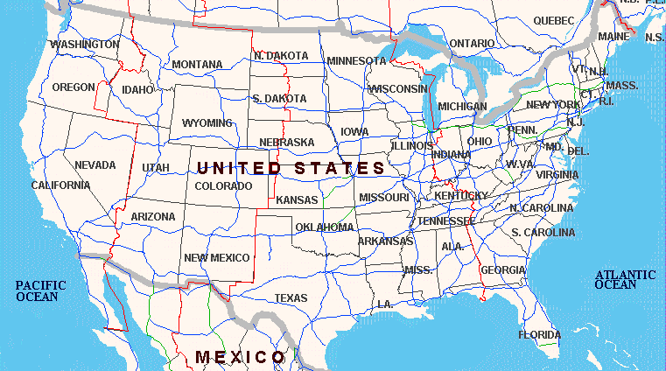
North America

Slide 6
Listen and answer the questions.
1. Which country has a large population, Canada or Mexico?
2. What’s the third most common language in Canada?
3. Which country has the largest population in North America?
Mexico.
China.
The U.S.

Slide 7
Match the statements with the countries according to the lesson.
Statements
Countries
People there mainly speak Spanish.
It’s the third largest country in area in
North America.
Canada
Over 2 million people speak Chinese there.
America
It’s the farthest north in North America.
It’s the largest country in population in
North America.
Mexico

Slide 8
Complete the passage with the correct forms of the words in the box.
large live square Spain speak common
There are three major countries in North America. They cover about 24 million ______ kilometres. Both in America and Canada, English is the ______________ language, while in Mexico, people speak mostly _______. In the U.S., over 2 million people ______ Chinese. The population of America is much________ than that of Canada. Some Mexican people leave their country to _____ and work in America.
square
most common
Spanish
speak
larger
live

Slide 9
Language points.
1. Canada is the biggest of the three countries in area.
in area 意为“在面积方面”，介词in表示“在……方面”。类似的用法有：in size 意为“在大小方面”；in shape 意为“在形状方面”。
Eg. Our town is five square kilometres in area.
我们城镇在面积上是五平方千米。

Slide 10
其次，area 意为“面积；地域”，常用the area of 表示“……的面积”，in the area of …意为“在……领域”。
Eg. What’s the area of your house?
你的房子面积是多大？

Slide 11
2. …the third most common language is Chinese.
“the +序数词+最高级+单数名词+范围”，表示“……是……的第几……”，注意形容词最高级前加基数词和序数词时意义不同。如：
the two largest islands of China 意为“中国最大的两个岛屿”；the second largest island of China 意为“中国的第二大岛屿”。

Slide 12
Exercise
根据句意及所给汉语提示，完成单词。
1. We will fly to the west _________ (海岸) of Africa.
2. The good basketball player comes from ________ (俄罗斯).
coast
Russia

Slide 13
II. 根据句意用方框中所给单词或短语的适当形式完成句子。
1. He needs _________ the word in the dictionary.
2. —Are you going with us?
—_________.
3. My sister likes singing English songs ______.
4. Have you ever _________ to Japan?
5. At last the bus _________.
a lot, start, sure, look up, travel
to look up
Sure
a lot
travelled
started

Slide 14
III. 补全对话。
A. Is it the world’s largest continent?
B. More than three billion people live in Asia.
C. Where are you going?
D. I’m looking for Asia.
E. What are you doing here?
F. They all speak Chinese.
G. How big is Asia?

Slide 15
W: Hello, Mr. Liu.
L: Hello, Wang Yifei. (1)_________
W: I’m looking at the map of the world.
L: The map of the world? What are you looking for?
W: (2)_________
L: I see. Have you found it?
W: Yes, I have. Look! Here it is. (3)_________
L: Let me see. The continent covers over 44 million square kilometres.
E
D
G

Slide 16
W: It’s so big. (4)_________
L: Yes, it is. There are more than 40 countries in Asia. And China is the biggest country in area and population.
W: Really? That’s great! I think the population
of Asia is large.
L: Yes. (5)_________
W: Thank you for telling me so much.
L: You’re welcome.
A
B

Slide 17
Homework
Write a report about the continent of the world.

Slide 18
Thank You

