Slide 1
Unit 1 Lesson3
I'd like some apple juice.
WWW.PPT818.COM

Slide 2
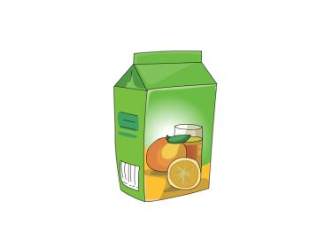
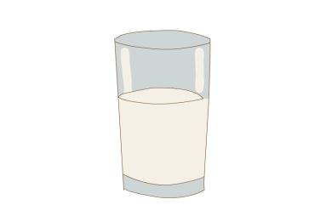

Slide 3
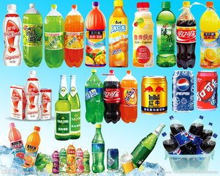
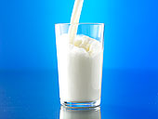
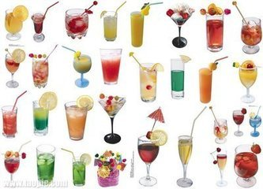
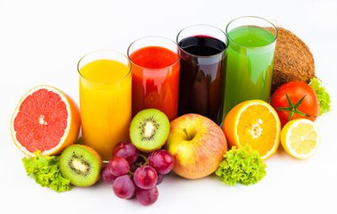
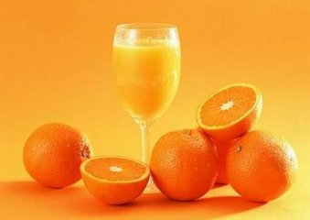

Slide 4
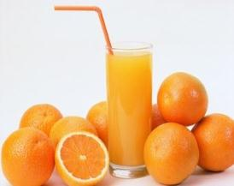
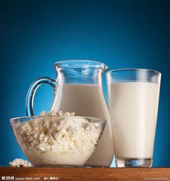
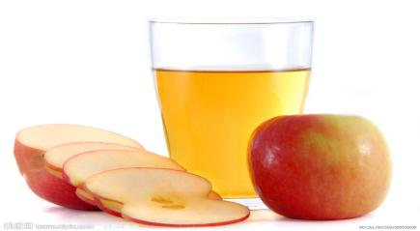

Slide 5
/
/
/
I'm hungry,mum.

Slide 6
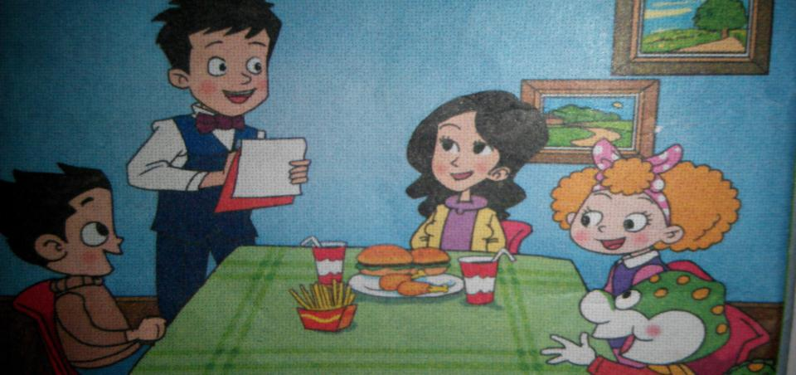

Slide 7
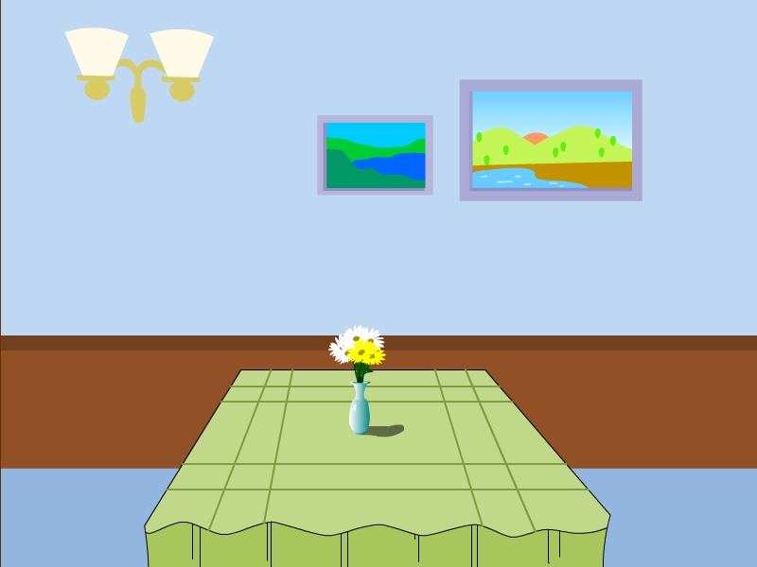

Slide 8
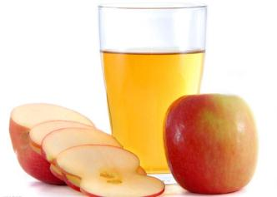
Coffee
_
apple juice
_
orange juice

Slide 9
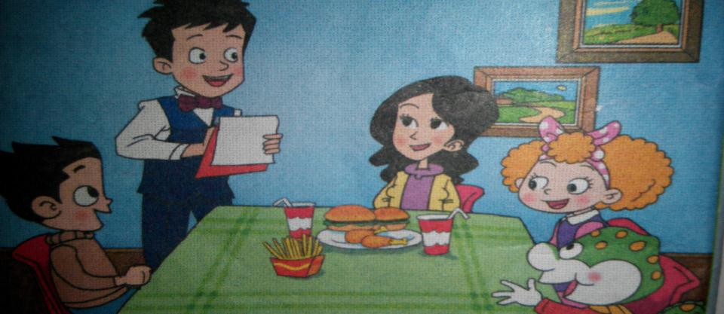
Listen and say .

Slide 10
Listen and say .

Slide 11
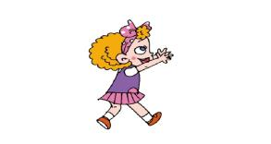
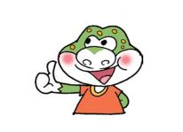
Would you like a drink?
_
_

Slide 12
Work in groups.
小组合作演练对话

Slide 13
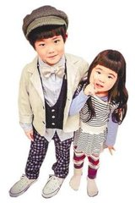

Slide 14
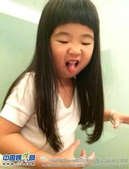
Would you like a drink?
I’d like some…….

Slide 15
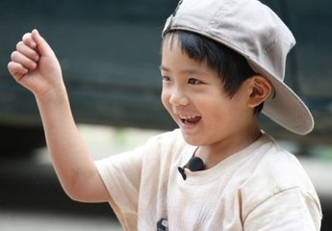

Slide 16
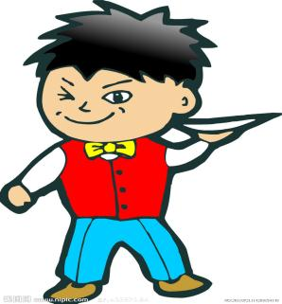
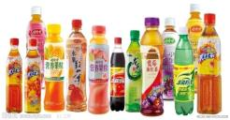
今天我是服务员
Yes....., please.
Would you like ....?

Slide 17
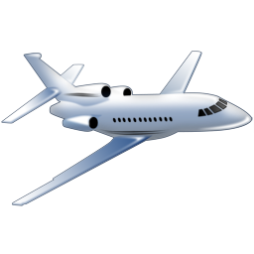
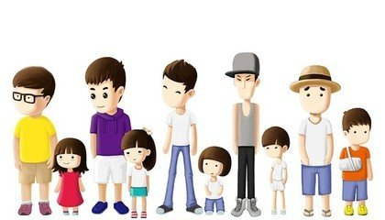

Slide 18
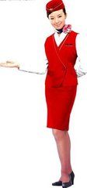
Would you like a drink?

Slide 19
Let'sing a chant
Would you like a drink?
Would you like a drink?
Yes.Coffee,please.
Yes.Coffee,please.
I'd like some apple juice.
I'd like some orange juice.
Thank you ! Thank you !

Slide 20
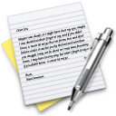
Homework
Introduce drinks that you like to your friends
(向朋友介绍你喜欢的食物）

