Slide 1
Unit3 Who’s That Man?
陕旅版六年级下册
第三课时
WWW.PPT818.COM

Slide 2
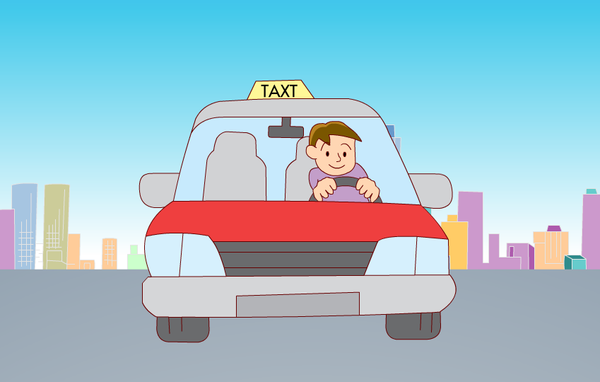
>>Warm-up
Sing a song

Slide 3
>>Lead-in
Free talk
My idol
-Who’s that woman?
-Who’s that man?
-She is Fan Bingbing.
-He is Zhou Jielun.
-What does she do?
-What does he do?
-She is an actor.
-He is a singer.

Slide 4
>>Presentation
Make sentences
-Who’s that woman?
Zhao Wei.
-She’s ...
-What does she do?
singer.
-She’s a ...
She is from …
But in the past 10
years, she is …
Anhui.
a actor.

Slide 5
>>Presentation
Look and say
introduces
a
b
c
d
Jackie Chan
Yao Ming
Yuan Longping
Han Hong
actor
basketball
player
scientist
singer
…
…
…
…

Slide 6
>>Presentation
Choose and talk
a: He is an actor. He is from Hong Kong.
He is in many films.
b: She is a Chinese singer.
She wears glasses and she is strong.
She sings well and she has written
Many nice songs.

Slide 7
>>Presentation
Choose and talk
c: He is a basketball player.
He is very tall.
He plays basketball very well.
Children like him very much.
d: He is a great scientist.
He looks a little thin.
He helps farmers plant much good rice.

Slide 8
>>Presentation
Choose and talk
A: He is an actor. He is from Hong Kong. He is in many films.
B: I think he is …
a
c
d
b
Jackie Chan
Yao Ming
Yuan Longping
Han Hong

Slide 9
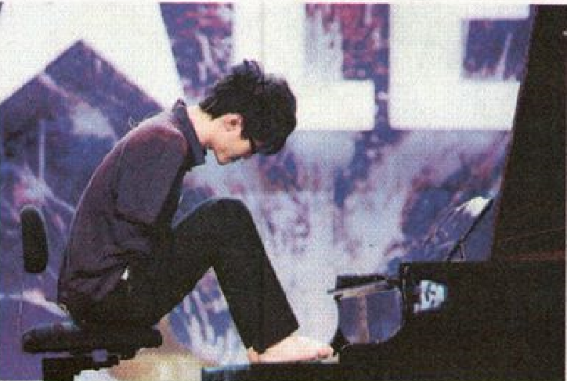
>>Presentation
Let’s learn more
Listen and answer
What did Liu Wei want to be?
He wanted to be a football player.
What happened to him at the age of nine?
He lost his arms.
What did he do in 2006?
He started to play the piano with his feet.
What do of think of him?
...

Slide 10
>>Presentation
Let’s learn more
Little Liu Wei wanted to be a football player.
But at the age of nine, he lost his arms.
He had to do everything with his feet.
He learned to swim and did it very well.
But at the age of nineteen, he had to stop because it was bad for him.

Slide 11
>>Presentation
Let’s learn more
In 2006, he started to play the piano with his feet.
How difficult it was!
But he made it.
He played seven or eight hours a day.
Now he plays it very well.

Slide 12
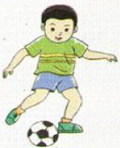
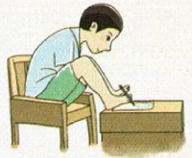
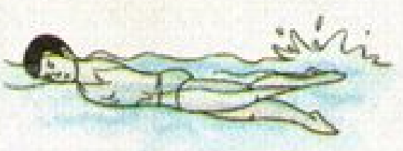
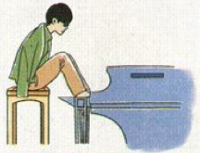
>>Practice
Let’s learn more
Read again and try to retell the story.
Little Liu Wei wanted to be a … At the age of nine, he … Then he had to … He … But at the age of nineteen, he had to … In 2006, he started to … with … He played … a day and now he plays it …

Slide 13
>>Practice
Show time
小组合作，模仿并复述课文录音，其他同学评价。
 | 模仿录音中的语音语调，有感情地朗读。
 | 可以脱离课本，适当改动其中部分，语音地道。
 | 适当添加内容，意思完整，有创新，表演生动。
good
great
Excellent

Slide 14
>>Summary
本课所学的重点内容：
… wanted to be a … At the age of nine, he … Then he had to … He … But at the age of nineteen, he had to … In …, he started to … with … He played … a day and now he plays it …

Slide 15
>>Homework
1.听课文录音并跟读，按照正确的语音、语调朗读并表演课文对话。 2.结合本课内容简短地仿写一篇英文人物传记。
3.预习B Read the words。
close

