Slide 1
Starter Module 1 My teacher and my friends
Unit 1
Good morning, Miss Zhou.
WWW.PPT818.COM

Slide 2
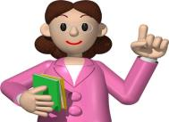
Hello, everyone.
My name is Miss Zhou.
I’m your English teacher.
I’m Chinese.
I’m from Wuhan.
What’s your name?

Slide 3
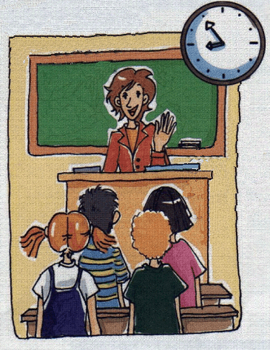
Listen and read
Hello, my name’s
Miss Zhou.
Good morning,
Miss Zhou.

Slide 4
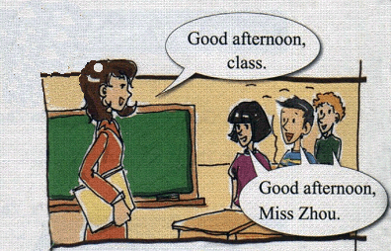
Good afternoon
class.
Good afternoon
Miss Zhou.

Slide 5
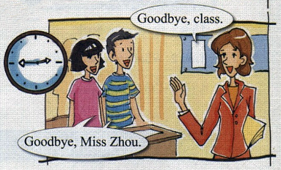
Goodbye, class.
Goodbye, Miss Zhou.

Slide 6
New words
hello int. 你好
class n. 同学；班级
name n. 名字
good adj. 好的
good morning 早上好
afternoon n. 下午
good afternoon 下午好

Slide 7
Match
1.Hello,my name’s Daming.
2.Good morning, Lingling.
3.Good afternoon, Carla.
4.Goodbye, Mike.
a) Goodbye, Tom
b) Hello, my name is Lingling.
c) Good morning, Carla.
d) Good afternoon, Mike

Slide 8
speak
Work in pairs.
Hello, my name is …
Good morning….

Slide 9
Good afternoon!
Afternoon!

Slide 10
Goodbye!
Goodbye!

Slide 11
Watch
观看字母歌视频，回唱的同学跟着一起唱。
字 母 歌

Slide 12
Write
a
c
D
E
f
A b C d e F g h I
j K l M N o P q R S
T u V W X Y z
B
G
H
i
J
k
p
Q
L
m
n
O
r
s
t
U
v
w
x
y
Z

Slide 13
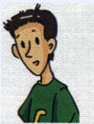
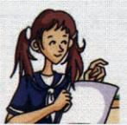
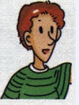
Listen
Name:
Tom
Carla
Mike

Slide 14
1. My name’s Tom, T-O-M ,Tom.
2. My name’s Carla, C-A-R-L-A , Carla.
3. My name’s Mike, M-I-K-E, Mike.

Slide 15
Practice
1. 早上老师走进教室，同学们应对老师说：
Good morning!
2.下午遇见，应该说：
Good afternoon!
3.晚上遇见，应该说：
Good evening!
4.当朋友向你问候：Hello!你应该回答：
Hello./Hi.
5. 你应该怎样问别人的姓名？
what’s your name?

Slide 16
1.-----Good morning, Lilei
Good morning
------ ______________ , Tom.
2. -----Hello.
Hello.
/ Hi
------ ________
3. ------Good evening .
Good evening
----- ____________
Good afternoon
4.------ ______________
---- Good afternoon

Slide 17
Homework
1. Learn the new words and expressions in this unit by heart.
2. Use polite expressions in English everyday.

