Slide 1
UNIT 2 Travelling Around
Section A Listening and Speaking
WWW.PPT818.COM

Slide 2
Tour Mayan Ruins
Take a step back in time and explore ancient Mayan ruins in Mexico,Guatemala,Honduras and Belize.

Slide 3
Mayapan Ruins
Also known as the Banner of the Mayas,Mayapan is thought of as the last great Maya capital.The Pre-Columbian Maya site is in south of the town of Telchaquillo,Yucatán,Mexico.More than 4000 structures,most residences^{①},are packed with the ancient city’s walls.Archeologists believe that Mayapan’s main temple is a smaller version^{②} of Chichen Itza’s Temple of Kukulkan.

Slide 4
Chichen Itza
Chichen Itza is one of the largest Maya cities,and it is one of the most visited archaeological sites in Mexico.More than 1 million tourists visit the Mayan ruins every year.The Temple of Kukulkan—also referred to as El Castillo—stands 98-feet tall with 9 square terraces^{③},and it’s a big draw for crowds during the spring and fall equinoxes (春分和秋分).As the sun sets,visitors crowd around the pyramid to see the shadows on the steps that look like a snake.

Slide 5
Lamanai Ruins
Belize’s Lamanai Mayan ruins are surrounded by the jungle’s thick vegetation^{④}.And in case you didn’t know,the word Lamanai comes from the Maya term “submerged crocodile” —a nod to the reptiles that live along the banks of the New River.

Slide 6
Uxmal,Pyramid of the Magician
Uxmal is the Maya word for “thrice-build”,which refers to the building of the Pyramid of the Magician.The Maya would often build a new temple over an existing one,and in this case,5 stages of building were found.At its height,Uxmal was home to about 25,000 Mayas.

Slide 7
Becan Mayan Pyramid
Head to the Campeche,Mexico,to see the Becan Mayan ruins.Visitors can explore 20 major ruins,including a number of temple pyramids in the jungle.Becan was a major city,occupied from 550 BC and abandoned^{⑤} around the 9th century AD.

Slide 8
词海拾贝
①residence n.住宅;住处;居住
②version n.版本;说法
③terrace n.平台;阳台;梯田
④vegetation n.植物;草木;(植物)生长
⑤abandon v.放弃;抛弃;放纵
典句欣赏
As the sun sets,visitors crowd around the pyramid to see the shadows on the steps that look like a snake.
译文:当太阳下山的时候,游客们拥挤在金字塔周围,观看台阶上的像蛇一样的影子。
分析:这是一个主从复合句。as引导时间状语从句,主句中that引导定语从句,修饰前面的shadows,在从句中做主语。

Slide 9
理解诱思
1.What is considered as the last Maya capital?
2.What does Lamanai mean in Mayan language?
答案:1.Mayapan. 2.The submerged crocodile.

Slide 10
Ⅰ
Ⅱ
Ⅰ.知识体系图解
castle
apply
visa
rent
pack
amazing
amazed
arrangement
extremely

Slide 11
Ⅰ
Ⅱ
申请
关注
和……分享
为……做准备

Slide 12
Ⅰ
Ⅱ
Ⅱ.听说导学
听教材P24的Listening part 1,填写表格信息。
France
two
passport
apply
flight
car

Slide 13
Ⅰ
Ⅱ
听教材P24的Listening part 2,填写表格信息。
Lijiang
sweaters
Town
guidebook

Slide 14
重点词汇
重点句式
随堂练习
1.pack vi.& vt.收拾(行李) vt.包装 n.(商品的)纸包;纸袋;大包
【课文原句】pack some clothes收拾一些衣服
【词汇精讲】本短语中的pack是动词,表示“收拾”。
This case is full.I can’t pack any more clothes in.
这箱子已装满,我塞不进更多的衣服。
She hurriedly packed a bag and bought a train ticket for home.
她匆忙收拾了一下包,买了张回家的火车票。

Slide 15
重点词汇
重点句式
随堂练习
【词汇拓展】
The crowds packed into the cinema on a wet day.
一大群人在雨天挤进了电影院。
Let’s pack up and get ready to start at once.
让我们收拾好行李,准备马上出发。

Slide 16
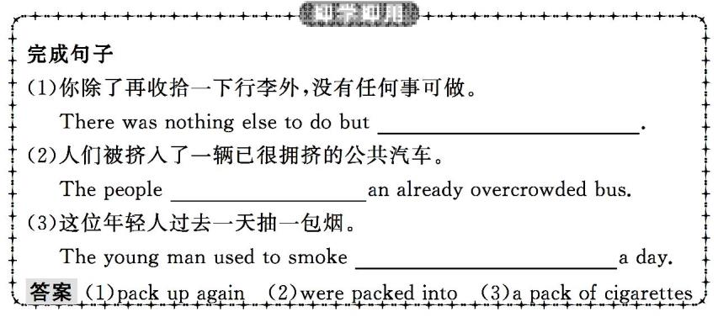
重点词汇
重点句式
随堂练习

Slide 17
重点词汇
重点句式
随堂练习
2.apply for 申请
【课文原句】I already have my passport,and I am applying for my visa tomorrow.我已经有了护照,并且明天我将申请我的签证。
【词汇精讲】apply for为固定词组,表示“申请”。表示 “向某人申请”,使用apply to sb for...
We’ve applied to the government for a home improvement project.
我们已经向市政府申请改善住房条件。
He wants to apply for the volunteer work.
他想申请这份志愿者工作。

Slide 18
重点词汇
重点句式
随堂练习
【词汇拓展】

Slide 19
重点词汇
重点句式
随堂练习
If you apply yourself to the job in hand,you’ll soon finish it.
如果你尽全力做你目前的工作,你将能很快做完。
What is most important is that we should apply theory to practice.
最重要的是我们应该将理论应用于实践。
As the wages were low,there were few applicants for the job.
因为工资低,没有什么人申请这份工作。

Slide 20
重点词汇
重点句式
随堂练习

Slide 21
重点词汇
重点句式
随堂练习
3.amazing adj.令人愉快的;令人惊喜的
【课文原句】Why famous:amazing waterfalls,colourful lakes,beautiful mountains为什么著名:令人惊奇的瀑布、多彩的湖泊、美丽的山峦
【词汇精讲】amazing是形容词,常表示主动关系或特性,一般用来说明事或物,意为“令人惊喜的”。修饰人时,表示人的心理状态,意为“感到惊奇的”。有时也可用amazed修饰表情和声音。
It was amazing that he knew nothing about the event.
他对这个事件毫不知情,真让人感到诧异。
People are amazed at the sight of Hong Kong-Zhuhai-Macao Bridge.
人们看到港珠澳大桥,无比惊讶。

Slide 22
重点词汇
重点句式
随堂练习
【词汇拓展】

Slide 23
重点词汇
重点句式
随堂练习
To his amazement,we were not amazed at/by his amazing achievements.
让他吃惊的是,我们没有对他令人吃惊的成就感到吃惊。
Tom was amazed by the girl’s calmness and quick mind.
汤姆惊讶于这个女孩的镇定和机智。

Slide 24
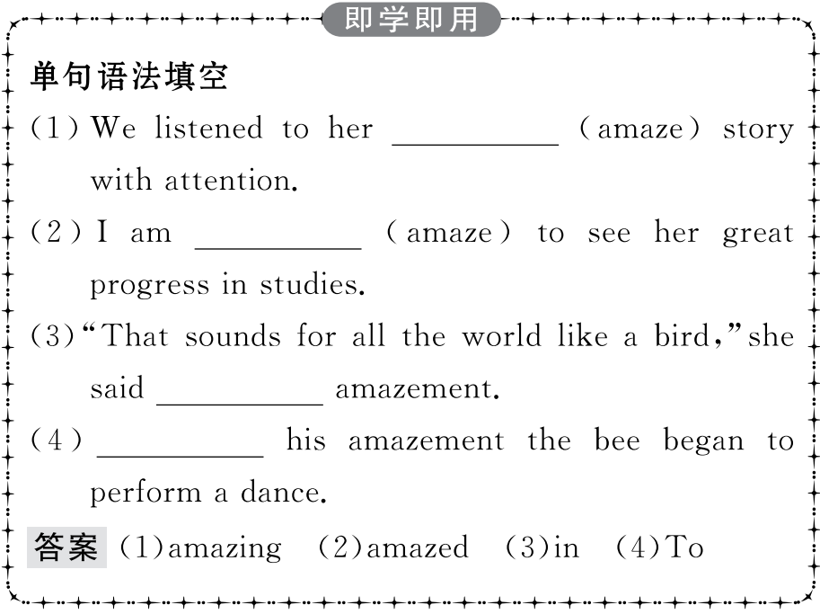
重点词汇
重点句式
随堂练习

Slide 25
重点词汇
重点句式
随堂练习
4.arrangement n.安排;筹备
【课文原句】Actually,I’ve just finished the travel arrangements!事实上,我刚刚完成了旅行安排!
【词汇精讲】arrangement为名词,表示“安排;筹备”。
This arrangement is agreeable to both sides.
这样安排对双方都合适。
We have made all the arrangements for the conference.
我们已做好会议的全部筹备工作。

Slide 26
重点词汇
重点句式
随堂练习
【词汇拓展】
arrange vt.筹备;安排;整理
Dave arranged for someone to drive him home.
戴夫安排人开车送他回家。
He told us that it was arranged that we had to have supper at the airport.
他告诉我们,根据安排我们必须在机场吃晚饭。
They are making arrangements for the important meeting.
他们正在为这次重要的会议做准备。

Slide 27
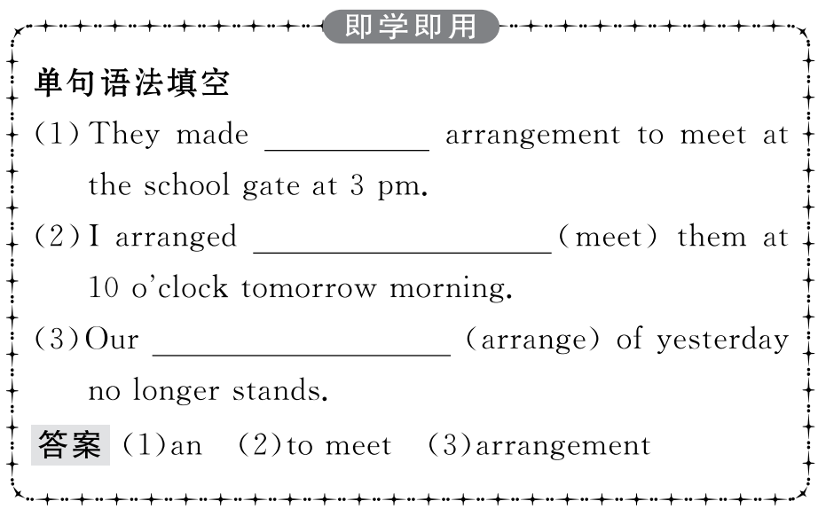
重点词汇
重点句式
随堂练习

Slide 28
重点词汇
重点句式
随堂练习
Once I get the visa,we’ll book flight tickets online.一旦我获得签证,我们将在网上预订机票。
【句式剖析】本句中once引导条件状语从句,主句用一般将来时,从句使用一般现在时表示将来的动作,即 “主将从现”。
Once you pass the exam,you’ll be able to relax.
一旦通过考试,你就可以放松一下了。
【句式拓展】
适用“主将从现”的情况:
(1)“主将从现”常用于时间状语从句、条件状语从句、让步状语从句等。
(2)祈使句+状语从句(一般现在时表将来)。

Slide 29
重点词汇
重点句式
随堂练习
(3)含有情态动词的现在式形式+状语从句(一般现在时表将来)
As soon as I get through with my work I’ll join you.
我工作一做完就来找你们。
If you train hard,you’ll make a good footballer.
你要刻苦训练,就能成为一名优秀的足球运动员。
He’ll definitely win,even if he falls over.
即使他跌倒了,他也必胜。
Put it in your diary before you forget.
用记事本记下,免得忘了。
How can you leave before the film is over?
电影还没散场,你怎么能离开呢?

Slide 30
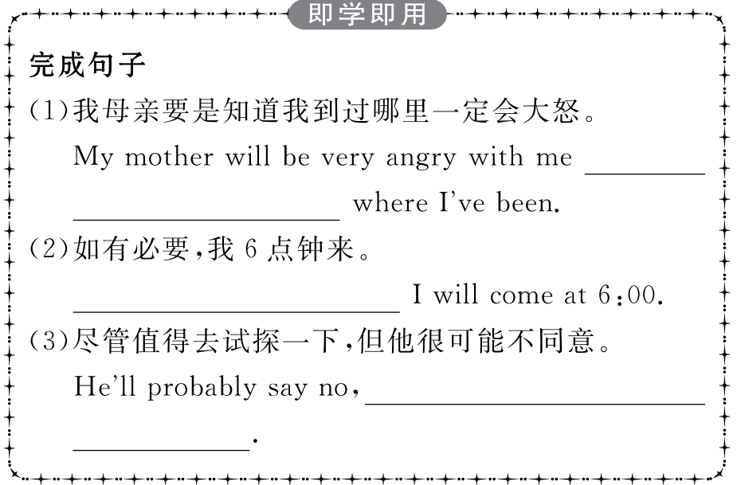
重点词汇
重点句式
随堂练习

Slide 31
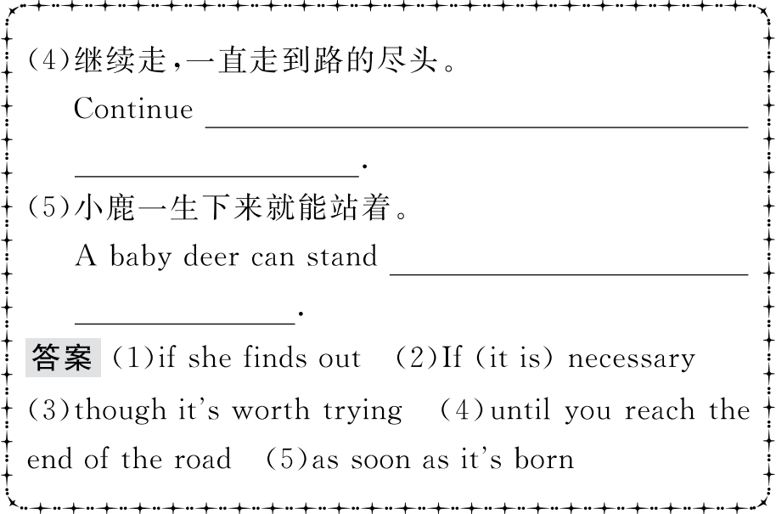
重点词汇
重点句式
随堂练习

Slide 32
重点词汇
重点句式
随堂练习
Ⅰ.单词拼写
1.The deadlines and what you need to (申请)depend on the programme.(2019·全国卷Ⅰ)
答案:apply
2.After (收拾) my suitcase,I as well as my classmates set off for our destination—a farm in the morning.(2019·北京卷)
答案:packing
3.One was that I was (惊奇的)at the fact that a sick person could feel much more better after seeing a doctor.(2019·全国卷Ⅱ)
答案:amazed
4.I keep practicing even when I’m (极其) tired.(2018·全国卷Ⅲ)
答案:extremely

Slide 33
重点词汇
重点句式
随堂练习
5.I’ll make an (安排) for you to be met at the airport.
答案:arrangement
6.I’d like to (租) a car for just one day.
答案:rent
7.I got a (签证) to visit Germany.
答案:visa
8.The prince lived in a large and beautiful (城堡).
答案:castle

Slide 34
重点词汇
重点句式
随堂练习
Ⅱ.用适当的介副词填空
1.I lost my card so I have to apply a new one.
答案:for
2.The visitors are amazed the waterfall.
答案:at
3.Listen key words and phrases while you are listening.
答案:for
4.He suddenly focused his attention the new hobby.
答案:on
5.Paul and his family are travelling Europe over the holiday.
答案:around

Slide 35
重点词汇
重点句式
随堂练习
6.Would you please make an arrangement us?
答案:for
7.The park is famous because of its model the castle in Disneyland.
答案:for
8.We all look forward the day when the scientists can discover more secrets of the universe.
答案:to

