Slide 1
Unit 8 Culture Shapes Us
Good Manners
WWW.PPT818.COM

Slide 2
学习目标
1. To review the usage of imperative sentence.
2. To learn about how to give suggestions about being a good host and a polite guest.
3. To realize the importance and necessity of good manners.

Slide 3
Look at this proverb:
Warming up
Manners make the man. 举止造就人。
Do you know its meaning?

Slide 4
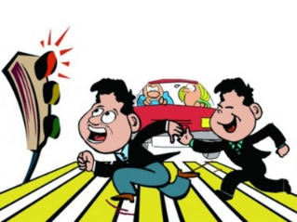
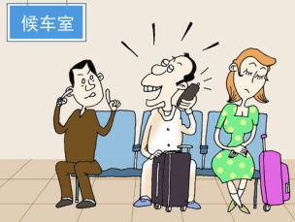
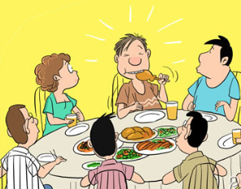
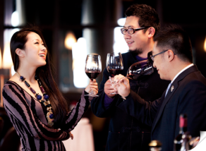
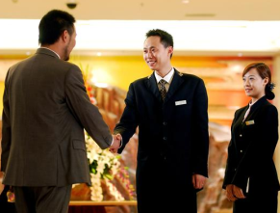
Is it good or bad?
Warming up

Slide 5
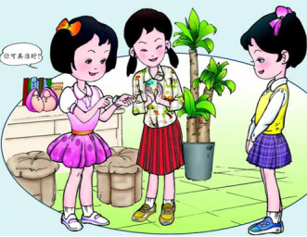
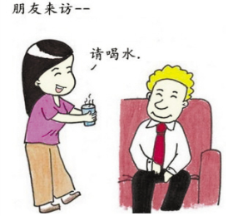
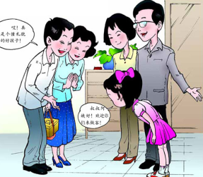
How do you usually treat a guest in your home? How are you treated when you visit your friend’s house?
Warming up

Slide 6
New words
tidy v. 使整洁；使整齐；整理
adj. 整洁的；整齐的
Russian adj. 俄罗斯的
n. 俄罗斯人；俄语
noisy adj. 喧闹的；吵闹的

Slide 7
(the left part: How to be a good host?)
Fast Reading
1.Read the tips from Mr. Manners.
2.Put all the tips in the right order in groups.
(Have a competition)

Slide 8
Read the left part and fill in the form.
Specific reading:
What should he do? | What shouldn’t he do?
1. 2. 3. 4. | 1. 2.

Slide 9
(the right part: How to be a polite guest?)
Fast Reading
Answer the following questions:
1. What gift can she bring?
2. What should she do after her visit?

Slide 10
Listen and fill in the blanks.
Listening
1. Bring a small gift, such as sweets or flowers.
2. ________ the rules of your host's home. Do what your host asks you to do.
3. Don't be _________, especially at bedtime.
4. Offer to help __________ the dinner.
5. Write a __________ note after your visit.
Follow
noisy
prepare
thank-you

Slide 11
Extensive thinking:
More advice for being a polite guest:
1. Make an appointment(预约) before you go.
2. Be on time and greet members in the order of age.
3. Ask if you should take shoes off before you walk into the house.

Slide 12
Discussion
Imagine that a Canadian friend comes to visit your house. What should you do to make him or her feel comfortable?
Make up a dialogue with your partner and act it out!

Slide 13
Group work
How polite are you?
Divide the students into six groups. Give the students six tasks and ask each group to choose a task. Then according to the task, the group members discuss it and give the advice, write down the advice and present it.

Slide 14
Exercise
用括号中所给词语的适当形式填空。
1. We should speak to the old people ________ (polite).
2. Li Hong likes playing ball games, ________ (especial) basketball.
3. Our classroom is bigger and brighter than ______ (they).
4. What a _________ (noise) street!
5. She is the girl _________ (mention) in my letter.
politely
especially
theirs
noisy
mentioned

Slide 15
Homework
1. Make a poster about good manners.
2. Preview next lesson.

