Slide 1
There are forty students in our class.
人教精通版四年级下册
WWW.PPT818.COM

Slide 2
Warm-up
Let’s sing
（单击图片可播放动画）

Slide 3
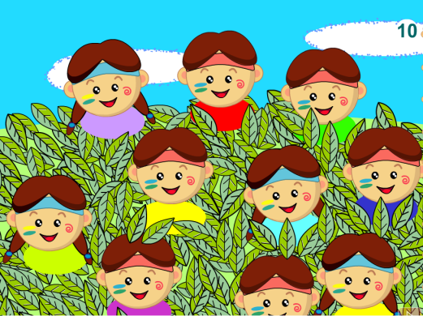
Lead-in
Count and say
How many children are there in the picture?

Slide 4
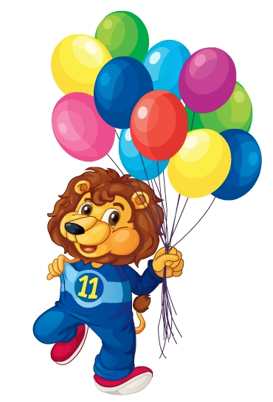
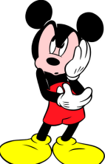
Lead-in
Look and say
How many balloons
are there?
eleven

Slide 5
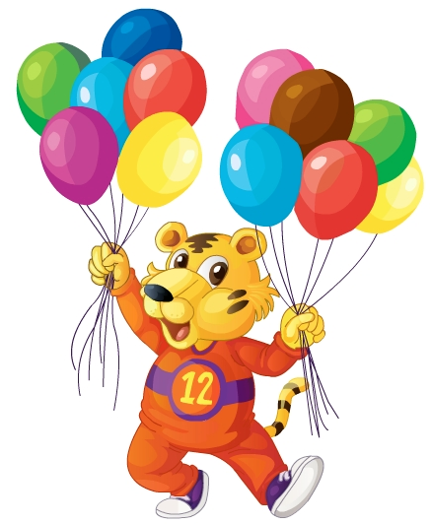
Lead-in
Look and say
How many balloons
are there?
twelve

Slide 6
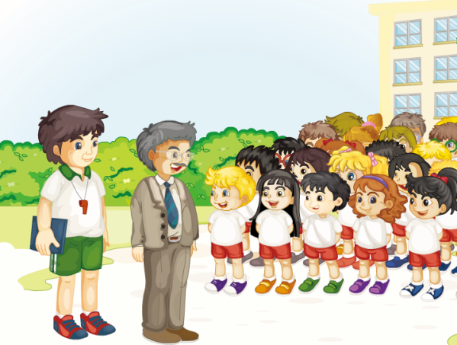
Presentation
Look and Think
Who are they? Where are they?
（单击图片可播放动画）

Slide 7
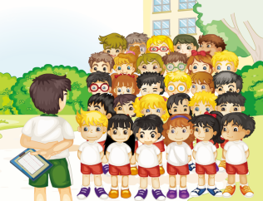
Presentation
Listen and say
What does Mr Gao teach?
He teaches PE.
How many students are there in their class?
Twenty-nine.

Slide 8
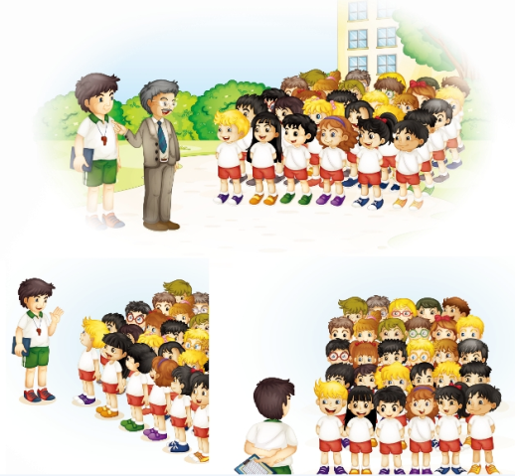
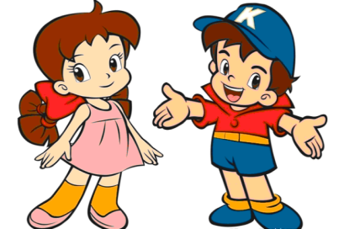
Practice
模仿Just talk语句，分组表演吧！

Slide 9
Practice
How many … are there in the picture?
…

Slide 10
Presentation
Let’s learn
21
22
23
twenty-one
twenty-two
twenty-three
24
25
twenty-four
twenty-five

Slide 11
Presentation
Let’s learn
26
27
twenty-six
twenty-seven
28
29
twenty-eight
twenty-nine

Slide 12
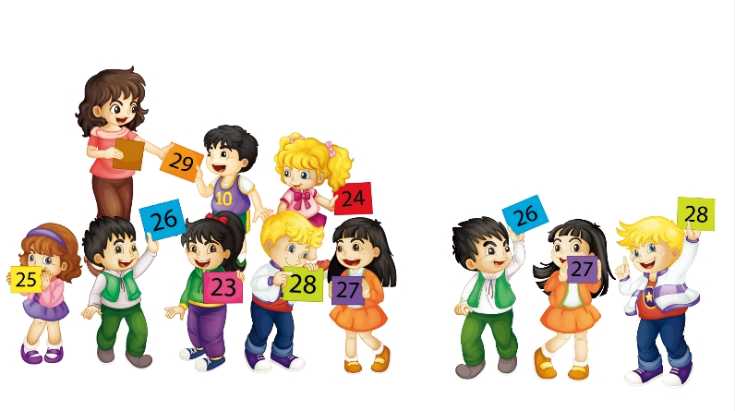
Practice
Let’s play
Find your neighbours.
Twenty-seven.
Twenty-six.
Twenty-eight.
We are neighbours.
We are neighbours.

Slide 13
Practice
活动
句子接龙

Slide 14
Summary
1. 本课学习的数字有哪些？
eleven
twelve
twenty-one …
2. 本课的重点句型是什么？
How many students are there in your class?
Twenty-nine.

Slide 15
Homework
跟读课文Just talk部分的录音，注意语音、语调。
模仿本课对话，编写一段新的对话（不少于4句）。
预习Lesson 8。
Close

