Slide 1
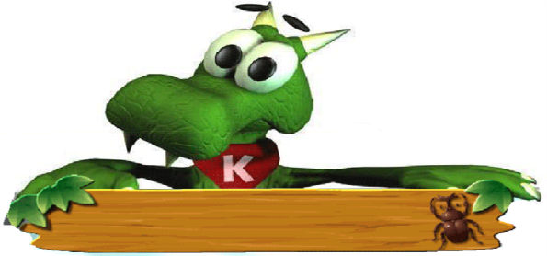
Lesson 33
2800 Years of Sports
WWW.PPT818.COM

Slide 2
Words & expressions
BC
athlete
compete
Olympia
married
公元前
n. 运动员
n. 竞争；比赛
奥林匹亚
adj. 结婚的；已婚的

Slide 3
Words & expressions
host
Olympic
amazed
spirit
represent
v. 主办；主持 n. 主人
adj. 奥林匹克运动会的
adj. 惊奇的；惊讶的
n. 精神；精灵
v. 代表；象征

Slide 4
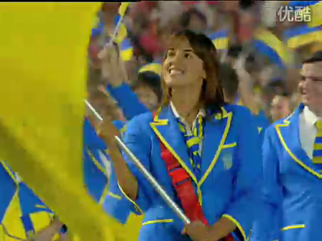
This is Olympic

Slide 5
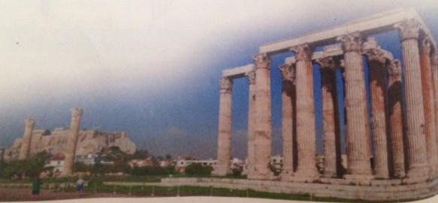
奥林匹克运动会（简称奥运会）是国际奥林匹克委员会主办的包含多种体育运动项目的国际性运动会，每四年举行一次。奥林匹克运动会最早起源于古希腊，因举办地在奥林匹亚而得名。奥林匹克运动会现在已经成为了和平与友谊的象征。

Slide 6
Think about it!
Have you ever watched the Olympics on TV? What did you watch?
Do you think the Olympics are important? Why or why not?

Slide 7
Objectives
To understand the conversation.
2. To learn some useful words and expressions about the history of the Olympics.

Slide 8
Words:
athlete compete married host Olympic amazed spirit represent
Expressions:
compete against take place
every four years be amazed at
Good point.

Slide 9
Read the lesson and match the questions with the answers.
In 1896.
In 2008.
Yes, it was.
In 776 BC.
In Greece.
When did the Olympics begin?
Where did the ancient Olympics start?
When did the first
modern Olympics begin?
4.When were the Beijing Olympics?
5.Was this the first time for China to hold the Olympic Games?

Slide 10
Listen to the passage and fill in the blanks.
new
The Olympic Games are ______and ____. The ancient Olympics started in _____BC and lasted for more than a thousand years. They took place every four years. _________could not compete in the ancient Olympics. In 1896, a ___________ started the modern Olympic Games. He believed the games would help bring __________and fair play to people all over the world. Now there are ________and _________Olympics every four years.
old
776
Woman
Frenchman
friendship
Summer
Winter

Slide 11
Language Points

Slide 12
1. Yesterday I asked you to do some
research on the history of the Olympics.
昨天，我让你们对奥运历史做一些研究。
do some research on 做一些关于...的研究
She suggested that college graduates do
some research on the salaries of people in
this industry.
她建议毕业生们做一些该行业工资情况的调查。
We are going to do some research on the
pollution of the Pearl River.
我们将做一些关于珠江污染的研究。

Slide 13
2. The ancient Greeks wanted to have the
best athletes compete against each other.
古希腊人想让最优秀的运动员进行比赛。
compete 动词，“竞争；对抗；比赛”。
compete for/to do sth. 为/做…….而竞争
Several companies are competing for /to
gain the contract.
几家公司正为一项合同而竞争。
compete against 和……竞争
I do not have you compete against your
classmates.
我不会让你们与同学竞争。

Slide 14
have the best athletes compete的语法结构为:
have sb. do sth. 让某人做某事
The teacher had all his students run fast.
老师让所有的学生加快速度跑步。
She had him wait at the gate for 10 minutes.
她让他在大门口等了10分钟。

Slide 15
3. They held the event every four years in
Olympia.
他们每四年在奥林匹亚举行一次运动会。
every four years=every fourth year 每四年
every与基数词、序数词、other或few连用，
表示时间或空间的间隔，意为“每……;每
隔…..”。
He comes here every three days (every third
day).
他每三天（每隔两天）来这儿一次。

Slide 16
4. Good point, Wang Mei. 说得好，王梅。
good point 说得好；好主意
Do you have some details? Normally careful
is a good point.
能不能说具体点呢？通常来说认真是优点。
That’s a very good point. Shall I answer you
first?
这是个很好的观点。我先回答你么？

Slide 17
5. Married women couldn’t even watch the
games!
已婚妇女甚至都不能观看这些比赛。
married为形容词，意思是“已婚的，有配偶
的”。
She is a married woman.
她是个已婚的女人。
She married for money.
她为金钱而结婚。

Slide 18
6. The ancient Greeks would be amazed at
how the Olympic Games have grown to
become a world event.
古希腊人会惊讶于奥林匹克运动会已经变
成了一项世界赛事。
be amazed at=be surprised at 惊讶于……
You will be amazed at the progress we have
made.
你将会对我们的进展感到惊讶。

Slide 19
amaze为动词，意思是“使……吃惊”。
What you told me just now amazed all of us.
刚才你说的事情让我们所有人都很震惊。
amazing为形容词，意思是“令人震惊的”。
That news is amazing.
这个消息令人震惊。
That is an amazing result.
那是一个令人震惊的结果。

Slide 20
7. They also represent their countries at the
highest level.
他们也代表着国家的最高水平。
represent意思是“代表；象征”，既可以表
达象征含义，也可以表示“代表……(某
人、某个团体……)”。
The dove represents peace.
鸽子象征和平。
represent的名词形式为representative。
There are three representatives in our school
我们学校有3名代表。

Slide 21
Time for Reflection
compete against
take place
every four years
be amazed at
Good point.
do some research on
和…..竞争
发生
每四年
对……感到惊奇
好主意；说得好
做一些关于…的研究

Slide 22
Fill in the blanks with the correct forms of the words. The first letter is given.
Although Guo Wenjun was m________ and had a baby, she still practiced hard for the Olympics and finally won a gold medal.
Xu Haifeng won the first Olympic gold medal at the Los Angeles Olympics in 1984. Since then, Chinese a________ have achieved excellent performances throughout the world.
arried
thletes

Slide 23
3. London is an old but m________ city. It was the h_____ of the 30th Olympic Games. Over two hundred countries and districts c__________ in the games.
odern
ost
ompeted

Slide 24
Fill in the blanks with correct words.
research
Do some ________ (研究) on what is more or less healthy.
But the Olympics is the goal of every ________ (运动员).
Many businesses ________ ________ (与……竞争) each other for profits.
Tonight she ______ (举办) a ball for 300 guests.
athlete
compete against
hosts

Slide 25
5. When you _____ _____ ____ (参加) any performance, you get out as much as you put in.
6. The meeting will______ _____(举行) later this afternoon.
7. When you respect yourself, you‘ll be ________ (感到惊奇的) at the opportunities the world presents you.
8. It can ___________ (代表) all the China.
take part in
take place
amazed
represent

Slide 26
Homework
The Best Olympic Sport: Choose one Olympic sport, do some research on it and write a report.

Slide 27
Preview
Learn the words and expressions in Lesson 34.
2. Underline the sentences you don’t understand on page 88.

