Slide 1
七年级上册
Unit 2 This is my sister
Section B (第2课时)
WWW.PPT818.COM

Slide 2
学习目标
1.复习掌握本单元表家庭成员的单词以及几个短语。
2.熟练运用本单元句型:
3.运用所学句型写文章
4.正确运用am, is, are及名词的复数

Slide 3
知识回顾
is
&
are
This ___ my sister.
That ____ his brother.
She _____ his aunt.
He _____ my uncle .
These _____ her parents.
Those ____ her friends.
They _____ my family.
is
is
is
is
are
are
are

Slide 4
知识回顾
Family Tree
grandfather/grandpa
grandmother /grandma
father/dad
mother/mom
uncle
aunt
son
daughter
cousins
brother
I
sister

Slide 5
自主反馈
按要求写出下列单词或句子。
1.grandfather (口语) _______
2. father (口语) ____
3. grandmother (口语) _______
4. mother (口语) ____
5. friend (复数) _______
6. aunt (对应词) ___________
grandpa
dad
grandma
mom
friends
uncle

Slide 6
自主反馈
photo
7. picture (同义词) ______
8. son (对应词) _______
9. 这就是……。_____________________
10. 我的两张家庭照片 ____________________
11. 在第一/下张照片中 __________________
12. 狗的名字 ____________________
daughter
Here is/are…
two photos of my family
in the first /next photo
the name of the dog

Slide 7
新课学习
3a. Complete the passage with the words in the box.
Let’s check the answers.
family
parents
Hi. My name is Paul. This is a photo of my ______. These are my ______ and these are my _______, John and Bob. This is my sister _____.
brothers
Cindy

Slide 8
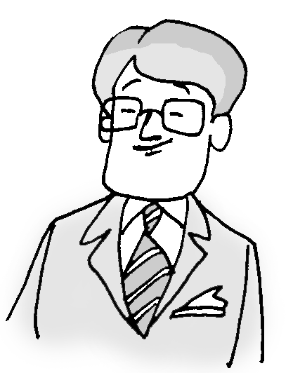
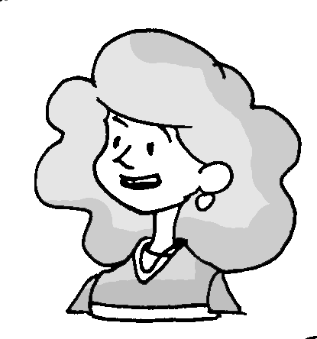
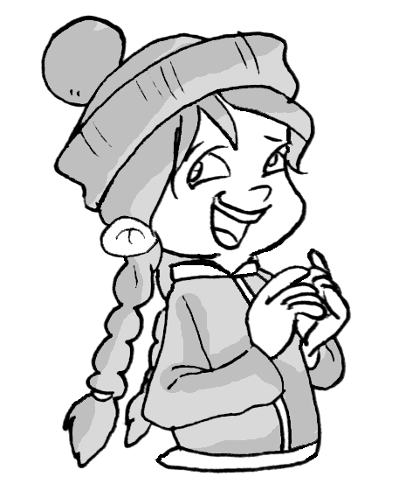
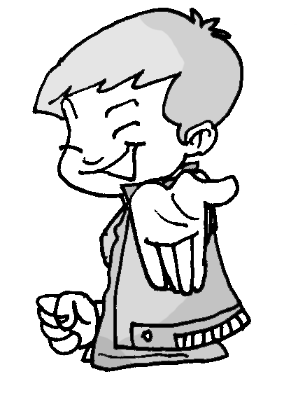
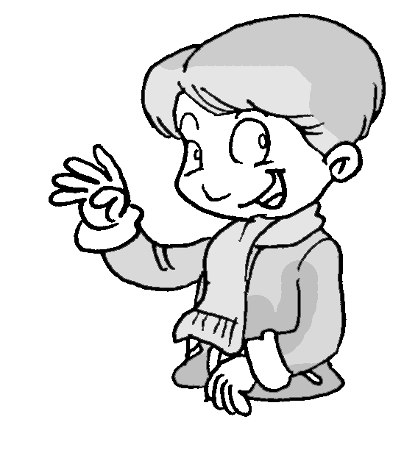
新课学习
Then draw a picture of Paul’s family.

Slide 9
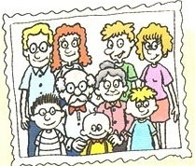
新课学习
3b. Bring a family photo to class and write about it. Then tell a classmate about your family.
Hi. I’m _________. Here is a photo of my
family. These are _________
___________________
___________________
___________________

Slide 10
新课学习
【指导】
1. 作文的前两句话已给出，第一空格处应填好自己的名字。
2. 然后，将照片上的家人的姓名或与自己的关系向大家作介绍。同学们可以按辈份或年龄的大小有顺序地依次进行介绍。
3. 注意运用正确的句型，在介绍父母或祖父母等多个人时，可用These/Those are…句型；在介绍单个的人时，应用This/That is…句型。

Slide 11
新课学习
Here’s an example:
Jack
Hi. I’m _____. Here is a photo of my family.
These are ____________ __________________ __________________ __________________
__________________
__________________
grandparents
Those are my parents.
Those are my aunt and
uncle. This is my brother
Bob. That is my cousin
Dale.

Slide 12
Self Check
1. Group the words for family members you have learned.
Male
Both
Female
father/dad
mother/mom
parents
grandfather/
grandpa
grandmother/grandma
grandparents
son
brother
cousin
daughter
sister
uncle
aunt

Slide 13
Self Check
2. Complete the conversation.
Bill: Here’s a photo of my family.
Dale: ________ he?
Bill: ____ my uncle.
Dale: _____ this girl?
Bill: _____ my cousin.
Dale: Are ___ your parents?
Bill: Yes, ___ are. And these ___ my grandparents.
Who’s
He’s
Who’s
She’s
they
they
are

Slide 14
Self Check
写出下列单词的复数形式
1. parent ________ 2. sister ________
3. brother _______ 4. girl ________
5. boy ________ 6. photo ________
7. family _______ 8. bus _________
9. watch ________ 10. girl _________
11. cousin _______ 12. dog _________
parents
sisters
brothers
girls
boys
photos
families
buses
watches
girls
cousins
dogs

Slide 15
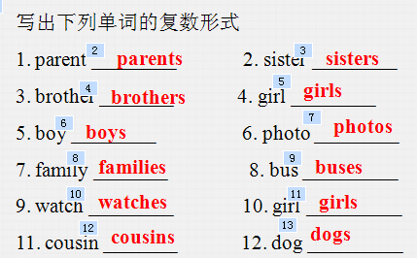
分组活动
总结归纳
1 组
2 组
3 组
4 组
总结归纳可数名词变复数的规则

Slide 16
Grammar
可数名词的复数形式。
a. 可以直接以数字计算的名词称为可数名词，可数名词有单数和复数两种形式。
b. 对可数名词来说，当表示一个人或事物时用单数形式；表示两个或两个以上的人或事物时则用复数形式。
c. 单数名数名词变为复数名词有以下规则：

Slide 17
Grammar
1、一般情况下在名词后面加-s。
pencil→pencils, sister→sisters,
2、以辅音字母加y结尾的名词，先将y改为i，再加-es。
family → families
3、以s, x, ch, sh结尾的名词后加-es.
watch→watches, box→boxes(盒子)

Slide 18
Grammar
4、以f或fe结尾的名词，先将f或fe改为v，再加-es
knife→knives(小刀)
5、以o结尾的名词，有的加-es，有的直接加-s。
tomato→tomatoes (西红柿)
photo→photos
6、特殊情况，无规则可循。 man→men (男人)

Slide 19
分组活动
Ask and answer
1 组
2 组
3 组
4 组
总结本课自己的收获，小组内交流。

Slide 20
新课总结
two nice photos of my family
两张我家人的漂亮照片
in the first photo
在第一张照片中
in the next picture
在下一张照片中
in my family
在我家
the name of my dog
我的狗的名字

