Slide 1
初中英语冀教版七年级
Unit 8 Countries around the World
Lesson 48: English-Speaking Countries
WWW.PPT818.COM

Slide 2
Review
I want to travel around China, Canada, the U.S. , the U.K. and Australia.
Can you introduce these countries to me?

Slide 3
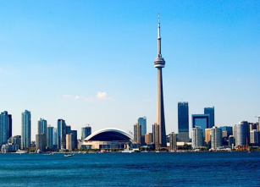
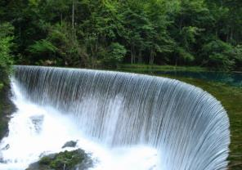
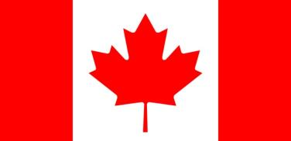
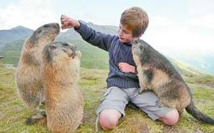
Canada

Slide 4
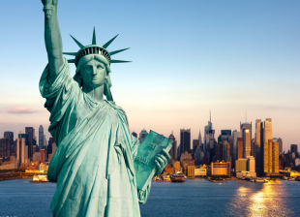
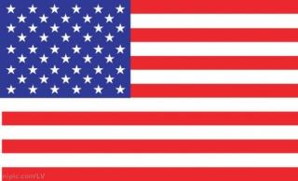
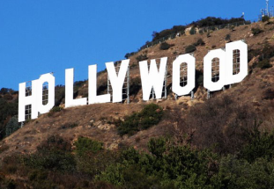
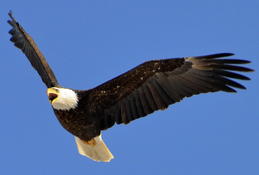
the U.S.

Slide 5
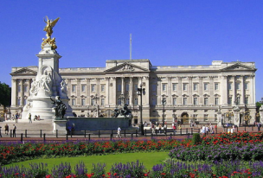
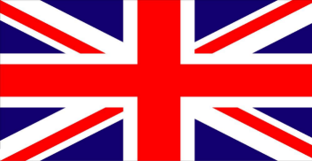
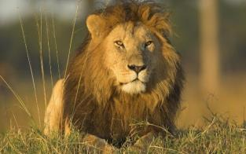
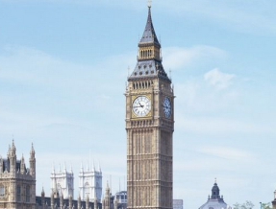
the U.K.

Slide 6
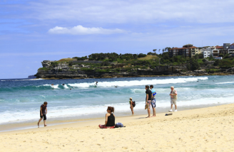
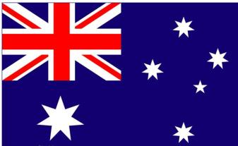
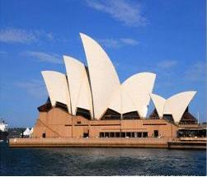
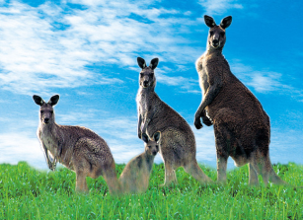
Australia

Slide 7
Presentation
English-Speaking Countries AROUND THE WORLD
People speak English as their ____ language in many countries. These English-Speaking countries are all the world. Some of these countries are _____ of China. Some of west of China. Some are east of China.
first
south

Slide 8
Here is a list of eight of these countries.
Australia Canada
India New Zealand
Singapore South Africa
the U.K. the U.S.

Slide 9
Listen and write true or false.
People speak English as their first language in eight countries. ( )
English-speaking countries are all over the world. ( )
Some English-speaking countries are north of China. ( )
Australia is an English-speaking country. ( )
T
T
F
T

Slide 10
Write the correct countries in the blanks.
It is south of China. People there speak Chinese and English. S_________
It has many beautiful beaches. Kangaroos are from this country. A_________
It is southeast of Australia. People there speak English. N__________
It is north of the U.S. and its capital is Ottawa.
C___________
ingapore
ustralia
ew Zealand
anada

Slide 11
Language points
1. People speak English as their first language in many countries. 在许多国家人们把英语作为他们的第一语言。
as在此处用作介词，意为“作为，当做”。
例：
She works as a teacher.
We speak Chinese as our first language .

Slide 12
2. Here is a list of eight of these countries.
这是这些国家中的八个国家的列表。
a list of … “ 一张……的列表/清单”。
例：
Please make a list of food.

Slide 13
Complete the table.
Country | Language | Capital city | National flag | National Symbol
China
The U.S
The U.K
Australia
Beijing
It’s red. It has five yellow stars
The Great Wall
Chinese
Canada
English and French
Ottawa
It is red and white.
It has a red leaf
Niagara Falls
English
Washington, D.C.
It is red and blue.
It has stars and stripes.
Statue of Liberty
English
London
It is red and blue.
Big Ben
English
Canberra
It is red and blue.
The Sydney Opera House

Slide 14
Homework
What other English-speaking countries do you know ?

