Slide 1
精通版·六年级上册
Unit 6 There are four seasons in a year.
WWW.PPT818.COM

Slide 2
Fun story

Slide 3
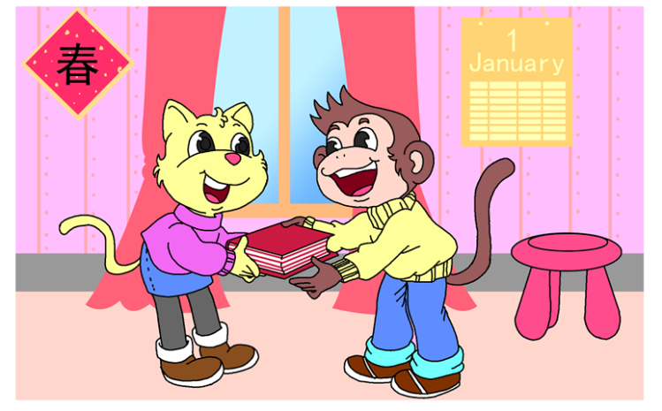
It is January 1st. Spring is coming. There is still snow on the windows. Mimi gives Micky a nice book as a New Year’s gift.

Slide 4
（今天）是1月1日。春天要到了。窗户上还有雪。咪咪给了米基一本好书作为新年礼物。

Slide 5
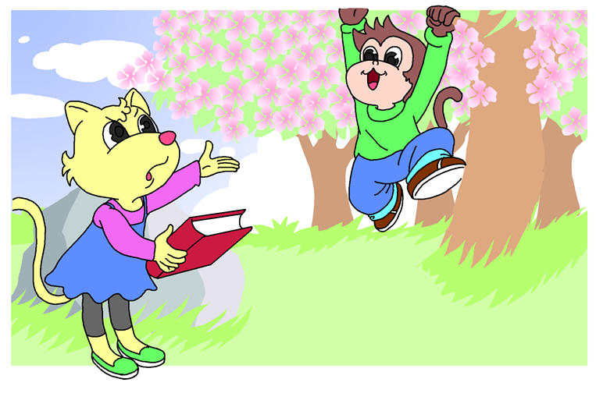
I will read it
tomorrow.
You aren’t reading the book. When do you want to read it?
It is March 1st. It is spring. Micky is climbing a tree. He is having fun.

Slide 6
我明天会看。
你没有在看书。你想要什么时候看它呢？
（今天）是3月1日。现在是春天。米基在爬树。他很开心。

Slide 7
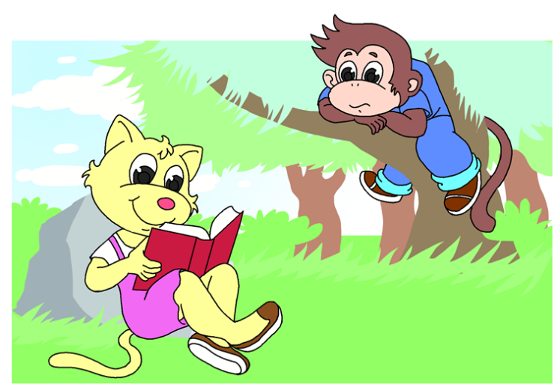
Mimi is reading. But I will read it
tomorrow.
It is June. It is already summer. The peach tree has a lot of fruit. Micky is picking peaches. He isn’t reading the book.

Slide 8
咪咪在看书。但是我会在明天看书。
六月了。已经是夏天了。桃树结了许多果实。米基在摘桃子。他没有在看书。

Slide 9
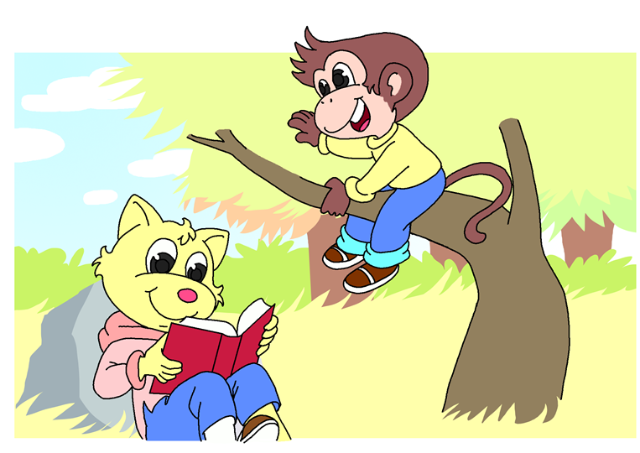
It is October. Autumn is here. The leaves are red, yellow and brown. Micky is looking for a bird. He isn’t reading the book.

Slide 10
十月了。秋天到了。树叶是红色、黄色和棕色的。米基在寻找鸟。他没有在看书。

Slide 11
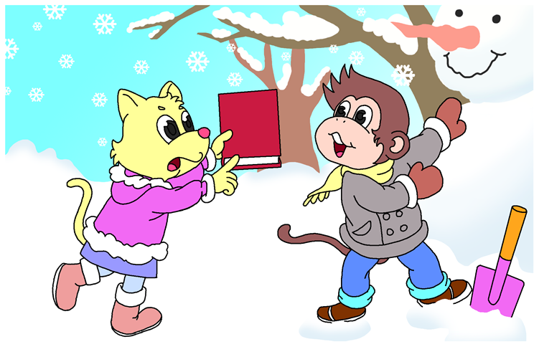
You didn’t do any reading the whole year!
It is December 31st. It is the last day of the last month of the year. It is snowing. It is winter time. Micky is still playing.

Slide 12
一整年你都没有看书！
（今天）是12月31日了。它是一年里最后一个月的最后一天。正在下雪。是冬天了。米基还在玩。

Slide 13
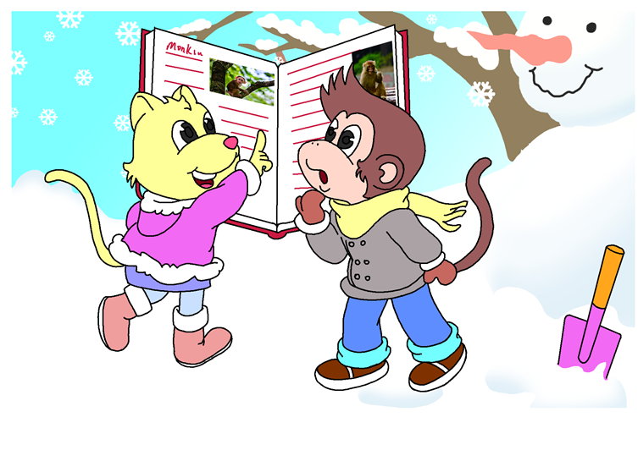
It’s about you.
What is the book about?
What is the book about? What is Micky thinking of? Tell your friend.

Slide 14
它是关于你的。
这本书是关于什么的？
这本书是关于什么的？米基在想什么？告诉你的朋友。

Slide 15
Let’s listen and number
4
3
7

Slide 16
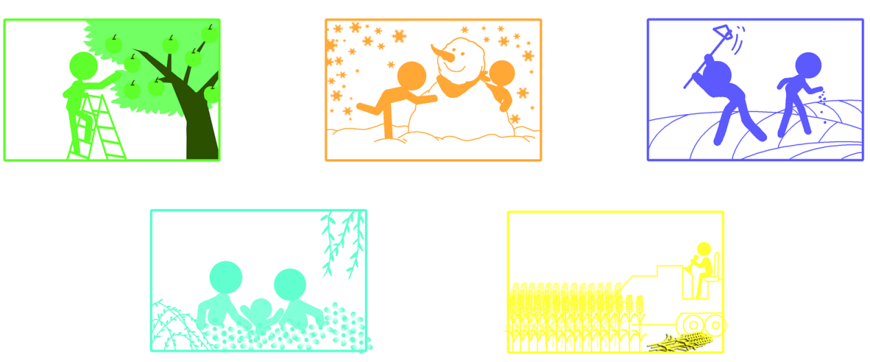
8
2
6
1
5

Slide 17
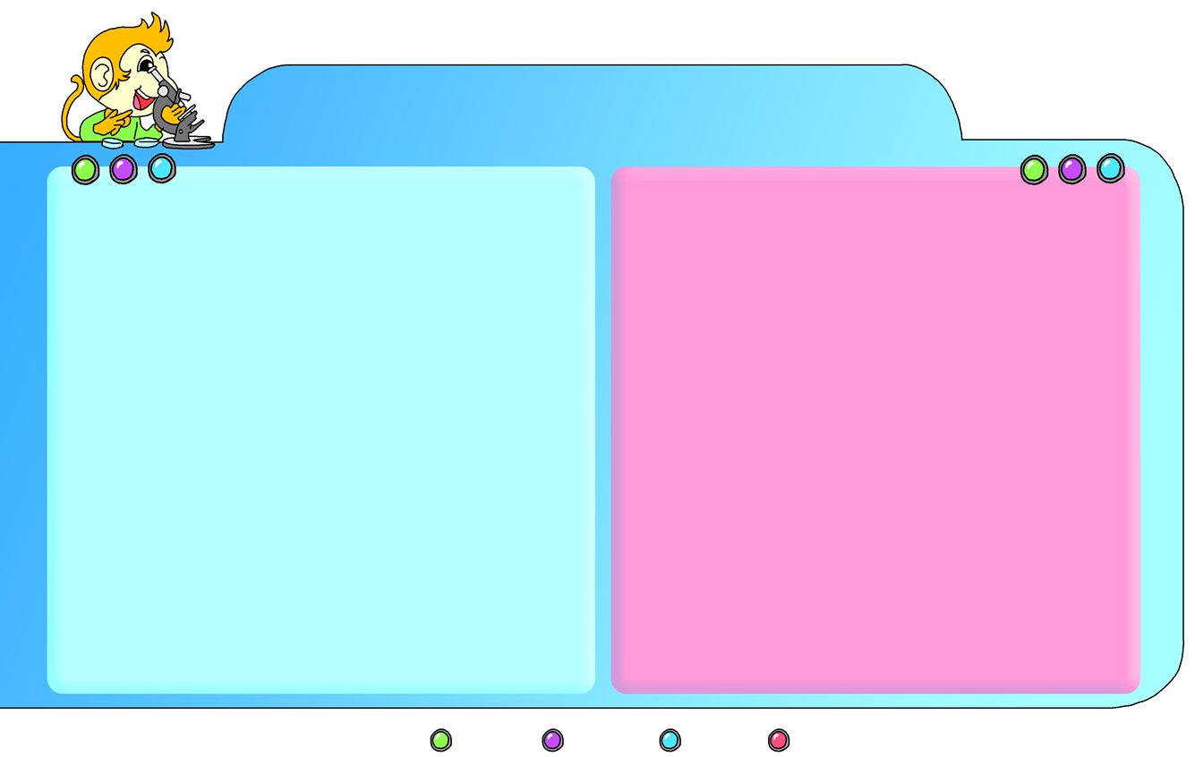
Language focus
What’s spring like?
What do people do in spring?
Trees have new green leaves.
There are a lot of flowers on the peach trees.
Birds sing to welcome the spring.
What do students do on summer holidays?
What do people do in autumn and winter?
Spring is the first season.
Summer is the second season.
Autumn is the third season.
Winter is the fourth season.
SKILLS
Listen
Speak
Read
Write

Slide 18
Language focus
farm the land
go on spring outings
fly kites go on a trip
go to a summer camp
have summer holidays
pick apples cut rice
make a snowman
sweep the snow
season spring little
green bird fly
begin close summer
weather heavy rain
autumn yellow brown
white winter snowman
SKILLS
Listen
Speak
Read
Write

Slide 19
Fun Facts
Reading for knowledge
Do you know what children do at Easter?
Easter is a festival in Western countries. Children often play a game called the Easter egg-hunt. It is an old English game. The children take little baskets to a field. They look for Easter eggs in the grass.

Slide 20
你知道孩子们在复活节做什么吗？
复活节是西方国家的一个节日。孩子们经常玩一个叫寻找复活节彩蛋的游戏。它是一个很老的英国游戏。孩子们带着小篮子来到田地里。他们在草里寻找复活节彩蛋。

Slide 21
They try to fill their baskets with eggs. Most English and American children like to play this game. They all love to eat the real eggs and the chocolate eggs.
Easter is in spring. It celebrates the start of new life. An egg is the best way to show this.

Slide 22
他们尽量把他们的篮子用蛋填满。大多数英国和美国的孩子喜欢玩这个游戏。他们都喜欢吃真正的蛋和巧克力蛋。
复活节在春天。它是为了庆祝新生命的开始。彩蛋是表达这一庆祝的最佳方式。

Slide 23
Paul is a little boy in England. Paul’s mother makes Easter eggs for an egg-hunt. It is the day before Easter. She cooks some eggs. Then she colours them. There are red, green, yellow and blue eggs. Paul’s mother also buys some chocolate eggs in the supermarket. They are colourful. Paul loves the chocolate eggs.

Slide 24
保罗是英国的一个小男孩。保罗的妈妈为寻找彩蛋游戏做复活节彩蛋。这是复活节的前一天。她做了很多蛋。然后她给它们涂上颜色。有红色、绿色、黄色和蓝色的蛋。保罗的妈妈也在超市里买了一些巧克力蛋。它们五颜六色的。保罗喜爱这些巧克力蛋。

Slide 25
Thinking tasks
1. In what season is Easter?
2. What game do American children play at Easter?
3. How do people make Easter eggs?
Easter is in spring.
Children often play a game called the Easter egg-hunt.
First they cook some eggs. Then they colour them.

Slide 26
4. What do you do in spring? Tick your springtime activities.
a Celebrate Spring Festival.
b Look at beautiful flowers.
c Play in the park.
d Fly kites.
e Go to the zoo.

Slide 27
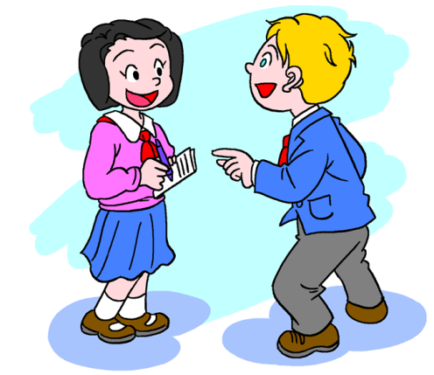
Play roles
I play in the park and fly kites.
What do you do in spring?

Slide 28
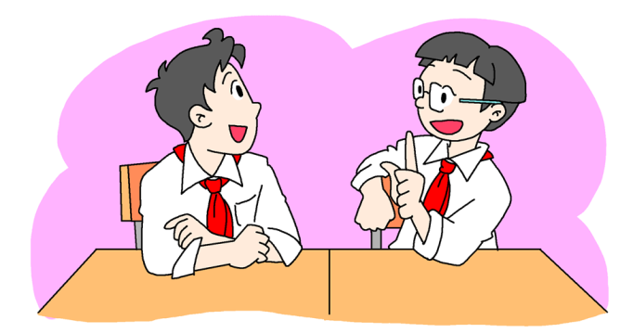
I go to the zoo.
What do you do in spring?

Slide 29
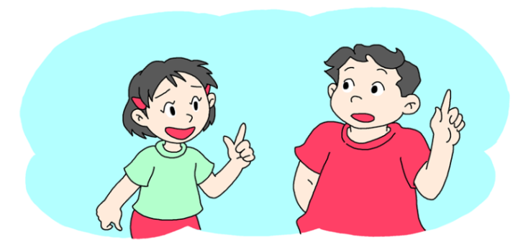
I celebrate Spring Festival.
What do you do in spring?

