Slide 1
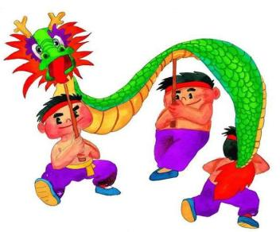
My mother is cleaning our house and sweeping away bad luck.
Module10 Unit 2
WWW.PPT818.COM
Notes:
1

Slide 2
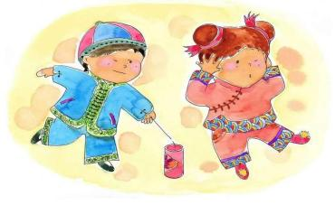
Learning aims
1. 扎实掌握本单元的词汇，能读懂有关春节庆祝活动的短文。
2. 能用现在进行时询问和表达正在发生的事情，尤其节日庆祝活动。
3. 乐于了解其他国家的重大节日，乐于参与相关的实践活动。

Slide 3
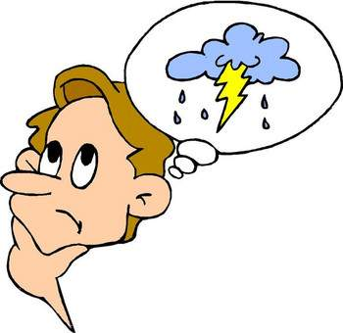
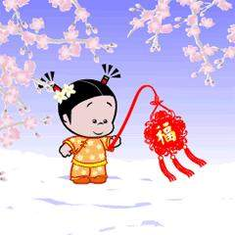
Take a guess!

Slide 4
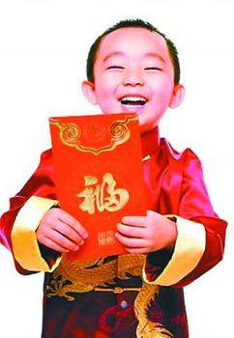
lucky money

Slide 5
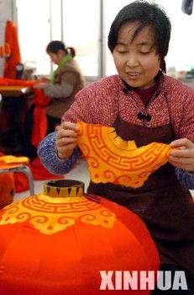
make big red lanterns
PPT模板：www.1ppt.com/moban/ PPT素材：www.1ppt.com/sucai/
PPT背景：www.1ppt.com/beijing/ PPT图表：www.1ppt.com/tubiao/
PPT下载：www.1ppt.com/xiazai/ PPT教程： www.1ppt.com/powerpoint/
资料下载：www.1ppt.com/ziliao/ 范文下载：www.1ppt.com/fanwen/
试卷下载：www.1ppt.com/shiti/ 教案下载：www.1ppt.com/jiaoan/
PPT论坛：www.1ppt.cn PPT课件：www.1ppt.com/kejian/
语文课件：www.1ppt.com/kejian/yuwen/ 数学课件：www.1ppt.com/kejian/shuxue/
英语课件：www.1ppt.com/kejian/yingyu/ 美术课件：www.1ppt.com/kejian/meishu/
科学课件：www.1ppt.com/kejian/kexue/ 物理课件：www.1ppt.com/kejian/wuli/
化学课件：www.1ppt.com/kejian/huaxue/ 生物课件：www.1ppt.com/kejian/shengwu/
地理课件：www.1ppt.com/kejian/dili/ 历史课件：www.1ppt.com/kejian/lishi/

Slide 6
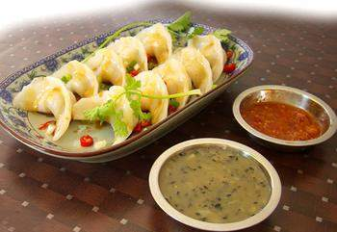
jiaozi

Slide 7

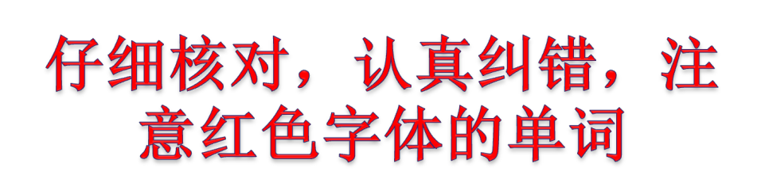
on the same day have a look
a few days before Spring Festival
sweep away bad luck the evening before Spring Festival a kind of
watch a special TV programme
visit uncles and aunts lucky money celebrate Spring Festival with a traditional family dinner on the evening before Spring Festival

Slide 8
比比谁记得好
B
一种...
观看一个特别的电视节目
给伯父伯母们拜年
压岁钱
A
在同一天
看一看
春节前
扫除坏运气

Slide 9

Reading
阅读小技巧：
1.确定题干中的关键词。
2.在文中找到与关键词相对应的信息。
3.将文中关键词所对应的信息与题目进行比较，以确定正确答案。

Slide 10
Reading
I. Read the passage quickly and match the paragraphs with the pictures in Activity1.

Slide 11
II.Read the passage again and answer the following questions
1. What’s Li Shan’s mother doing?
______________________________________
2. What are the family in picture2 doing?
_______________________________________
3. What are the family in picture3 doing?
______________________________________
She is cleaning the house and sweeping the floor.
They are celebrating Spring Festival with a traditional family dinner.
They are visiting his uncles and aunts.

Slide 12
从文中找出并且划出信息句，并将错误句子改正。
III.Deep reading
I. Check(√) the true sentences.
1.Spring Festival happens every year and on the same day.( )
2.Spring Festival comes in February.( )
3.After the dinner, we usually go to bed.( )
4.I always get a hongbao.( )
×
×
×
√

Slide 13
IV. Fill in the blanks with the correct form of the words and expressions from the box.
从文中找出信息句，整理成答案，注意语言的准确性，规范，简洁。

Slide 14
Listen and watch the flash
身体坐正，认真观看，注意单词的发音和句子的语调。可小声模仿。
Read the passage
1. 起立读课文。最大声！最快速！最清晰！
2. 读完立即坐下，划出疑难点，更好的理解课文。
You are the best!

Slide 15

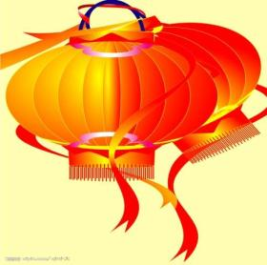
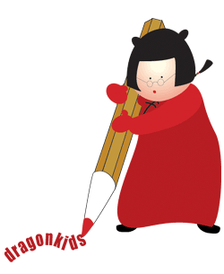

Language points

Slide 16

1. 独立完成语言点习题。(3minutes)
2. 小组讨论：请起立且讨论出本小组最佳答案，推举一名同学上台展示。 (4minutes)
展示：
1.展示同学声音洪亮，发音标准，语速适中
2.其他同学认真倾听，学习别人优点，并积极纠错。
依稿读+3分，脱稿+5分，

Slide 17
1.a few意思是“一些，少量”，后接可数名词复数。
注意：a little意思是“一些，少量”，后接不可数名词。
2.sweep away意为“扫去，扫除”
eg. He is sweeping away the broken glass(碎玻璃).(汉译英)

Slide 18
3.a kind of 意为“一种”
Eg. The tiger is a kind of animal.
4.mean v.意思是，意味着
①意思是eg. Hongbao means lucky money.
②意味着.后接n/doing.
Eg. Missing the last bus means walking home. (汉译英)

Slide 19
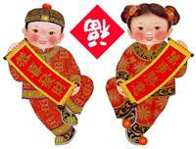
Homework:
1.复习并整理笔记。
2.预习下一节课。
Homework
Review the grammar we have learned today.

