Slide 1
Unit 8 When is your birthday?
Self Check
WWW.PPT818.COM

Slide 2
一、单项选择。
1.My birthday is ______ January and Peter's birthday is ______ March 26th.
A．in，at B．in，/ C．in，on D．on，in
2．—When is Mr.Wang going to the US?
—On ______．
A．June B．June 4th
C．the year 2014 D．June 2014

Slide 3
3．She is only ______．
A．ten months old B．ten months
C．ten monthes old D．tenth years old
4．This is a big room.It is ______．
A．Jim and Tom B．Jim's and Tom's
C．Jim and Tom's D．Jim's and Tom
5．Friday is ______ birthday of my grandma's.
A．eighty B．the eightieth
C．eightieth D．the eighty

Slide 4
6．We often ______ on my grandfather's birthday.
A．have a School Day B．have a party
C．has a party D．has a school trip
7．—Is Julia's birthday on May 1st?
—Yes，______．
A．she is B．she's
C．he is D．it is
8．There are ______ days in a week.______ day of a week is Saturday.
A．seventh，Seventh B．seven，Seven
C．seventh，The seventh D．seven，The seventh

Slide 5
9．—When is ______ birthday?
—His birthday is on November 11th.
A．your B．Lucy's C．Jack's D．my
10．______ Bill ______ an English Day this term?
A．Do，has B．Does，have
C．Does，has D．Do，have

Slide 6
二、词汇运用。
A)根据句意及汉语提示写单词。
11．Everyone is very ______(快乐的) on that day.
12．December is the ________(第十二) month of a year.
13．We have an English ______(晚会) in July.
14． __________(九月) 10th is Teachers' Day.
15．Our art _________(节日) is on May 5th.
happy
twelfth
party
September
festival

Slide 7
B)用括号内所给词的适当形式填空。
16．Does he want ________(have) a birthday party?
17．When ____(be) your parents' birthdays?
18．Which is the ______(nine) one?
19．My _________(brother) birthday is on January 1st.
20．Our school trip is on October ____(five)．
to have
are
ninth
brother's
fifth

Slide 8
三、从方框内选句子补全对话。
A．What about the school trip?
B．What about his birthday?
C．When is the basketball game?
D．Fine，thank you.
E．When is your birthday?
F．When is his birthday?
G．When do you have the English test?

Slide 9
A：Hello，Jim！How are you?
B：21.____
A：What are they?
B：They are some fruit and a cake.
A：Why?
B：I will have a birthday party.
A：22.____
B：My birthday is on October 5th.Please come to my birthday party on that day.
A：OK.I will go to the party.23.____
B：The basketball game？Oh，it's on October 3rd.
D
E
C

Slide 10
A：Good.24.____
B：The school trip is on September 25th and 26th.
A：25.____
B：Oh，the English test is on September 28th.
A：Great. Thank you.
B：You're welcome.
A
G

Slide 11
四、完形填空。
I am Wu Gang. I 26. __ a big family. My grandfather is seventy 27. __ old and my grandmother is sixty­nine. My father likes basketball，my mother 28. __ tennis，and I like 29. __．
C
B
A
C
My grandfather's birthday is on New Year's 30. __．My grandmother's birthday is on 31. __．November 15th is my father's birthday and December 20th is 32. __．When is my birthday？My birthday is on June 1st！It's 33. __！
A
C
B
A

Slide 12
Every Sunday we have a family party and every 34. __ we have a trip.I have a very 35. __ family.
B
C
26．A.has B．likes C．have
27．A.year B．years C．months
28．A.likes B．like C．like to
29．A.color B．class C．soccer
30．A.Day B．Week C．Month

Slide 13
31．A.February 31st B．February 30th
C．February 14th
32．A.my mother B．my mother's birthday
C．my birthday
33．A.fun B．old C．blue
34．A.day B．month C．morning
35．A.dear B．small C．happy

Slide 14
五、阅读理解。
A
I'm Nancy.I'm twelve years old.I like September very much.September 9th is my birthday，and my mother's birthday is in September，too.We have a birthday party every year.In our school，we have an art festival on September 18th.And we have a Sports Day on September 27th，too.I am really busy this month，but I am very happy.Which month do you like?

Slide 15
36．It's Nancy's ____ birthday this year.
A．twelve B．twelfth C．ninth
37．____ isn't in September.
A．Nancy's birthday B．Nancy's mother's birthday
C．Nancy's father's birthday
38．____ birthday is on September 9th.
A．Nancy's B．Nancy's father's C．Nancy's mother's
39．____ is on September 27th.
A．School trip B．Sports Day C．Book sale
40．An art festival in our school is on ____．
A．September 18th B．October 18th C．September 10th
B
C
A
B
A

Slide 16
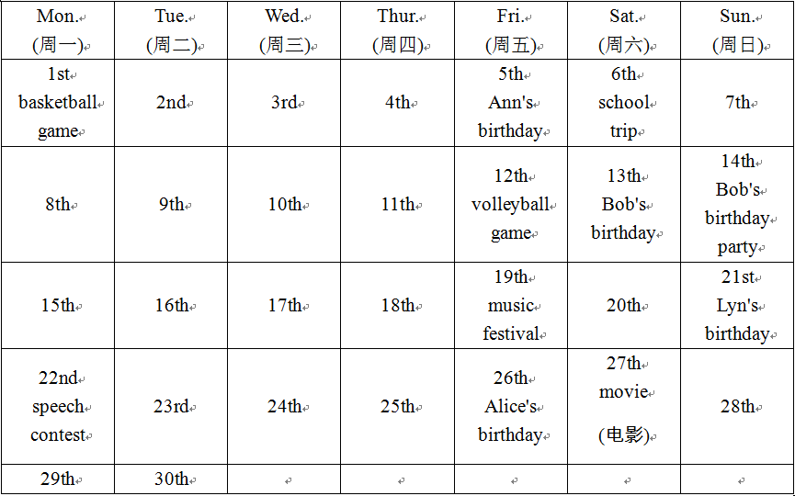
B
It's April now.Look at Gina's timetable(时间表)．

Slide 17
41.____ is on April 21st.
A．Ann's birthday B．Alice's birthday
C．Bob's birthday D．Lyn's birthday
42．Gina wants to go to a birthday party on ____．
A．April 13th B．Friday(周五)
C．the second Sunday D．April 30th
43．Gina can't go to the movie with Li Ming on April 19th because she has a ____．
A．school trip B．music festival
C．speech contest D．party
D
C
B

Slide 18
44．On the second Friday，Gina has a ____．
A．birthday party B．basketball game
C．volleyball game D．movie
45．Gina has no activities(活动) on ____．
A．Wednesday(周三) B．Saturday(周六)
C．April 22nd D．April 27th
C
A

Slide 19
六、从方框中选择合适的单词完成短文填空。
her，are，birthday，have，old，is，years，they，and，how
My name is David. I __46__ four good friends.__47__ are Sally，Joe，Ben __48__ Lisa. Sally and Joe __49__ twelve years old. Sally's __50__ is on April 9th and Joe's birthday is on July 6th.__51__ about Ben and Lisa？Ben's birthday is on November 13th and he is thirteen __52__ old. Lisa is fourteen.__53__ birthday is on January 20th.How __54__ am I？I am eleven years old. My birthday __55__ on August 8th.
46．______ 47. _____ 48. ____ 49.____
50．________ 51.____ 52.______ 53.____ 54．____ 55.___
have
They
and
are
birthday
How
years
Her
old
is

