Slide 1
Unit 3
Could you please clean your room?
Section B (第2课时)
WWW.PPT818.COM

Slide 2
Ⅰ. 根据句意及汉语提示写出相应的单词和短语
1. Kids these days already have enough _____(压力)
from school.
2. Housework is a _____(浪费)of their time.
3. And _______(而且), I think doing chores is not so
difficult.
stress
waste
anyway

Slide 3
develop
4. Doing chores helps to _______(发展) children’s
____________ (独立)and teaches them how to look
after themselves.
5. It also helps them to understand the idea of _______
(公平).
6. As a result, he often ___ __(生病)and his grades
________ (落下).
independence
fairness
fell
ill
dropped

Slide 4
neighbor’s
7. Our ___________ (邻居的)son got into a good college
but during his first year, he had no idea how to ____
____ __ (照顾)himself.
8. They should spend their time on school work __
_____ __(为了)get good grades and get into a good
university.
9. Children these days _______ ___(依赖)their parents
too much.
take
care
of
in
order
to
depend
on

Slide 5
Ⅱ. 将下列句子补充完整
1. 我们只让他们做学生分内的事好吗?
______ we just ___ them ___ their job __ students?
2. 仅仅在学校获得好成绩是不够的。
__ is not enough __ ____ ___ good grades at school.
Could
let
do
as
It
to
just
get

Slide 6
3. 在家里为孩子提供一个干净舒适的环境是父母的职
责。
__ __ the parents’job to _______ a clean and
comfortable environment at home ___ their children.
4. 孩子们越早学会独立, 对他们的未来就越好。
____ ______ kids learn to be independent, ___ ______
it is for their future.
It
is
provide
for
The
earlier
the
better

Slide 7
5. 现在他们没必要做家务。
________ ___ _____ ___ them to do housework now.
There’s
no
need
for

Slide 8
考点1 in order to目的是;为了
*They should spend their time on school work in order to get good grades and get into a good university.
为了取得好成绩, 进入一所好大学, 他们应当把时间花在学业上。

Slide 9
*Mr Allen works hard in order that his children can have a better life.
艾伦先生为了他的孩子们能有一个更好的生活而努力工作。
【自主归纳】
in order to意为“目的是;为了”, 后接动词原形, 其否定结构为in order not to do sth. “为了不做某事”。

Slide 10
【妙辨异同】in order to /in order that表“目的”
in order to | 意为“目的是;为了”, 后接动词原形
in order that | 意为“为了;以便”, 后接从句

Slide 11
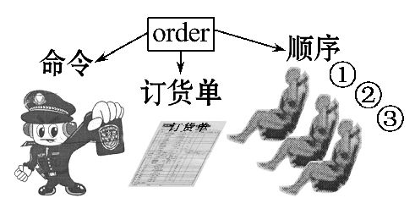
【拓展延伸】 order的其他常见用法

Slide 12
(1)order作名词, 意为“命令;指示;顺序;订单”等。
Please put the pictures in order.
请把这些图片按顺序排列。
(2)order作动词, 意为“命令;点(菜、饮料等);定(货);预订”等。
*He only ordered a glass of coffee.
他只是点了一杯咖啡。

Slide 13
【即学活用】
①(2015·武威中考)______stop more accidents, we should slow down the driving speed.
A. In order that B. In order to
C. Thanks for D. Thanks to

Slide 14
【解析】选B。考查短语辨析。thanks for感谢……;thanks to幸亏, 由于;in order that为了, 后跟从句;in order to为了, 后跟动词原形。句意: 为了防止更多的事故, 我们应该降低开车速度。故选B。

Slide 15
②(2016·齐齐哈尔中考)She dressed up ______everyone might notice her.
A. in order to B. in order that
C. although
【解析】选B。考查固定短语。in order to后面接动词原形, in order that后面跟目的状语从句, although后面接让步状语从句。句意: 为了引起大家的注意她打扮得很漂亮。故选B。

Slide 16
【拓展训练】
(2014·黄石中考)为了让我们学校更加美丽, 我们打算在
学校周围种植更多的树木和花草。
We’ll plant more trees and flowers around our school
__ _____ to make it more beautiful.
in
order

Slide 17
考点2 provide v. 提供;供应
*It is the parents’ job to provide a clean and
comfortable environment at home for their children.
在家里为孩子提供一个干净、舒适的环境是父母的责任。
*The sun provides us with light and heat.
(=The sun provides light and heat for us. )
太阳给我们提供光和热。

Slide 18
【自主归纳】
provide为及物动词, 意为“提供;供应”。常用于结构:
provide sth. for sb. 为某人提供某物;
provide sb. with sth. 供给某人某物。

Slide 19
【即学活用】
①(2016·玉林中考)Some people think it’s the parents’ job to ____their children ____a clean and comfortable environment at home.
A. offer ;to B. offer ;with
C. provide ;with D. provide ;to

Slide 20
【解析】选C。考查动词短语辨析。句意: 有人认为给孩子提供一个干净舒适的家庭环境是父母的职责。表示“为某人提供某物”可以用短语“offer sth. to sb. ”, “offer sb. sth. ”或“provide sb. with sth. ”来表达, 故选C。

Slide 21
②这个组织每年为他们提供住房。
The program ________ them ____ houses every year.
provides
with

Slide 22
考点3 depend on依靠;信赖
*Children these days depend on their parents too much.
现在的孩子们过于依赖父母。
*Camels depend on the desert plants for their food.
骆驼依赖沙漠植物为食。

Slide 23
*You can depend on this English dictionary.
你可以靠这部英语词典。
*Are mobile phones good or bad? It depends on how people use them.
手机是好事还是坏事? 这取决人们如何用它。

Slide 24
【自主归纳】depend on的三种含义
(1)依靠;依赖
(2)信赖
(3)取决于

Slide 25
【即学活用】
①(2016·襄阳中考)—Are you going to have a part time job during the summer vacation?
—Yes. I think I shouldn’t always ______my parents since I’ve grown up.
A. fight against B. argue with
C. hear from D. depend on

Slide 26
【解析】选D。考查动词短语辨析。fight against对抗;argue with与……争吵;hear from收到……的来信;depend on依靠、取决于。由答语中“既然我已长大了”, 可知上文应意为“我认为我不应该总是依靠父母”, 空白处意为“依靠;依赖”。故选D。

Slide 27
②你的未来取决于你现在如何努力学习。
Your future _______________________________
____________.
depends on how hard you work/ are
working now

Slide 28
【要点备选】
考点1 since conj. 因为;既然
prep. , conj. & adv. 从……以后;自……以来
*Since they live in one house with their parents, they should know that everyone should do their part in keeping it clean and tidy.
既然他们与父母住在一个房子中, 他们就应该知道每个人都应当参与家务来保持家里干净整洁。

Slide 29
*Mr Brown has worked in Shanghai since 1998.
布朗先生自从1998年就在上海工作。
*The little girl has been unable to walk since she was born.
这个小女孩自出生起就不能走路。
*Mike and Peter met at primary school and have been close friend sever since.
迈克和彼得在小学相识, 自那时起他们就是好朋友。

Slide 30
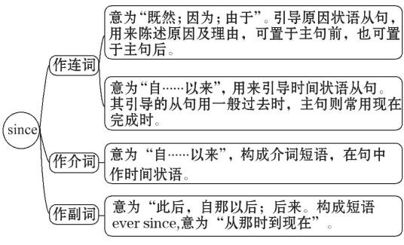
【自主归纳】since的三种用法

Slide 31
【即学活用】
①既然你不喜欢这本书, 我再借给你一本。
_____ you don’t like the book, I’ll lend you another one.
②Rick has learned a lot about Chinese culture ______
he came to China.
A. before B. when C. until D. since
Since

Slide 32
【解析】选D。考查连词辨析。before在……之前;when当……的时候;until直到;since自从。根据句意“自从来到中国, Rick已经学了很多中国文化。”可以判断用since。故选D。

Slide 33
考点2 waste n. 浪费;垃圾
*Housework is a waste of their time.
家务劳动是在浪费他们的时间。
*Cathy thinks playing computer games is a waste of time.
凯茜觉得玩电脑游戏是浪费时间。
*You shouldn’t throw waste everywhere.
你不应该到处乱扔垃圾。

Slide 34
【自主归纳】
waste作名词, 意为“浪费;垃圾”, 常用搭配: a waste of time“浪费时间”。

Slide 35
【拓展延伸】 waste的其他用法

Slide 36
*Mr Smith asks us not to waste water.
史密斯老师要求我们不要浪费水。
*A factory is pouring waste water into the river.
一家工厂正在往河里倾倒废水。

Slide 37
【即学活用】
①不要浪费食物, 请把它吃光。
Don’t _____ ____, please eat it up.
②看太多电视是在浪费时间。
Watching too much TV is a _____ __ ____.
waste
food
waste
of
time

Slide 38
【拓展训练】
我们不能乱扔废纸。
We can’t throw _____ ______ about.
waste
paper

