Slide 1
Module
12
Save our world
Unit 1 If everyone starts to do something, the world will be saved.
WWW.PPT818.COM

Slide 2
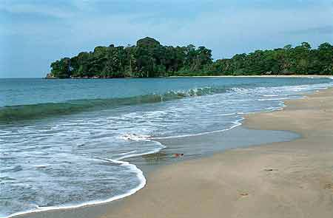
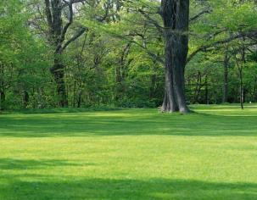
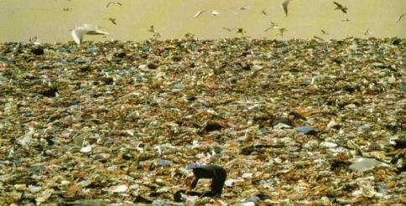
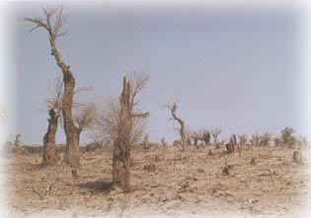
Warm up
Talk about the pictures.

Slide 3

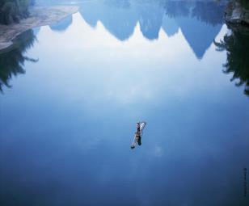
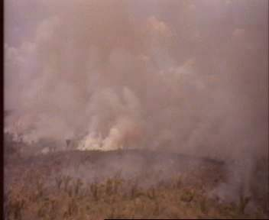
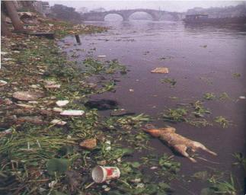

Slide 4
New words and expressions
/'fæktrɪ/
factory
制造厂；工厂 n.
pollute
/pə'lu:t/
污染 v.
回收利用；再使用(废品) v.
recycle
/ri:'saɪkl/
/weist/
废料，废弃物 n.
waste
enemy
/'enəmɪ/
敌人；仇人 n.
庄稼；作物 n.
crop
/krɒp/

Slide 5

/kɪl/
杀死；弄死 v.
kill
石油 n.
oil
/ɒɪl/
较小的；较少的 adj.
较少数；叫少量 n.
/les/
less
无望的 adj.
/'həʊplɪs/
hopeless

Slide 6
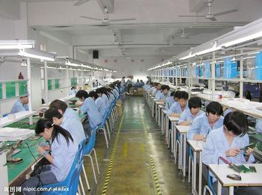
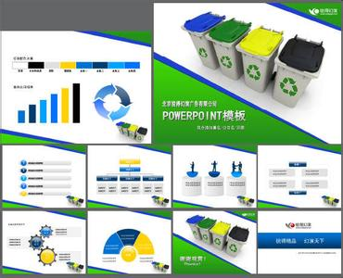
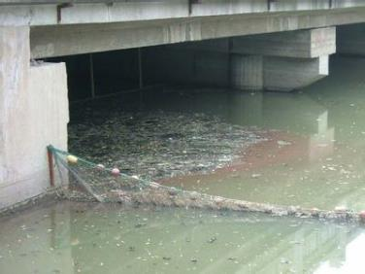
factory制造厂；工厂
recycle
回收利用；再使用(废品)
pollute污染

Slide 7
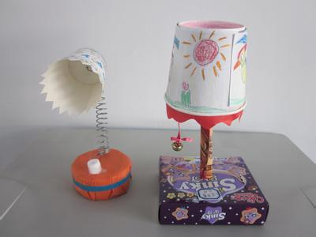
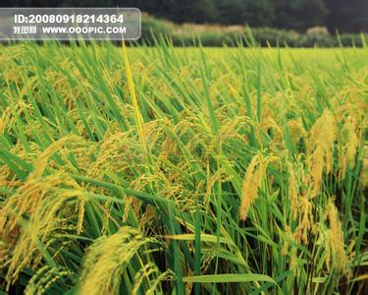
waste废料，废弃物
The waste can be used.
废弃物也能够被使用。
crop
庄稼；作物

Slide 8

enemy敌人；仇人
复数：enemies
Don’t make an enemy of him. 不要与他为敌。
oil石油
作“石油”讲时，是不可数名词。
The country is rich in oil and coal.
这个国家石油和煤很丰富。

Slide 9

Listening and vocabulary
Work in pairs. Look at the pictures and talk about them. Use the words in the box to help you.
factory, pollute, recycle, waste

Slide 10
Air has been polluted because factories produce electricity and energy for human being every day.
A large numbers of metal cans are thrown away everywhere. We waste a great deal of metal

Slide 11


2. Listen and complete the sentences.
pollution
1. The factory is causing a lot of___________.
2. There should be some________ to stop
pollution.
3. We can_________ waste products, such as
__________and paper in a recycling centre.
rules
recycle
glass

Slide 12

Watch and read

Slide 13
3. Listen and read.
Lingling: After our lesson on the environment,
I’m worried about the future. Pollution is
our great enemy, and we have to fight it. If the
rivers are polluted, farmers can’t use
water for their crops.
Tony: And in some places, pollution from
factories spreads over cities and villages. It
makes people ill, and may even kills them.
Pollution is a danger to our health.
Betty: And there’re so many cars on the road.

Slide 14
They use so much oil and cause pollution as
well.
Daming: But we are only students. We can’t do
anything about factories and cars.
Betty: It’s no use talking about things we can’t
do. We’ve got to think of things we can do!
Daming: Such as…?
Lingling: Do you think we can make our school
a green school?
Daming: What’s a green school?
Lingling: At a green school, every class collects

Slide 15
waste or rubbish which can be recycled or
used again. Then the school sells the waste
and uses the money to help students in
poor areas.
Daming: Nice idea!
Betty: Students at a green school also learn
ways to save energy and recycle at home. That
means less waste.
Tony: That’s a good idea. Though pollution is
heavy now, I don’t think it’s hopeless. If
everyone starts to do something, the world will
be saved.

Slide 16
Language points
1. And in some places, pollution from
factories spreads over cities and villages.在一些地方， 来自工厂的污染遍布城市和村庄。
spreads over遍布在..., 复盖在...
What he studied spread over many fields.
他所研究的内容涉及许多领域。

Slide 17

2. Pollution is a danger to our health.
污染有害我们的健康。
a danger to…“对…是一种威胁；有伤害”，
相当于be dangerous to
It is a danger to your computer's health.
=It is dangerous to your computer's health.
这对你电脑的健康是个威胁。

Slide 18
3. And there’re so many cars in the street.
They use so much oil…
街道上有很多车，他们使用很多石油…
so many很多
You can’t crush so many people into the classroom.你不能让这么多人挤进教室。
so much很多
辨析：so many与so much
so many 用来修饰可数名词， so much 用来修饰不可数名词。

Slide 19
There was so much noise outside that we
couldn’t hear the teacher.
外面嘈杂声很大， 以致我们不能听到老师的话。
He feels nervous when her faces so many people.
面对那么多人， 他感到紧张。
4. as well 也；又
拓展：
(1). 相当于too或also, 常位于句末，无须用逗号与句子隔开。

Slide 20
I am going to London and my sister is going to as well.
我要去伦敦， 我妹妹也去。
(2).as well 在口语中也可置于句中， 作“也好，
也行”或“倒不如”解。用来缓和语气。
You may as well go.你去也好。
(3). As well 也可以直接用于just之后， 用作应答
语。可视为(It’s just as well)的省略。作“幸亏，
幸而，无妨， 没关系”讲。
-We are too late to see the film.
- Just as well, I hear it isn’t very good.

Slide 21
5. Such as …？例如……
such as 表示举例，意为“例如，诸如
此类的，像……那样的”，相当于like
或 for example。
Animals such as rabbits and deer continue to
be active all winter.
像兔和鹿这样的动物整个冬天都很活跃。
There are few poets such as Keats and Shelly. 像济慈和雪莱这样的诗人现在很少了。

Slide 22
6. That means less waste.
(1). less 较小的，较少的； 较少数，较小量
1). less 是 little(小；少)的比较级。
He spends less time (in) doing experiments.
他做实验花的时间较少。
2). “less+形容词或副词”构成比较， 译为“较不，更不”。
It is less cold than it was yesterday.
天气不如昨天冷。

Slide 23
3). Less作名词时， 表示“较小量，较少量”
Less than ten of the thermometers remain.
这些温度计剩下不到十支。
4). less 作介词时， 译为“不足， 还差”
Five less two leaves three. 五减去二余三。
The time cycle is a year less three days.
(时间)周期是差三天一年。

Slide 24
7. I don’t think it’s hopeless.
我不认为它是没有希望的.
hope可做名词和动词， 表示“希望”
(1). 用于表示可能实现的事情， 后接从句，
用陈述语气。
I hope I shall see him again. 我希望再见他一次。
(2). Hope 多用于指多好事物的盼望， 预想； 对
坏事物的预想多用I am afraid…
I hope it will be fine tomorrow.
我希望明天天气好。

Slide 25
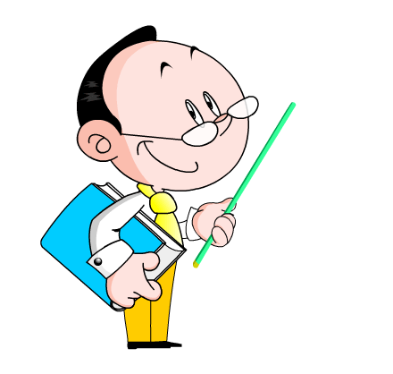
(3). hope 所希望的一般指将来或现在的事情，
不指过去的事情。
I hope he will come. 我希望他会来。
(4). Hope 可用于 hope to do 结构， 但不能说
hope sb. to do sth.
I hope to watch the football match again.
我希望再看一次那场足球赛。

Slide 26
Important Phrases
1. at a green school
在环保学校
2. collect waste
收集废品
3. sell the waste
卖废弃物
4. in poor areas
在贫穷地区
5. learn ways to
学习…的方法
6. Save money and recycle
节约钱并回收
7. start to do something
开始做些某事

Slide 27

Now complete the notes.
Problems
farmers can’t
If the rivers are polluted,_____________
_____________________________.
2. In some places, pollution from factories _________________________________ .
3. The cars on the road__________________
_____________________________ .
use water for their crops
spreads over cities and villages
use so much oil and
cause pollution as well

Slide 28
What the students can do?
4. Support a green school: every class _______________________which can be_______________________. Then the school _______________________________to help students__________________.
5. Students learn________________________
_________________. That means__________.
collects waste or rubbish
recycled or used again
the school sells the waste
in poor areas
ways to save energy and
recycle at home
less waste

Slide 29

Everyday English
It’s no use…
Such as…?
Nice idea!

Slide 30
4. Complete the passage with the correct form
of the words in the box.
cause, enemy, factory, kill, oil, pollute, spread
enemy
Pollution is our great (1)________. Pollution from (2)____________is a danger to our health, and may even (3)____people. Factories sometimes(4)________ rivers, and farmers cannot use the water for their crops. Pollution
(5)________ over cities and villages, and that (6)______ even more danger. Cars in the street use a lot of (7)_____and cause pollution too.
factories
kill
pollute
spread
causes
oil

Slide 31
Pronunciation and speaking
5. Listen and mark the words which the
speaker links.
After our lesson on the environment, I’m
worried about the future.
2. Students at a green school also learn ways to save energy and recycle at home.
Now listen again and repeat.

Slide 32
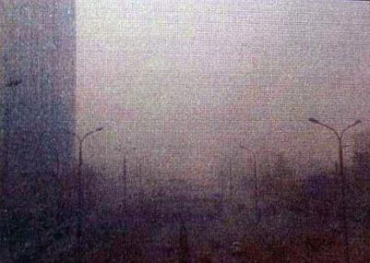
6. Work in pairs. List the pollution in your place.
Choose one problem and say what should be done
about it.
The air pollution in our
city is getting worse. What can we do to stop it?
- I think we can ride our bicycles to school more .

Slide 33
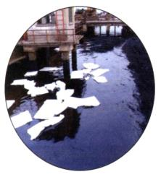
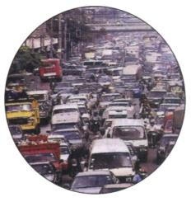
Sample
—The water are polluted, farmers can’t use them to water their crops .We should stop the factories from polluting the river.
— I agree. And we should stop them
from polluting the air as well.

Slide 34
Exercises
一. 根据句意及首字母提示完成单词。
1. Don’t w_____ water. Please turn off the cock
after you wash your hand.
2. I get a job in a f_________.
3. It’s more and more important for every to
save e__________ now.
4. Air p_______ is quite harmful to our health.
5. The students from a green school are
helping collect waste paper and bottles for
r_______.
aste
actory
lectricity
ollution
ecycling

Slide 35
二. 用所给单词的适当形式填空。
wasteful
We should give up those __________(waste) habit in order to save our world.
2. Some factories________ (cause) pollution.
3. I think ______________(environment)
education for kids is necessary.
4. Most students on our school often collect
________(reuse) waste for recycling.
5. If we don’t look after our earth well, the future will be _________.(hope)
cause
environmental
reusable
hopeless

Slide 36
三. 根据汉语意思完成英语句子。
1. 每个人都应该关心自己的健康。
be
careful
about/of
Everyone should ______ _______ _________ his health.
2. 来自该市的很多人都决心节约用水。
So
many
______ _______ people from the city made up their mind to save water.

Slide 37
3. 迈克喜欢奶茶和可乐之类的饮料。
Mike likes drinks_____ ______ milk tea and cola.
such
as
4. 应该谈谈我们的事情。
talk
about
We should ____ _____ what we can do.

Slide 38
Homework
Finish the exercises in the workbook.

Slide 39



