Slide 1
Welcome to China! Section C
Unit 1 Topic 1
WWW.PPT818.COM

Slide 2
Make a dialog with him/her.
T: Good afternoon.
S（s）: Good afternoon.
T: I’m ..., are you ...?
S1: Yes, I am.
T: Nice to meet you.
S1: Nice to meet you, too.
T: How do you do?
S2: How do you do?

Slide 3
S1: Good afternoon. How are you?
S2: Fine, thanks. And you?
S1: I’m fine, too.
S2: See you later.
S1: See you.

Slide 4
Practice
S: Good morning，Miss/ Mr. ...
How are you?
T: I’m fine. Thank you. And you?
S: I’m fine, too. Goodbye, Miss/ Mr. ...
T: Bye.

Slide 5
Pair work
A: Good afternoon. How are you? B: Fine, thanks. And you? A: I’m OK, too. B: See you later. A: See you.

Slide 6
1b Practice the conversations
above with your partner, using your
own names. Then change partners and practice again.
A: Good afternoon/evening, …
B: …
A: How are you?
B: …
A: Goodbye, …
B: …

Slide 7
Please say these letters as quickly as possible.

Slide 9
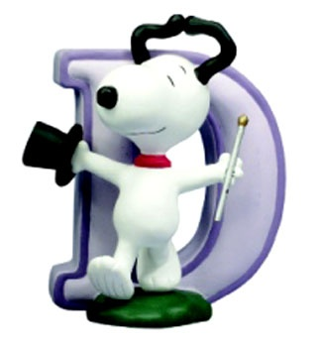
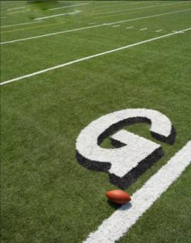

Slide 12
2b Work alone
Listen and fill in the blank. Then listen again and pay attention to the rule of each group.
Ff ___ ___
___ ___
___
Pp ___
___
Qq ___
___

Slide 13
Play a game.
Play the English letter game: The first student in the first team begins with “A”, the second student follows with “B”, the third “C”, but when he/she meets with vowel first, he/she says “Bing”, the second “Bing Bing” and so on. (except A for the first time)

Slide 14
For example:
A, B, C, D, Bing, F, G, H, Bing Bing, J, K, L, M, N, Bing Bing Bing, P, Q, R, S, T, Bing Bing Bing Bing, V, W, X, Y, Z, Bing Bing Bing Bing Bing, B, C ... until all the students join the game.

Slide 15
3
Group work
Make more capital letters with pens or pencils after the models and then read them out.

Slide 16
Sum up
问候
Good morning.
Good afternoon.
How are you？
I’m fine, thank you. And you?
告别
Goodbye.
Goodbye./Bye.
See you later.
See you.

Slide 17
Homework
Make letter models or letter cards, and choose the best.
Write 26 letters.
Practice greeting sb.

