Slide 1
人教精通版五年级下册
Unit 6 We’re watching the games.
WWW.PPT818.COM

Slide 2
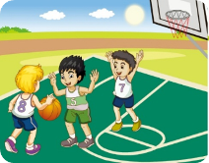
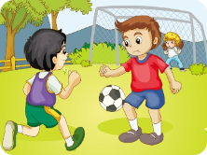
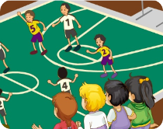
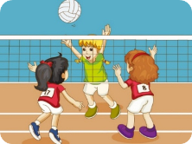
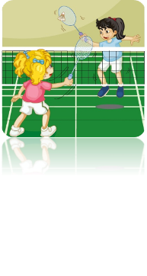
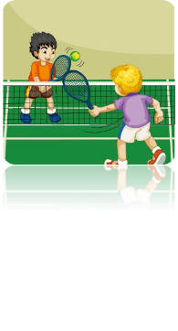
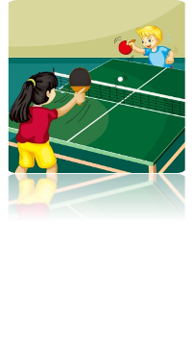
>>Warm-up
What are they doing?
They’re…

Slide 3
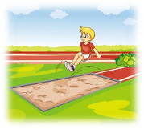
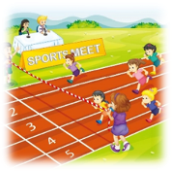
>>Lead-in
Review
high jump
1. Are you watching the __________?
long jump
2. They’re doing the ____________.
3. The young girls are _________.
They’re _________ so _______.
running
running
fast

Slide 4
>>Presentation
Just practise

Slide 5
>>Practice
Just practise
Are you ______________________?
Yes, we are.
watching the high jump
Are they _____________________?
No, they aren’t.
doing the high jump, too

Slide 6
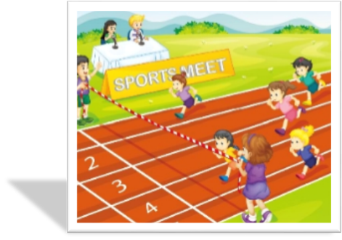
>>Practice
Just practise
The young girls are _______ (run) so fast.
running
They’re all good ________! (run)
runners

Slide 7
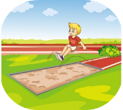
>>Practice
Match the pictures with the sounds

Slide 8
>>Presentation
Just write
high jump
跳高
long jump
跳远
run
跑步
---Are you watching the high jump?
---Yes, we are.

Slide 9
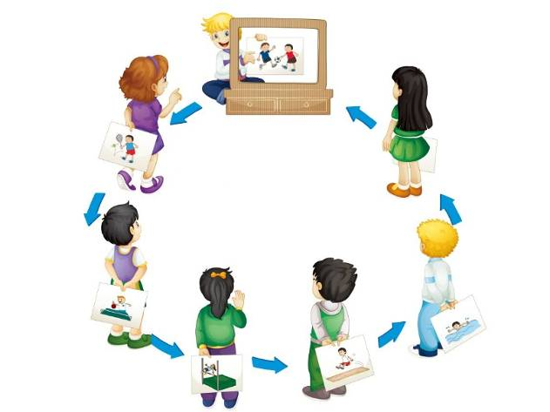
>>Practice
Let’s play
Let’s look at these boys. What are they doing?
Are they playing football?
Yes, they are.

Slide 10
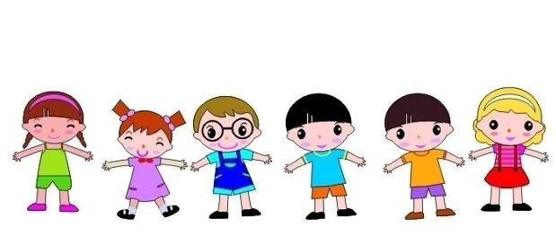
>>Practice
They’re doing high jump.
They’re doing long jump.
What are
they doing?
What are
they doing?

Slide 11
>>Presentation
Let’s chant

Slide 12
>>Summary
四会词汇：
high jump
long jump
run
如何询问和回答“你在看跳高吗”？
---Are you watching the high jump?
---Yes, I am.
如何询问和回答“他们也在跳高吗”？
---Are they doing the high jump, too?
---No, they aren’t.

Slide 13
>>Homework
1. 观看课文动画，按照正确的语音、语调朗读课文。
2.熟练朗读Let’s chant部分。
3. 预习Revision。
close

