Slide 1
Crafts
第二课时
WWW.PPT818.COM

Slide 2
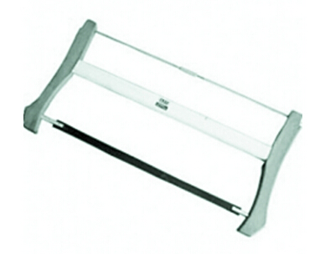
Warming
Do you know who invented the saw?
Lu Ban.

Slide 3
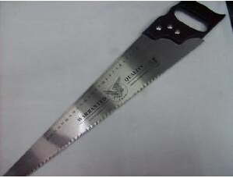
Presentation
What’s this?
It’s a saw.

Slide 4
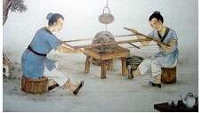
Presentation
What are they?
They are craftsmen.

Slide 5
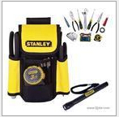
Presentation
What’re they?
They are tools.

Slide 6
Presentation
A long time ago, there was a craftsman. His name was Lu Ban.

Slide 7
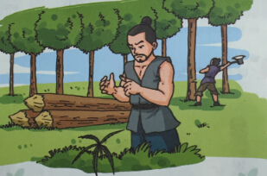
Presentation
One day, a leaf cut his finger. He thought, “ How could such a small leaf hurt my finger?”

Slide 8
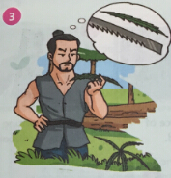
Presentation
He looked at the leaf carefully. There were many teeth on the leaf and the teeth were sharp.

Slide 9
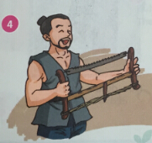
Presentation
Soon Lu Ban made a saw. It was the first saw in the world. People are still using this tool today.

Slide 10
Discussion
Complete the summary of this story.
Lu Ban ______ a craftsman. One day, a leaf _____ his finger. He saw _____________ on the leaf. Lu Ban then made___________.
was
cut
many teeth
a saw

Slide 11
Work in pairs
According the passage, ask and answer in pairs.
Lu Ban.
Who made the first saw in the world?

Slide 12
Work in pairs
How did he find the saw?
One day….
….

Slide 13
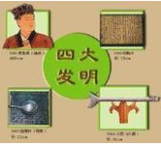
Practice in groups.
Do you know them? Talk about them in groups.

Slide 14
Summary
本课重点句型：
One day, a leaf cut his finger.
There were many teeth on the leaf and the teeth were sharp.
Soon Lu Ban made a saw. It was the first saw in the world.

Slide 15
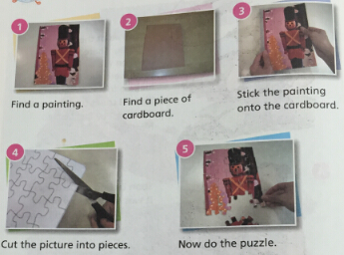
Homework.
Make and say.

