Slide 1
WWW.PPT818.COM

Slide 2
Let's Chant
One, two, tie your shoes.
Three, four, close the door.
Five, six, pick up sticks.
Seven, eight, don’t be late.
Nine, ten, start again.

Slide 3
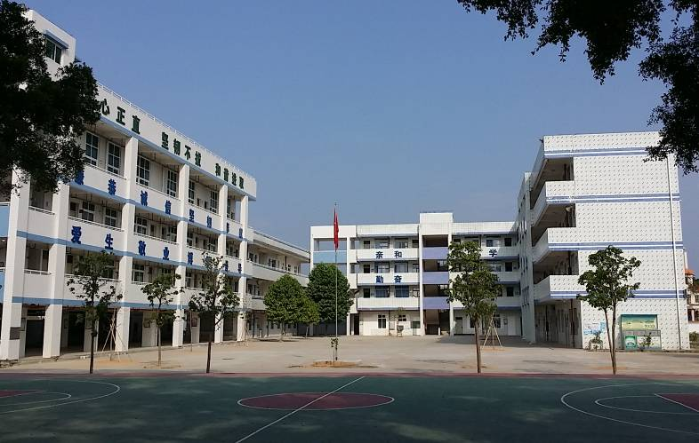
our school

Slide 4
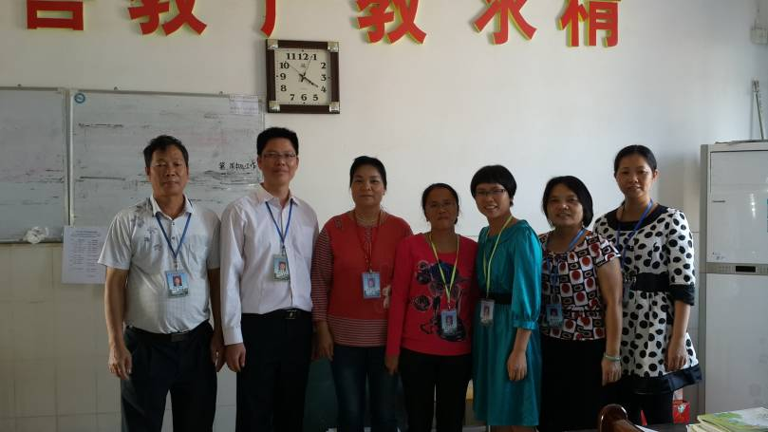
How many teachers are there?
There are seven.

Slide 5
se
ele
ven
11
How many chairs are there ?
There are eleven.

Slide 6
t
wel
come
ve
12
How many buildings are there?
There are twelve.

Slide 7
13
th
ir
teen
How many apples are there?
There are thirteen.

Slide 8
Classroom building
5
5
5
fi
ve
f
teen
How many classrooms are there?
There are fifteen.

Slide 9
个位 | 十几
one | eleven
two | twelve
three | thir
four
five | fif
six
seven
eight
nine
teen
fourteen
teen
sixteen
seventeen
eighteen
nineteen

Slide 10
个位 | 十几
one | eleven
two | twelve
three | thir
four
five | fif
six
seven
eight
nine
十几十几，
-teen, -teen, -teen,
t-e-e-n, -teen.
teen
fourteen
teen
sixteen
seventeen
eigh
eighteen
t
teen
nineteen

Slide 11
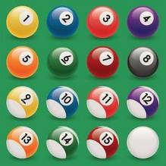
Read together
材料来源：
《小学英语目标实施手册测试卷》四年级上册。
11
12
13
eleven ducks
twelve dogs
thirteen chickens
14
19
16
fourteen books
sixteen balls
nineteen flowers

Slide 12
Read and count
+
tw
en
1
=
20
ty
19
nineteen and one is
twenty
20 + 20 =
four
for
40
ty
twenty and twenty is
forty

Slide 13
个位 | 十几 | 几十
one | eleven | ten
two | twelve
three | thirteen
four | fourteen
five | fifteen
six | sixteen
seven | seventeen
eight | eighteen
nine | nineteen
twen
ty
thirty
for
ty
fifty
sixty
seventy
eighty
ninety
十几十几，-teen, -teen, -teen, t-e-e-n, -teen.
几十几十，-ty, -ty, -ty, t-y, -ty.

Slide 14
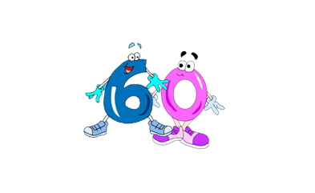
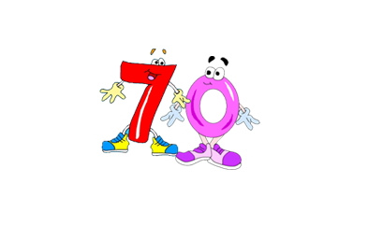
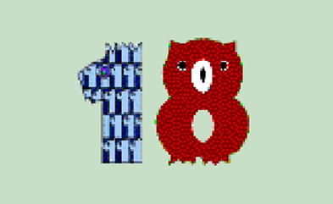
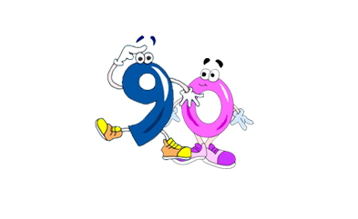
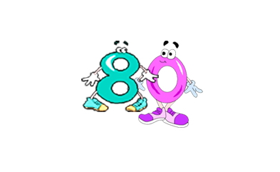
挑战题一
What can you see?
(快速说出你看见了什么?)

Slide 15
挑战题二
听选题：
( ) 1. A. 5 B. 15
( ) 2. A. 13 B. 30
( ) 3. A. thirteen B. fourteen
( ) 4. A. fourteen B. forty
( ) 5. A. eighteen B. eighty
A
A
B
B
A

Slide 16
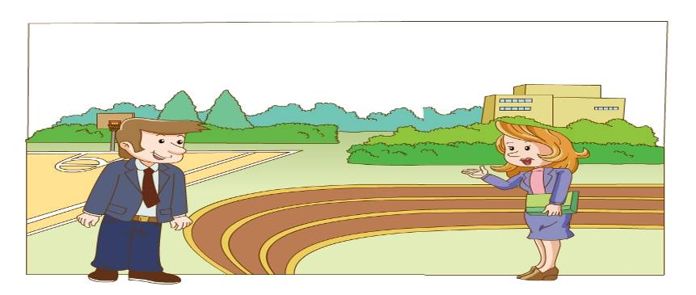
挑战题三
T
( ) 1. This is Ms White’s school.
F
( ) 2. There are 28 classrooms in the school.
38
T
( ) 3. There are 13 English teachers in the school.

Slide 17
挑战题四
选择适当的答案：
( ) 1. --How many are there in your school?
--There are seventeen.
A. classroom B. classrooms
How many + 名词复数 + are there +介词短语.
B
s
( ) 2. -- Is your school big or small ?
-- _________________
A. Yes , it is . B. It’s big .
B
表示选择，根据情况选择or的前面或者后面来回答。

Slide 18
小结：这节课你学到了什么？

Slide 19
Homework:
1、抄写本节课所学的新单词。
2、熟读P33数词表，并在练习纸上默写。
3、读Let’s talk三遍。

