Slide 1
Unit3 My father is a writer.
五年级上册
WWW.PPT818.COM

Slide 2
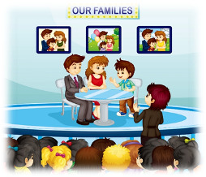
>>Review
Think and say
1. What does Wei Min’s father do?
2. Is Wei Min’s mother an actress?
3. What does Wei Min want to be in the future?
He’s an actor.
No. She’s a factory worker.
He wants to be an actor.

Slide 3
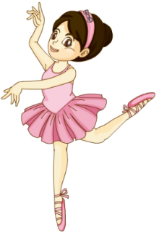
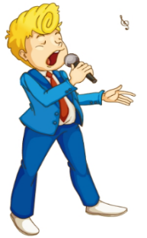
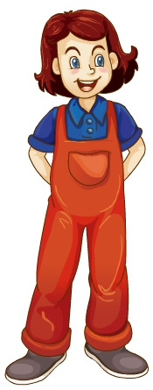
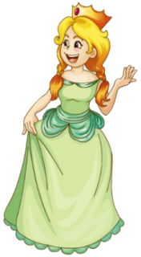
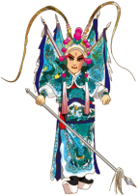
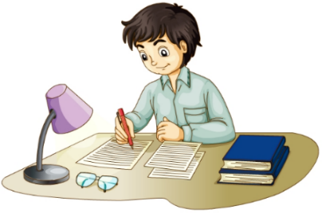
>>Lead-in
Play a game
快速抢答
job

Slide 4
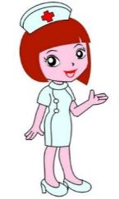
>>Presentation
Free talk
What does your father/mother do?

Slide 5
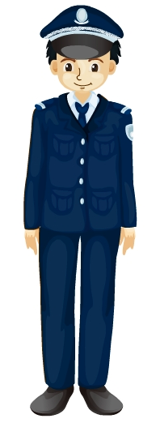
>>Presentation
Look and say
policeman

Slide 6
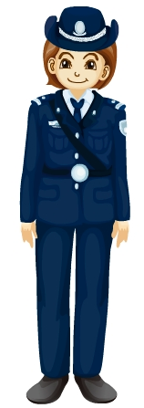
>>Presentation
Look and say
policewoman

Slide 7
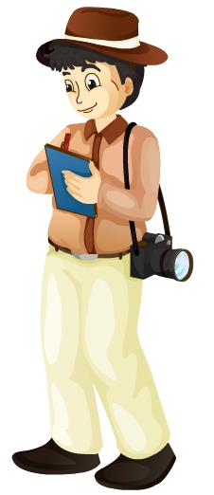
>>Presentation
Look and say
reporter

Slide 8
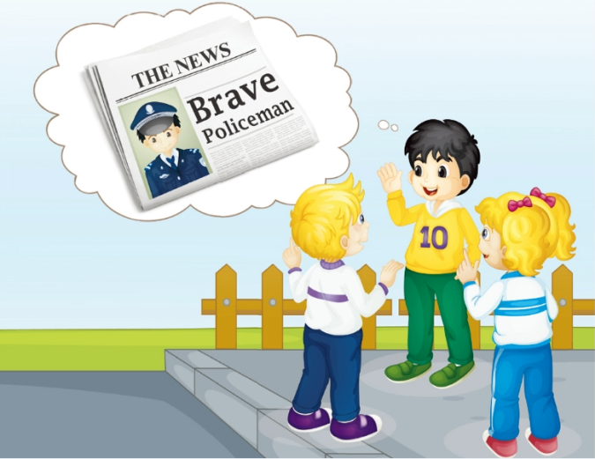
>>Presentation
Listen and answer
1. Who’s he?
He is Gao Wei’s uncle.
uncle
2. What does he do?
What’s his job?
He is a policeman.

Slide 9
>>Presentation
Read and answer
3. What does policeman often do?
He often helps people in his work.
4. What does the policeman look like?
He looks great in his uniform.

Slide 10
>>Presentation
Read and answer
5. What’s Gao Wei’s aunt job?
aunt
= What does Gao Wei’s aunt do?
She’s a policewoman.

Slide 11
>>Presentation
Just talk
Listen and imitate
Gao Wei: Hi, Kate! Look at today’s newspaper.
Kate: Wow! A policeman.
Gao Wei: Who is he? Can you guess?
Peter: Sorry, I don’t know.
Gao Wei: He’s my uncle.
Kate: Really? He looks great in his uniform.

Slide 12
>>Presentation
Just talk
Listen and imitate
Gao Wei: Yes. He often helps people in his
work.
Kate: Oh, he’s a good policeman! How
about your aunt? What’s her job?
Gao Wei: She’s a policewoman.
Peter: I want to be a policeman in the future!

Slide 13
>>Practice
Show time
小组合作，练习对话并表演，其他同学评价。
Pronunciation (语音) |  | Fluency (流利) | Cooperation (合作)
OK!
Great!
Super!

Slide 14
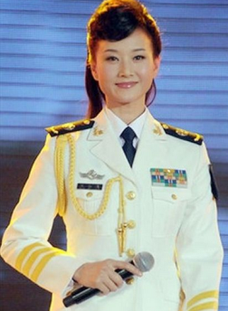
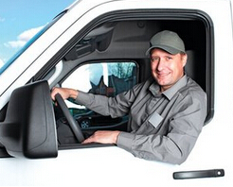
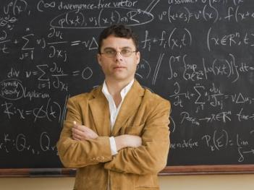
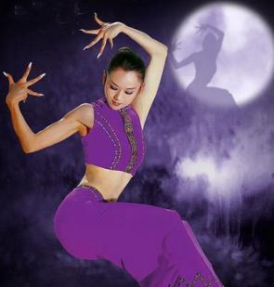
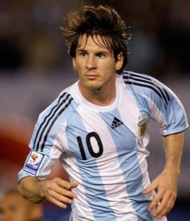
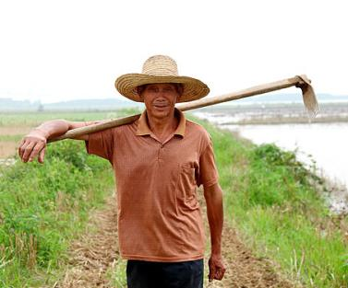
>>Practice
看图对话
What’s his/her job?
He/She is a …

Slide 15
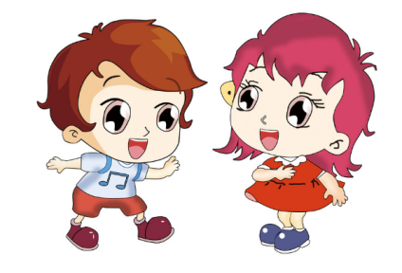
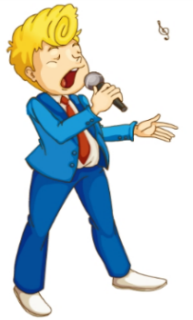
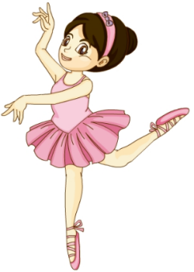
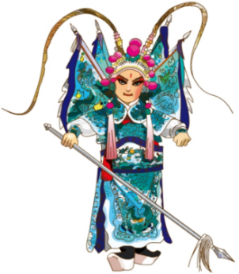
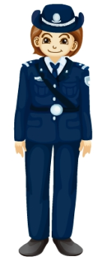
>>Practice
I do you guess
做动作，猜职业
What’s he/she job?
He/She is a …

Slide 16
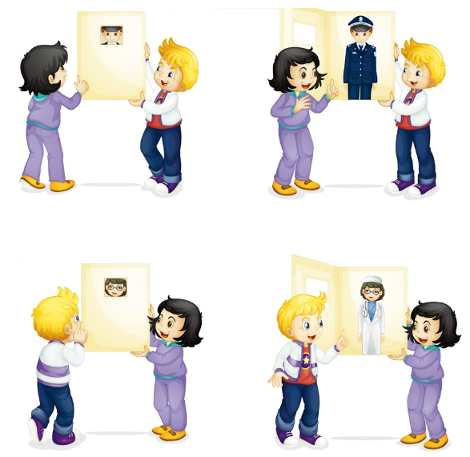
>>Practice
Let’s play
2
4
He’s my uncle.
He’s a policeman.
1
Who’s he?
What’s his job?
3
5
6
7
She’s my aunt.
What’s her job?
Who’s she?
8
She is a doctor.

Slide 17
>>Summary
本课的重点单词：
policeman policewoman uncle aunt
本课的重点句型：
—What’s his job?
—He/She is ...

Slide 18
>>Homework
1. 制作一张调查表，调查你身边的家人和朋友（至少6人）关于他们的职业。
2.预习 Lesson19。

