Slide 1
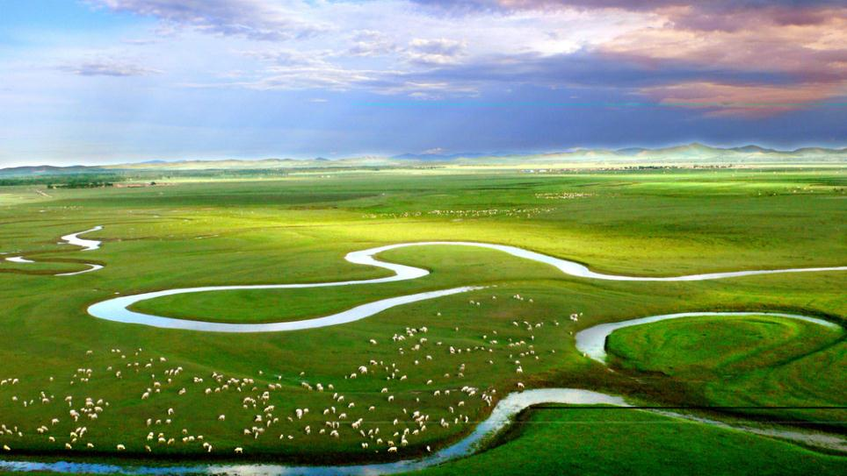
Unit 3 On the move
Period Five Writing—Writing a sports story
WWW.PPT818.COM

Slide 2
Period Five Writing—Writing a sports story
PART 1
技法点拨
PART 2
写作训练

Slide 3
PART
1
技法点拨
文体分析 把握写作动脉

Slide 4
◆写作指导
本单元的写作任务是写一篇自己喜欢的运动故事，属于事物介绍类说明文。该类说明文的主体时态通常采用一般现在时，但具体情况具体分析，根据实际情况采用适当的时态。在介绍自己喜欢的运动时，宜采用“总—分—总”的结构，介绍某项运动的发展史和某个体育明星时可以采用时间顺序，介绍奥运场馆和举办城市时可采用空间顺序。在行文时，应使用恰当的过渡词汇，使各要点之间成为一个有机的整体。

Slide 5
◆常用表达
1.表示喜欢：
I like...best.
Of all the...I like...best.
My favourite...is...
2.表示喜欢的理由：
I like it because...
There is no doubt that...
The reason why I like...is that...

Slide 6
3.表示某项运动的优势：
It plays an important role/part in...
It does us a lot of good.
It is of great benefit to me.
4.介绍某项运动的起源、发展：
...originated as...
...developed into a sport from...
5.表示结论：
In all...
In a word...
It can make us healthy and wealthy.

Slide 7
PART
2
写作训练
弄清文络 写作妙笔生花

Slide 8
请根据下表信息，写一篇80词左右的英语短文介绍你最喜欢的运动。
最喜欢的运动 | 篮球
开始产生兴趣 | 九岁，那时父亲教我打篮球
现在练习情况 | 校篮球队成员；放学后或周末打大约一小时
喜欢的原因 | 快乐；健康；交友
最喜欢的篮球明星 | 姚明

Slide 9
◆审题谋篇
审题
写作要求是介绍自己最喜欢的运动。写作时应注意下面几点：
1.确定文体：这是一篇介绍类文章。写作时注意介绍类文章的写作特点。
2.主体时态：文章应以一般现在时为主。
3.主体人称：由于是介绍自己喜欢的运动，所以人称应该以第一人称为主。

Slide 10
谋篇
本文应分为三部分。
第一部分：简介我最喜欢的运动。
第二部分：对如何开始这项运动和练习情况进行描述。
第三部分：喜欢的原因，自己的偶像。

Slide 11
◆遣词造句
核心词汇
1.对……感兴趣 _____________________
2.在……几岁时 _____________
3.与……比赛 ______________________
4.不但……而且…… __________________
be/become interested in
at the age of...
have competitions with...
not only...but also...

Slide 12
连词成句
1.我喜欢很多运动，其中篮球是我的最爱。(and连接的并列句)
I like many kinds of sports .
2.我在九岁时第一次对篮球感兴趣，那时爸爸教我怎样打篮球。(and连接的并列句)
I first became interested in basketball at the age of nine ______________________
.
3.篮球可以给我带来很多快乐、健康和朋友，所以我非常喜欢它。(so连接的并列句)
Basketball can bring me lots of happiness，health and friends，_____________
.
and basketball is my favorite
and then my father taught
me how to play it
so I like it so
much

Slide 13
句式升级
1.请用“介词＋关系代词”引导的定语从句改写句1。
________________________________________________________
2.请用定语从句改写句2。
___________________________________________________________________________________________
3.请用why引导的定语从句改写句3。
________________________________________________________________________________________________
I like many kinds of sports，of which basketball is my favorite.
I first became interested in basketball at the age of nine，when my father taught me how to play it.
The reason why I like basketball so much is that it can bring me lots of happiness，health and friends.

Slide 14
◆组句成篇
用适当的过渡词语，把以上词汇和句式，再加上联想内容，组成一篇80词左右的英语短文。

Slide 15
参考范文
I like many kinds of sports，of which basketball is my favorite.I first became interested in basketball at the age of nine，when my father taught me how to play it.I have been practicing hard.Now I am a member of our school basketball team and I often play basketball for about an hour after school or on weekends.Sometimes we also have competitions with students from other schools.The reason why I like basketball so much is that it can bring me lots of happiness，health and friends.My favourite basketball star is Yao Ming.

