Slide 1
Unit 2
My mother’s cleaning our house and sweeping away bad luck.
WWW.PPT818.COM

Slide 2
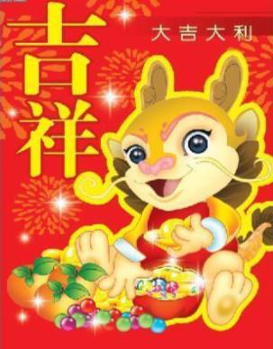
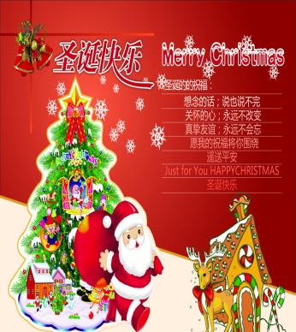
Spring Festival
Christmas Day

Slide 3
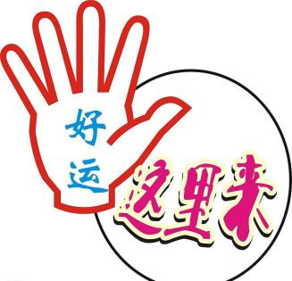
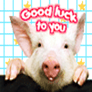
Good luck

Slide 4
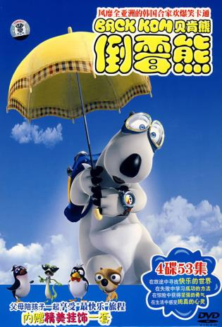
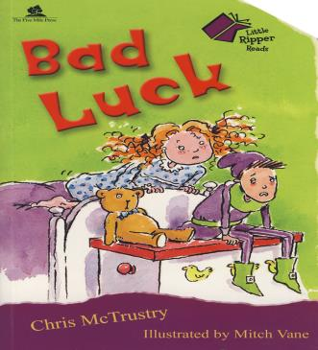
Bad luck

Slide 5
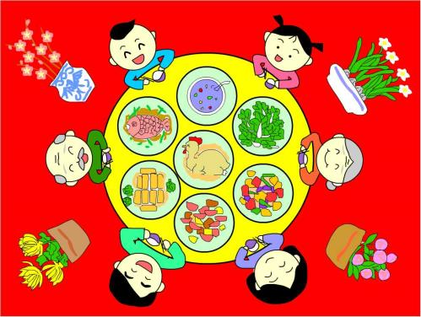
a traditional family dinner on the evening before Spring Festival.

Slide 6
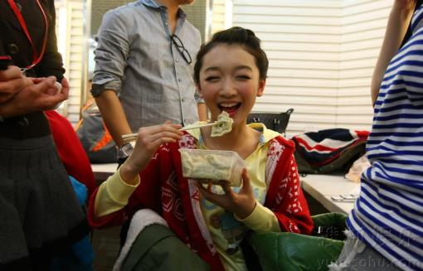
I am eating jiaozi—a kind of dumpling.

Slide 7
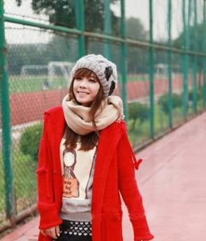
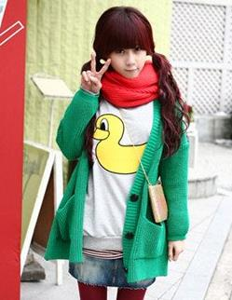
We are wearing new sweaters and coats.

Slide 8
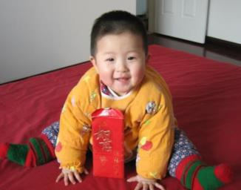
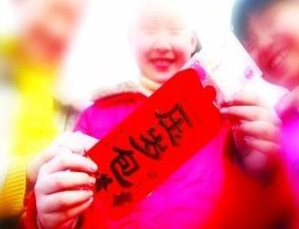
I always get a hongbao, lucky money, from them.

Slide 9
Work in pairs
Look at the pictures and talk about what’s happening.

Slide 10
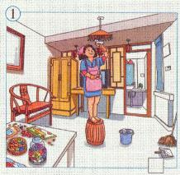
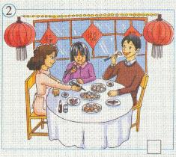
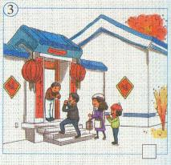
—What’s Li Shan’s mother doing?
—She’s cleaning the house.

Slide 11
Complete the passage with the correct words and expression from the box.
celebrate dumplings few luck mean programme sweep away traditional
We (1) _________ Spring Festival in January or February. A (2) ______ days before Spring Festival we clean
celebrate
few

Slide 12
our homes and (3) ____________ all the bad (4) _____. In the evening before Spring Festival we have a big family dinner. We eat lots of (5) _________ food, such as jiaozi – a kind of (6) __________. We usually watch a special (7) ___________ on television, and parents usually give their children a hongbao. It (8) ________ lucky money.
sweep away
luck
traditional
dumplings
programme
means

Slide 13
Writing
The notes about Christmas in Britain.
a) go shopping for presents
b) have a traditional family dinner
c) open presents on Christmas Day
d) put the presents next to the Christmas
tree

Slide 14
e) get lots of food ready
f) sing Christmas songs
g) say Merry Christmas to family and friends
h) have a Christmas tree

Slide 15
Look at the notes about Christmas in Britain. Match the notes with the headings.
Getting ready ____________
Presents ____________
Traditional things on Christmas Day
________________________________
a, e
c, d
b, c, d, f, g, h

Slide 16
Learning to learn
When you write new words, write them under headings, in groups or in a word map. Use pictures and drawings.

Slide 17
Write sentences with the notes in Activity 4.
Join two notes and write one sentences with and.
go shopping for presents; get lots of food ready
→They go shopping for presents and they get lots of food ready.
You can leave out the second they.
→ They go shopping for presents and get lots of food ready.

Slide 18

Choose one of the headings in Activity 4 and write about Christmas in Britain.
Getting ready
People go shopping for presents and get lots of food ready.

Slide 19
达标练习
A. Translate these phrases into English.
1. 好运
2. 倒霉
3. 新年里
4. 一种
good luck
bad luck
on New Year’s Day
a kind of

Slide 20
5. 在午夜
6. 在元宵节
7. 一年到头
8. 在除夕
9. 扫去
at midnight
at Lantern Festival
all the year round
on Spring Festival’s Eve
sweep away

Slide 21
B. 单词拼写
1. We are ________ (涂漆) the wall together.
2. It ________ (意味着) happening.
3. There are lots of __________ (饺子) on the plate.
4. __________ (每个人) has his own problems.
painting
means
dumplings
Everyone

Slide 22
C.完成句子。
1. 我们必须马上把树叶扫掉。
We must ___________ the leaves at
once.
2. 他们用鲜花装饰房间。
They _________ the house ___________.
sweep away
decorate with flowers

Slide 23
3. dumplings 是什么意思？
_________ dumplings ______?
4. 我们有好几天不打扫家居。
We _________ the house ____________.
5. 元宵全年带给我们好运。
Yuanxiao ________________________
________________________________.
What do mean
don’t clean for a few days
brings us good luck all the year round

Slide 24
D. 按要求改写句子。
Is your uncle making lanterns?
(否定回答)
_________________________________
2. She’s sweeping the floor at the moment.
(一般疑问句)
__________________________________
No, he isn’t.
Is she sweeping the floor at the moment?

Slide 25
3. They’re getting ready for the Lantern
Festival. (划线部分提问)
________________________________
4. They go shopping for presents. They get
lots of food ready. (用and合成一句话)
________________________________
________________________________
What are they getting ready for?
They go shopping for the presents and get lots of food ready.

Slide 26
THANK
YOU
PRESENTED
BY
OfficePLUS

