Slide 1
Writing an E-mail in English
WWW.PPT818.COM

Slide 2
Learning targets
1. Be able to use the words and phrases: pal,
introduce, play chess, try to do sth., look
forward to
2. To learn to write an e-mail in English
3. To learn some key sentences:
(1)Let me introduce myself.
(2)I have no brothers or sisters, but I have many
friends.
(3)In this e­mail，I am trying to use some new
words.

Slide 3
Lead in
Why do you learn English?
1.English opens the door to the world.
2.English can give you new opportunities.
3.With a good knowledge of English ,you can have bright future.
4.English helps you communicate with people from all over the world.

Slide 4
5.English can help you understand cultural differences around the world.
6.English connects you with the world.
7.English open the door to the world.

Slide 5
Do you write e-mails?
Who do you usually write e-mails to?
What do you write in your e-mails?
PPT模板：www.1ppt.com/moban/ PPT素材：www.1ppt.com/sucai/
PPT背景：www.1ppt.com/beijing/ PPT图表：www.1ppt.com/tubiao/
PPT下载：www.1ppt.com/xiazai/ PPT教程： www.1ppt.com/powerpoint/
资料下载：www.1ppt.com/ziliao/ 范文下载：www.1ppt.com/fanwen/
试卷下载：www.1ppt.com/shiti/ 教案下载：www.1ppt.com/jiaoan/
PPT论坛：www.1ppt.cn PPT课件：www.1ppt.com/kejian/
语文课件：www.1ppt.com/kejian/yuwen/ 数学课件：www.1ppt.com/kejian/shuxue/
英语课件：www.1ppt.com/kejian/yingyu/ 美术课件：www.1ppt.com/kejian/meishu/
科学课件：www.1ppt.com/kejian/kexue/ 物理课件：www.1ppt.com/kejian/wuli/
化学课件：www.1ppt.com/kejian/huaxue/ 生物课件：www.1ppt.com/kejian/shengwu/
地理课件：www.1ppt.com/kejian/dili/ 历史课件：www.1ppt.com/kejian/lishi/

Slide 6
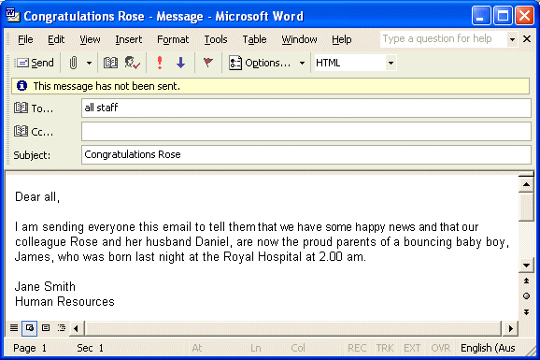
write an e-mail

Slide 7
Do you want to know more friends? Please introduce yourself to others. You can talk about:
1. Your name;
2. Your family;
3. Your hobby.
...

Slide 8
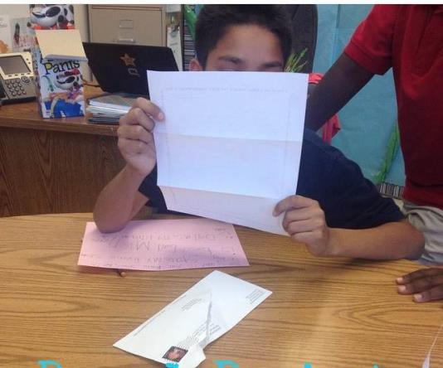
Words and expression
pal
n. 伙伴；朋友
He is writing to his pen pal.
他正在给他的笔友写信。

Slide 9
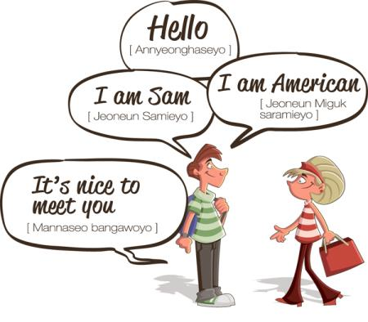
introduce
v. 介绍
You should intriduce yourself first when you meet others.
遇到别人的时候，首先你要介绍自己。

Slide 10
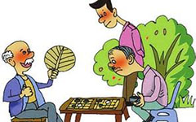
They're playing chess.
他们正在下象棋。

Slide 11
The young girl is trying to achieve her dream.
这个年轻的女孩正努力实现她的梦想。

Slide 12
I'm looking forward to the concert.
我很期待这场音乐会。

Slide 13
Presentation
Wang Mei has a new pen pal.Her name is Jessica.She is from Africa.This is Wang Mei's first e­mail to her.
Dear Jessica,
Let me introduce myself. My name is Wang Mei. I'm twelve years old.I live with my mother and father. I have no brothers or sisters, but I have many friends. I am 1.6 metres tall. I like to play chess. Last year, I won first place in my school. My favourite food is noodles. I can make noodles myself!

Slide 14
Do you study any other languages in school？I am learning English now.I want to have some more English­speaking friends.Learning English opens the world up to me.
In this e­mail，I am trying to use some new words.I will teach you some words in my language.Can you say，“Ni hao”？That means，“Hello”．Try it!

Slide 15
Here is a picture of me.What do you look like？Can you send me a photo of yourself？I'm looking forward to your reply.
Your new Chinese friend,
Wang Mei

Slide 16
Let’s Do It!
1. Listen and write true(T) or false(F)．
Jessica is from Canada. ( )
This is Wang Mei’s second e-mail to Jessica. ( )
Wang Mei has no brothers or sisters. ( )
Wang Mei wants to have some more English-speaking friends. ( )
Wang Mei sends a photo to Jessica in her e-mail. ( )
F
F
T
T
T

Slide 17
2. Read the lesson and answer the questions.
1. How tall is Wang Mei?
2. What game does Wang Mei like to play?
3. What is Wang Mei trying to do in her e-mail?
4. What Chinese words does Wang Mei teach Jessica?
5.What is Wang Mei looking forward to?
She is 1.6 metres tall.
She likes to play chess.
She is trying to use some new words.
She teaches Jessica “Ni hao”．
She is looking forward to Jessica's reply.

Slide 18
3. Fill in the blanks with the correct forms of the phrases in the box.
try to play chess win first place
look forward to
play chess
(1)I like to ________ with my friends.It's a fun game.
(2)Please write soon. I'm ________________ your reply.
(3) I ________ call him, but his phone was off.
(4)A：I _____________ in the English competition.
B：Good for you！
looking forward to
tried to
won first place

Slide 19
4. Imagine you are Jessica. Write an e­mail back to Wang Mei.
Dear Wang Mei,
____________________________________________________________________________________________________________________________________________________________________________________
Yours,
Jessica

Slide 20
Language points
1. Let me introduce myself.
introduce作及物动词，意为“介绍”。常用短语：introduce oneself 自我介绍；introduce A to B. 把A介绍给B。
例：Can you introduce yourself first？
你能先介绍一下你自己吗？
She often introduces her friends to her sister.
她常把她的朋友们介绍给她妹妹。

Slide 21
2. In this e­mail, I am trying to use some new words.
try (not) to do sth.表示“尽力(不)做某事”。含有try 的其他短语：try one's best to do sth. 表示“尽某人最大努力做某事”；try doing sth.表示“尝试去做某事”。
例：We'll try to improve our teaching methods. 我们将尽力改进我们的教学方法。Let's try knocking at the back door. 我们敲后门试试。

Slide 22
3. I'm looking forward to your reply.
look forward to 盼望；期待。其中to是介词，后接名 词或动名词。
例：I’m looking forward to the football match tomorrow. 我期盼着明天的足球比赛。
We are looking forward to seeing a 3-D movie.
我们正期待着看一场3D电影。

Slide 23
Exercises
Ⅰ. 单项选择。
1. Tony, my new pen _______, is from Canada.
A. place B. pal C. photo D. player
2. First, please introduce _______ in English.
A. you B. your
C. yours D. yourself
B
D

Slide 24
3. Yao Ming is about _______.
A. 2.26 metre tall B. 2.26-metre tall
C. 2.26 metres tall D. 2.26-metres-tall
4. How many _______ friends do you have?
A. English-speak
B. speak-English
C. speaking-English
D. English-speaking
C
D

Slide 25
Ⅱ. 根据汉语意思完成句子。
1. 他既没工作也没房子。
He has ______ a job ______ a house.
2. 学生们正盼望着你的到来。
The students are ________ ________
________ your coming.
3. 我可以把我的新笔友介绍给你吗？
Can I ________ my new pen pal ______ you?
not or
looking forward
to
introduce to

Slide 26
4. 这是他的笔友写给他的第一封电子邮件。
This is his pen pal’s first e-mail ______ ______.
5. 我将尽力教你一些汉语。
I will ______ ______ teach you some Chinese.
to him
try to
6. 让我做一下自我介绍。
Let me ________ ________.
7. 我想认识更多的说英语的朋友。
I want to _______ _______ _________________
friends.
introduce myself
know more English-speaking

Slide 27
Summary
1. Learned some useful words and phrases: pal,
introduce, play chess, try to do sth., look forward to
2. Learned key sentences:
(1)Let me introduce myself.
(2)I have no brothers or sisters, but I have many
friends.
(3)In this e­mail, I am trying to use some new words.

Slide 28
Homework
Do you want to have a pen pal?
Try to write an e-mail and introduce yourself to your new pen pal.

