Slide 1
Unit 6
Would you like to take a trip?
WWW.PPT818.COM

Slide 2
1
lead—in
this or that
these or those
2
Crossing the river
3
Monster hunt
4
Let's wrap it up

Slide 3
1
Lead-in

Slide 4
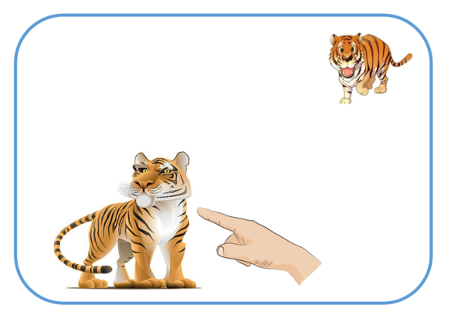
this or that
this
this 这个 表示近；

Slide 5
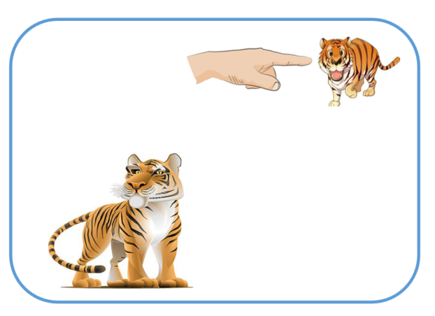
this or that
that
that 那个表示远；

Slide 6
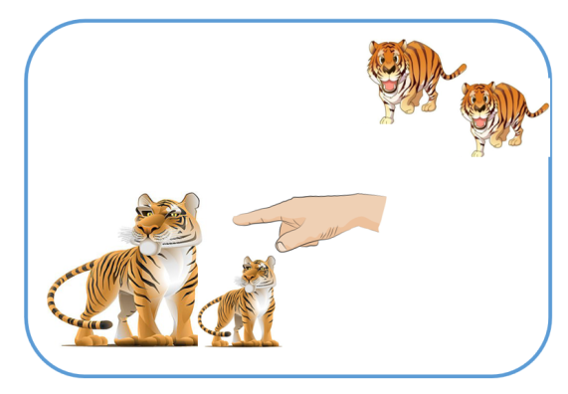
these or those
these
these 这些 表示近；

Slide 7
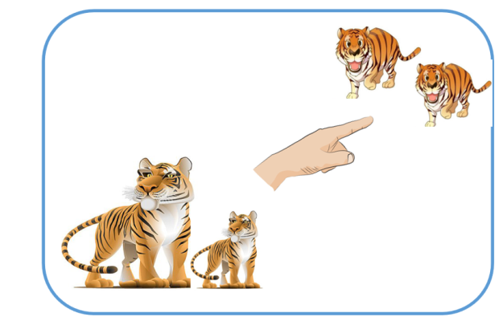
these or those
those
those 那些 表示远；

Slide 8
this和these都是指向近处
this数量上是等于1
these数量上大于1

Slide 9
that和those都是指向远处
that数量上是等于1
those数量上大于1

Slide 10
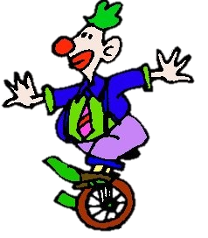
this or that
these or those

Slide 11
This
_______ is my blue cap.
this
that
these
those

Slide 12
That
_______ is my white T-shirt.
this
that
these
those

Slide 13
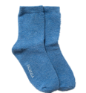
These
_______ are my blue socks.
this
that
these
those

Slide 14
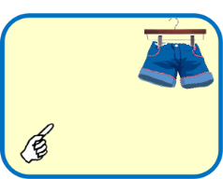
Those
_______ are my blue shorts.
this
that
these
those

Slide 15
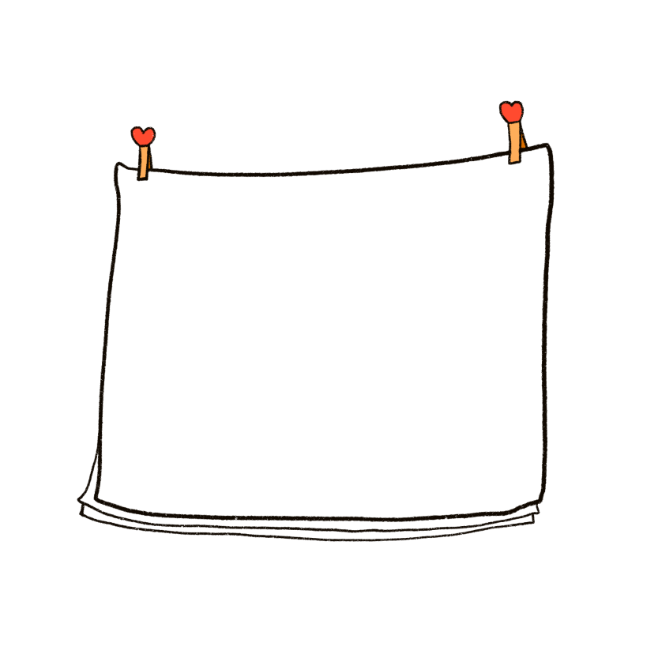
Let's wrap it up
That is
（远）
Those are
单数
复数
小口诀：
this 这个 表示近；
This is
that 那个 表示远；
These are
these 这些 表示近；
（近）
those 那些 表示远；

Slide 16
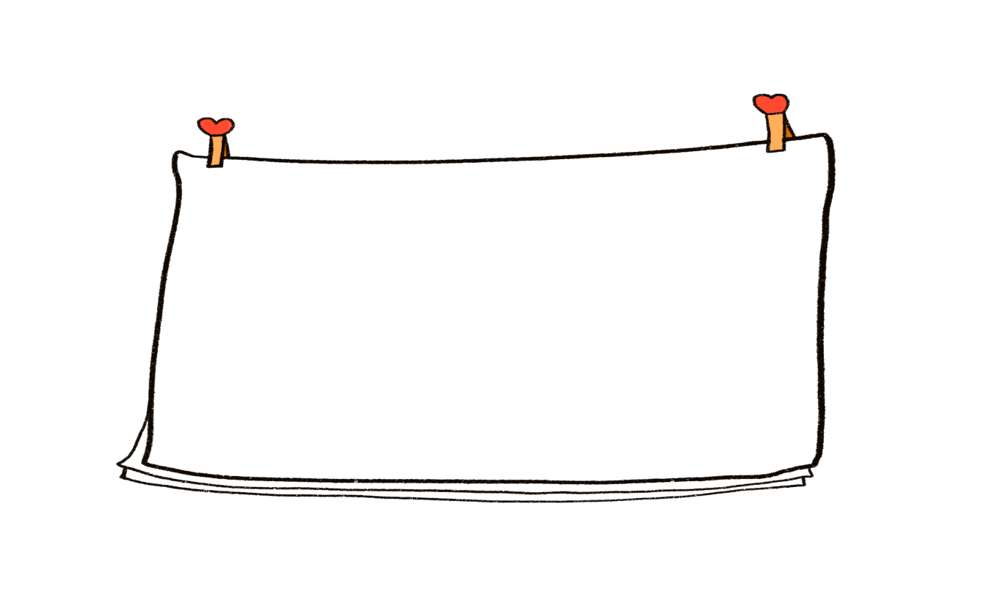
Let's wrap it up
小口诀：
this/that+可数名词单数 + is
these/those＋可数名词复数+are

