Slide 1
Unit 10
You’re supposed to shake hands.
Section A (第1课时)
WWW.PPT818.COM

Slide 2
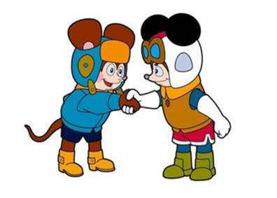
Warming up
What do people do when they meet for the first time?

Slide 3
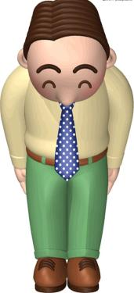
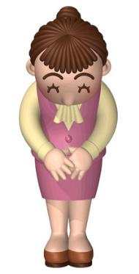

Slide 4
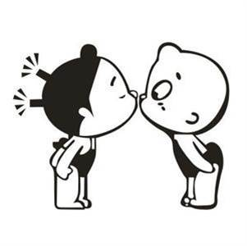

Slide 5
What do people do when they meet for the first time?Match the countries with the customs.
1a
Countries | Customs
1._________Brazil 2._________the United States 3._________Japan 4._________Mexico 5._________Korea | a.bow b.shake hands c.kiss
c
b
a
b
a

Slide 6
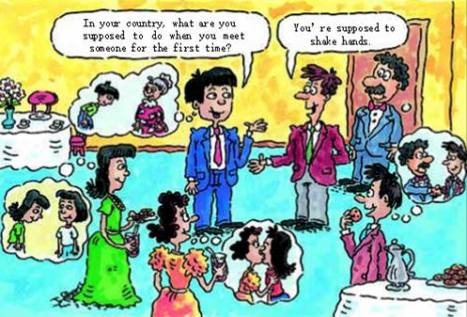

Slide 7
1b
Listen and check your answers in 1a.

Slide 8
1c
Make conversations about what people in different countries do when they meet for the first time. Talk about the countries in 1a or other countries.
A:What are people in Korea supposed to do when they
meet for the first time?
B:They're supposed to bow.How about in the United
States?
A:In the United States, they're expected to shake hands.

Slide 9
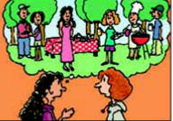
Maria is an exchange student.Last night she had dinner at an American friend’s house.Listen and check (✔) the mistakes Maria made.
2a
Maria's mistakes
________arrived late
________ate the wrong food
________greeted Paul's mother the wrong way
________wore the wrong clothes
✔
✔
✔

Slide 10
2b
Listen again. Fill in the blanks.
1.Maria was supposed to arrive at 7:00,but she___________________.
2.In Maria's country,when you're invited for 7:00,you're expected to
_____________________.
3.When Maria met Paul's mom,she was supposed to
_____________________.
4.Maria should ask what she is supposed to___________________if she
is invited to a party next time.
arrived at 8:00
come later
shake hands
wear

Slide 11
2c
Role-play a conversation between Maria and Dan. Use the information in 2a and 2b.
Dan:How was the dinner at Paul's house last night?
Maria:Well,it was OK,but I made some mistakes.I was
supposed to arrive at 7:00,but...

Slide 12
2d
Role-play the conversation.
Katie:How was the welcome party for foreign students last night?
John:Great!I made some new friends.But a funny thing happened.
Katie:What?
John:I met a Japanese boy called Sato,and as soon as I held out
my hand,he bowed.
Katie:That's how people in Japan are expected to greet each
other.It's impolite if you don't bow.
John:I didn't know that.So I just stood there with my hand
out.Finally,I returned the bow.

Slide 13
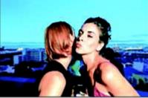
Katie:I remember when I first met Marie last
year,I did the same thing.I held out
my hand and to my surprise,she kissed
me on both sides of my face!
John:I wouldn't mind that!
Katie:Very funny.Later I found out French
people are supposed to kiss when they
see each other.

Slide 14
Language Points
1.In your country,what are you supposed to do when you meet someone for the first time?在你们国家，当你初次与某人见面时你应该做什么？（教材第73页）
be supposed to 意为“应该”，后接动词原形，相当于should 或 ought to,用来表示劝告、建议、义务、责任等。其否定形式为be not supposed to,意为“不应该”。
e.g.:We are supposed to be here at six.
Everyone is supposed to wear a seat belt in the car.
Children are not supposed to play soccer in the street.

Slide 15
2.In the United States,they’re expected to shake hands.在美国，他们应该握手。（教材第73页）
（1）be expected to do sth.意为“（某人）被期望做某事；应该做某事”，此处相当于be supposed to do sth。
e.g.:You’re expected to get good grades this term.
（2）expect及物动词，意为“期望；预料；期待”，后可接名词、代词、动词不定式或从句。其常用结构：expect to do sth. 意为“期待做某事”；expect sb. to do sth.意为“期待某人做某事”。
e.g.:I expect a letter from my family.
She expected to come back next week.
I expected you to do your duty.
I expected that I’ll back on Sunday.

Slide 16
3. He greeted Paul’s mother the wrong way. 他问候保罗母亲的方式不对。（教 材第74页）
（1）greet及物动词，意为“和……打招呼；迎接”，相当于say hello to sb.， 后接名词或代词作宾语。
e.g.:We greeted her by saying “Good morning”.
（2）the wrong way意为“以错误的方式，错误地”，相当于in the wrong way。当way 构成的短语表示“用……方式/方法”时，常加介词in。如果way前有this,that或the等词时，in 可以省略，但是如果位于句首，in 则不可省略。
e.g.:You understood him in the wrong way.

Slide 17
4.I held out my hand and to my surprise,she kissed me on both sides of my face!我伸出手（想要握手），可令我吃惊的是，她亲吻了我的两颊！（教材第74页）
to one’s surprise意为“使/让某人吃惊的是”。其中surprise用作名词，意为“惊奇，诧异”。
e.g.:To my surprise,she got a perfect score on the English exam.
I have a surprise for you.

Slide 18
【拓展】①in surprise惊奇地
e.g.:Rose looked at her mother in surprise.
②be surprised at...对……感到吃惊
e.g.:We are very surprised at the news.
③be surprised to do sth.做某事令人感到惊讶
e.g.:I was surprised to see you here.

Slide 19
Exercise
一、根据句意及首字母提示补全单词。
1.Students are supposed to g__________ their teachers when classes begin.
2.I guess hugs and k__________ are only used between close friends.
3.There are different c__________ in different countries.
4.People in Japan are supposed to b__________ when they meet for the first time.
reet
isses
ustoms
ow

Slide 20
二、根据汉语意思完成句子。
1.当你遇到一个陌生人的时候，你应该怎么做？
What__________you__________to do when you
meet a stranger?
2.他这次没有犯错误。
He didn't__________ __________ __________ this
time.
3.我一到北京就给你打电话。
I will call you __________ __________ __________ I
arrive in Beijing.
4.他以错误的方式和玛丽的妈妈打招呼。
He greeted Mary's mother__________ __________
__________.
are
supposed
make
any
mistakes
as
soon
as
the
wrong
way

Slide 21
Homework
1.Listen and read after the tape at home.
2.Read and recite 2d.

Slide 22
Thank you!

