Slide 1
Unit 2 Topic 3
Whose cap is this?
Section C
WWW.PPT818.COM

Slide 2
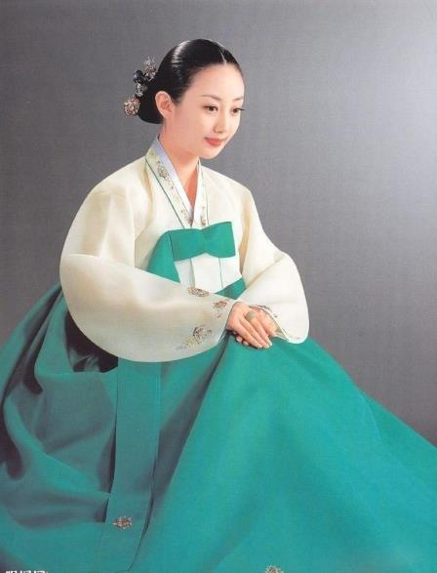
What does she look like?

Slide 3
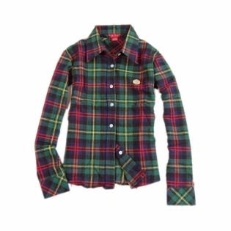
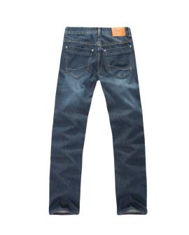
clothes
I’m going to put on some clean clothes.

Slide 4
new
These books are new.
old
Why do you keep this old
book?

Slide 5
class
mate
They are my new classmates.

Slide 6
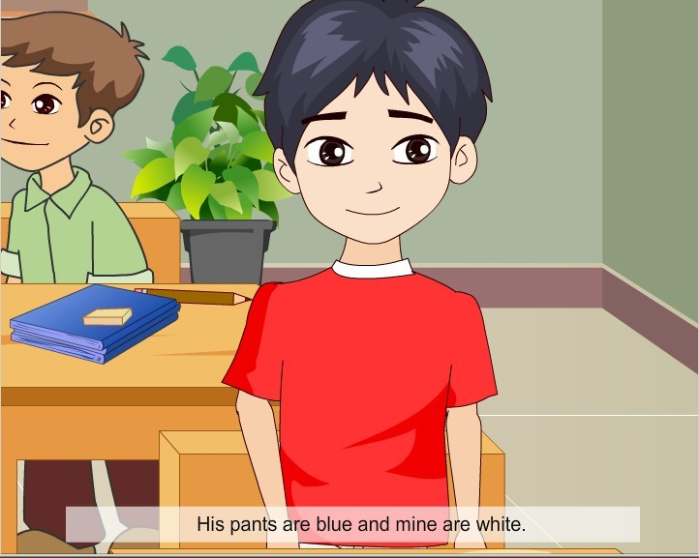
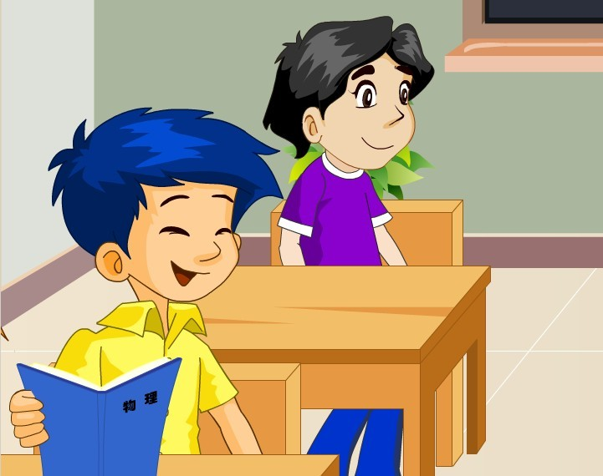
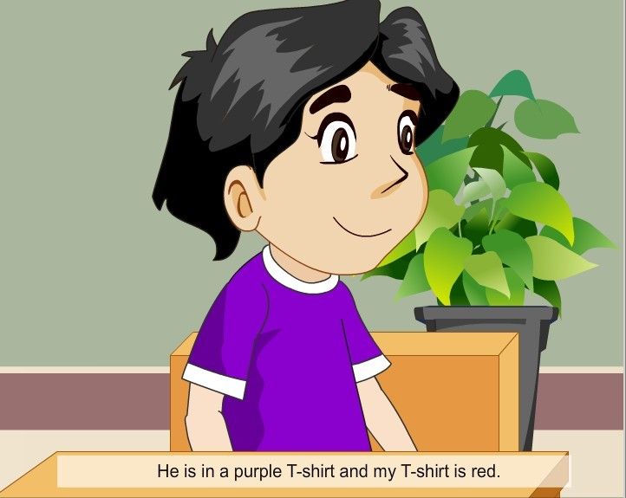
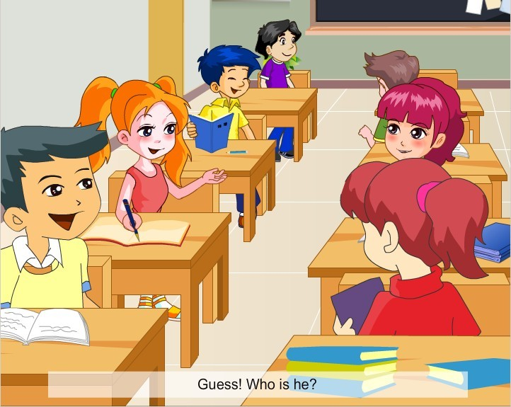
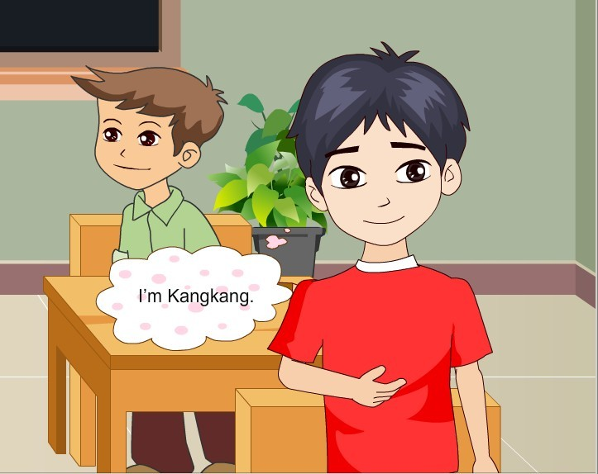
1a
Read and understand

Slide 7
Read 1a again and mark True (T) or False (F).
(1) Kangkang’s new classmate comes from China. ( )
(2) They don’t have the same looks. ( )
(3) They are in different clothes. ( )
(4) Kangkang’s pants are yellow. ( )
(5) Kangkang’s classmate’s shoes are black. ( )
F
F
T
F
T

Slide 8
1b Work alone
Read 1a again and complete the table. Then color the picture.
Person Clothes Color | Kangkang | Kangkang’s classmate
T-shirt
Pants
Shoes
red
purple
white
blue
blue
black

Slide 9
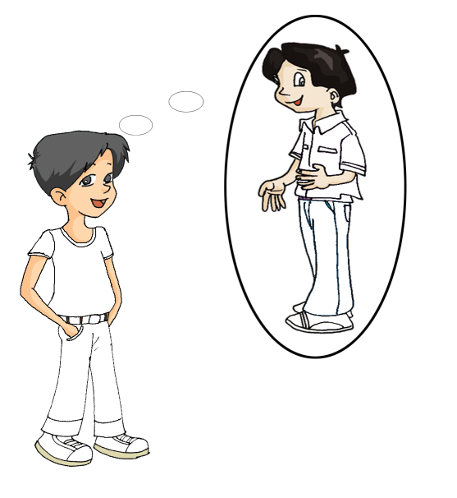
Color the picture.

Slide 10
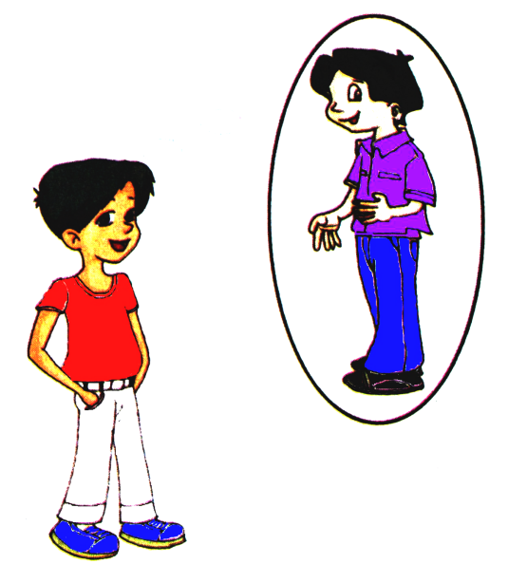

Slide 11
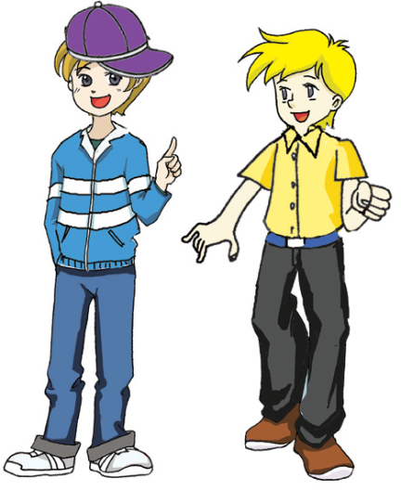
Look at the picture of Tom and Dick carefully and write a passage to describe them.
You can begin like this:
I have two new classmates.
They are Tom and Dick…

Slide 12
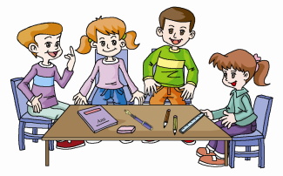
3
Group work
Work in groups. Mix your things together and find out
the owners. You may use the following expression:
1. Is this \ Are these ...?
Yes. It’s \ They are ... \ No. It’s \ They are ...
2. Whose ... is this \ are these?
I think it’s \ they’re ...

Slide 13
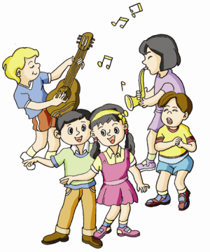
Let’s chant.
If you’re wearing RED,
Put your hands on your head.
If you’re wearing BLACK,
Touch your back.
If you’re wearing BROWN,
Touch the ground.
If you’re wearing BLUE,
Put your hands on your shoe.
If you’re wearing YELLOW,
Wave to your fellow.

Slide 14
Read the sounds.

Slide 15
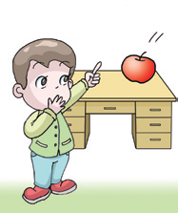
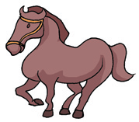
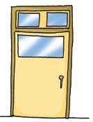
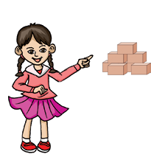
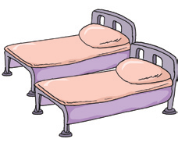
/hɔ:s/ ____ /dɔ:/_____ /ðæt/_____
horse
door
that
those
/θ ri:/______ /bedz/_____ /ðəuz/______
three
beds

Slide 16
Read and find the same sound.
1. mom are not what car box
/a:/
2. yours strong tall short long
/ɔ:/
3. thank think three mouth
/θ/
4. this they that these those
/ð/

Slide 17
summary
学习音标。
/a:/ /ɔ:/ /θ/ / ð / /ts/ /dz/
2. 学习描述新朋友。
His/Her name is ...
He/She comes from ...
He/She has … and…
He/She is in...
His/Her pants/shoes/T-shirt are ...

Slide 18
Homework
★Write a passage to introduce your classmates.
★Prepare color pens and paper.
★ Collect some pictures of your favorite actors.
Notes:
18

