Slide 1
Section A Period 2 (2c—3c)
Unit 8
How do you make a banana milk shake?
WWW.PPT818.COM

Slide 2
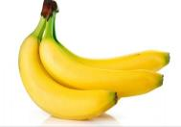
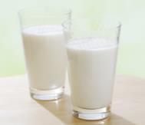
Practice
A: How many bananas are there in the picture?
B: There are three. / Three.
A: How much milk are there in the picture?
B: There are two cups. / Two cups.

Slide 3
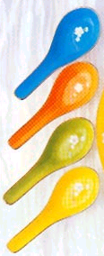
A: How many watermelons do you eat every day?
B: I eat four. / Four.
A: How much honey do you drink every day?
B: I drink four spoons. / Four spoons.

Slide 4
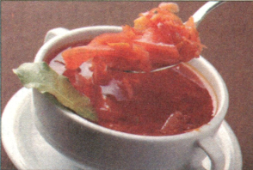
2d role-play the conversation
Anna: Sam, I want to make Russian(俄罗斯的） soup for
a party on Saturday. Can you tell me how?
Sam: Sure. First, buy some beef, one cabbage,
four carrots, three potatoes, five
tomatoes and one onion. Then, cut up the
vegetables.
Anna: What’s next?
Sam: Next, put the beef, carrots and potatoes into a pot（锅） and add（添加） some water. After that, cook them for 30 minutes. Then, add the cabbage, tomatoes and onion and cook for another 10 minutes.
Anna: Ok, that’s it?
Sam: No, one more thing(还有一件事）. Finally, don’t forget to add some salt（盐）.

Slide 5
Reading
Read the conversation and fill in the chart below.
2d
one | cabbage
one
three
four
five
some
onion, cabbage
potatoes
carrots
tomatoes
beef

Slide 6
基数词+计量单位+of +不可数名词
如：
a piece of paper
two spoons of honey
a cup of yogurt
a bar of chocolate

Slide 7
3a
Circle the correct word in each question.
1. How (much/many) bananas do we need?
2. How (much/many) sugar do we need?
3. How (much/many) bread do we need?
4. How (much/many) tomatoes do we need?
5. How (much/many) cheese do we need?

Slide 8
Task
Make popcorn.

Slide 9
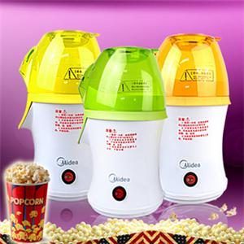
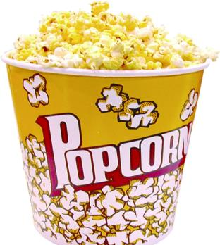
popcorn machines
popcorn

Slide 10
3b
Complete the questions and answers. Then match them.
____ 1. __________ do you make popcorn?
____ 2. __________ corn do we need?
____ 3. __________ do we do next?
____ 4. __________ salt（盐） do we need?
____ 5. Now can we eat it?
How
How much
What
How much

Slide 11
a. Half a cup.
b. _________, put the corn into the popcorn machine（机器）.
c. Yes, we can!
d. Next, _________ on the machine. _________, add （添加）the salt.
e. Just one spoon.
First
turn
Finally

Slide 12
____ 1. __________ do you make popcorn?
____ 2. __________ corn do we need?
____ 3. __________ do we do next?
____ 4. __________ salt do we need?
____ 5. Now can we eat it?
b
a
d
e
c
a. Half a cup.
b. _________, put the corn into the popcorn machine.
c. Yes, we can!
d. Next, _________ on the machine. _________, add the salt.
e. Just one spoon.

Slide 13
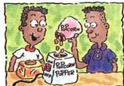
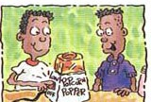
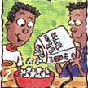
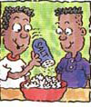
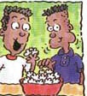
How to make popcorn?
First, put the popcorn into the
popcorn machine.
Next, turn on the machine.
Next, pour the popcorn into a bowl.
Then, add some salt to the popcorn.
Finally, you can eat it.

Slide 14
3c
Write how to do one of the following things. Then tell your partner how to do it.
First, dig a hole. Then …
Do you know how to plant a tree?
plant a tree
make beef noodles
wash clothes
take out a book from
the library

Slide 15
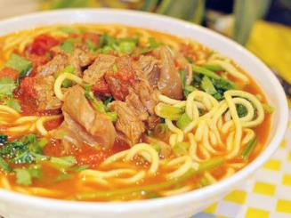
Can you make noodles with beef and tomatoes?
First,
Next,
Then,
Finally,
cut up the tomatoes and beef
cook the noodles
add the tomatoes and beef to the noodles.
add salt to the noodles

Slide 16
根据句意，用括号中所给单词的适当形式填空
1. How many _________ (teacher) are there in
your school?
2. I have three _________( watch ).
3. There are some ________( orange) on the
table.
teachers
watches
oranges

Slide 17
tomatoes
chicken
4. I like _________(tomato) and _______
(chicken).
5. How much _______( honey ) do we need?
6. Tina, let’s _________(make) fruit salad.
7. Oh, it ______(rain) last night, so the ground
is wet now.
honey
make
rained

Slide 18
stronger
8. Tom is a little _________ ( strong) than Mike.
9. I think English is ________________ (important) than any other subject.
10. My mother ________( take) the bus to work every day.
more important
takes

Slide 19
--- What’s in the icebox?
--- A few ____, but little ____.
A. apple, milk B. apple, milks
C. apples, milks D. apples, milk
答案：D

Slide 20
I'm so hungry. Please give me ______ to eat.
A. three bread
B. three pieces of bread
C. three pieces of breads
D. three piece of bread

Slide 21
Thank you for your listening!

