Slide 1
Module 9 Great inventions
Unit 2 Will books be replaced by
the internet?
WWW.PPT818.COM

Slide 2
目
录
CONTENTS
1 学习目标 2 新课导入
3 新课讲解 4 当堂小练
5 课堂小结 6 课后作业
7

Slide 3

学习目标
Ability objective
1.To get information from the passage about the great inventions.
2.To master the passive voice of the simple future tense.
Moral objective
1. To arose Ss’ interest in learning about the great inventions.
2. To encourage Ss to be proud of our great country.
3. To develop the ability to cooperate with others.

Slide 4
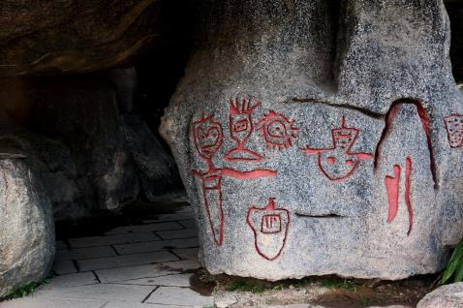
新课导入
Warming up
思 考
What did people use to remember something long long ago?

Slide 5
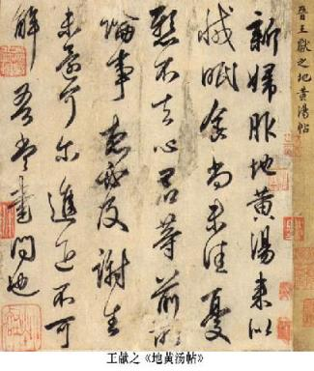
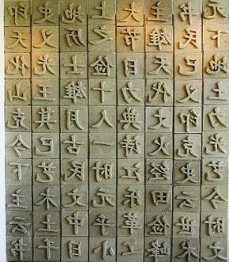
新课导入
What was invented in China during the Sui and Tang Dynasties?
Where did people start to write on about 2,000 years ago?

Slide 6
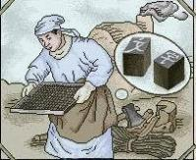
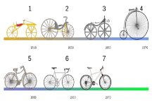
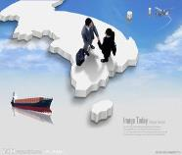

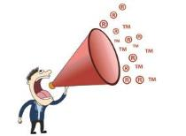
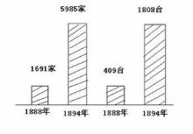
新课导入
printing n. 印刷
development n. 进步
trade n. 买卖；交易
introduction n.
引进；采用；推行
amount n.
量，数量
spread v. 扩展；蔓延；传播

Slide 7

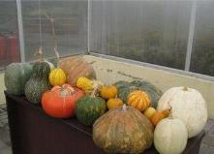
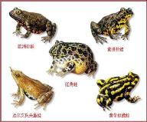
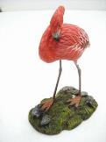

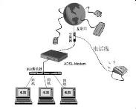
新课导入
store v. 存储；储藏
varied adj. 各种各样的
form n. 种类；类型
connection n. 电话连接；计算机网络连接
single adj.
仅一个的；单个的
direction n.
方向

Slide 8

新课讲解
1
Work in pairs. Read the title of the passage in Activity2.
Discuss and make a list of the advantages of books and the Internet.

Slide 9
新课讲解
2
Read the passage and match the main ideas with the paragraphs.
The world before printed books
The world after the invention of printing
Life with paper and printing
Technology and books
The future of books
2
3
1
4
5

Slide 10

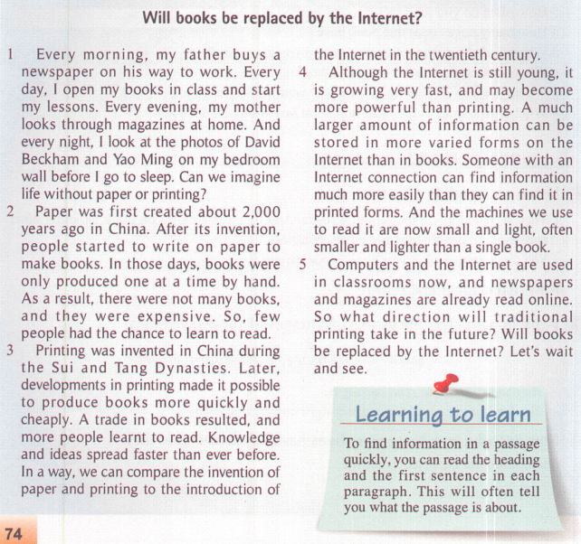
新课讲解

Slide 11
新课讲解
Now complete the time table.
In the 1960s
The Internet was invented for the army to use.
In the 1970s
Scientists and businesspeople wanted to use the Internet to send and receive messages.

Slide 12
新课讲解
In 1991
The World Wide Web was invented.
More and more people started to use the Internet to send various types of files.
In the 1990s
Today
The Web has hundreds of millions of users. It has changed the way people live, work and play.

Slide 13
新课讲解
Para.1 Life with paper and printing
Every morning, father, newspaper, on his way to...
Every day, open, in class, start my lessons
Every evening, mother, look through
Every night, look at, photos of…on...wall before...
Can, imagine, without…printing?
Para.2 Paper
Paper, first created, 2,000
After its invention, people, started to…, make books
In those days, books, produced, one at a time by…
As a result, there not.., expensive
So, few…, had the chance to…learn to…

Slide 14
新课讲解
Para.3 Printing
Printing, invented, in, during….Dynasties
Later, developments in printing made….to produce…..more….
A trade in…resulted, more people learnt …
Knowledge and ideas, spread….than ever before
In a way, compare the invention of…..to….the introduction of...twentieth
Para.4 Internet
Although, still young, is growing…, may …. more powerful than…
A much lager amount of…, can be…, in more varied forms, Internet, than,
in books
Someone with…, can find information, more… that they can find it….
And the machines, read, small, light, often…than a single book

Slide 15
新课讲解
Para.5 The future of books
Computers, Internet, classrooms, newspapers, magazines, already, read online
So, what direction will traditional printing take?
Will … be replaced by….?
Let’s….

Slide 16
新课讲解
Complete the table.
3
When | What
About 2,000 years ago | paper created
During the Sui and Tang Dynasties
Today
printing invented
computers and the Internet used in classrooms, and newspapers and magazines are read online

Slide 17
新课讲解
4
Complete the passage with the words in the box.
developments direction introduction powerful replace spread trade
Books were expensive because they were made by hand, but (1) _____________ in printing made it cheaper and faster to make books. A(n) (2) _________ in books resulted, and knowledge (3) ________ more quickly than ever before. The (4) ___________ of the Internet has changed the world in a similar way, and the Internet is much more (5) _________. With more and more people using the Internet, the (6) _________ that traditional printing will take in the future is uncertain, and computers may (7) _______ books one day.
developments
trade
spread
introduction
powerful
direction
replace

Slide 18
新课讲解
5
Read the sentences and notice how we give reasons and results.
Books were only produced one at a time by hand. As a result, there were not many books.
2 Because there were not many books, few people learnt to read.
3 These machines are smaller and lighter than books, so they are easy to carry.

Slide 19
新课讲解
as a result
as a result是一个固定短语，意为“因此，结果”，表示后面句子与前面句子所表达的内容构成因果关系，前面是因后面是果。它与so可以进行转换。如：
Tony got up late that morning. As a result, he didn’t catch the first bus.
= Tony got up late that morning, so he
didn’t catch the first bus.

Slide 20
新课讲解
because
because是连词，引导原因状语从句。because +句子可以直接回答以why开头的特殊疑问句。
e.g. I like playing basketball because it’s fun.
—Why is Lily crying?
—Because she can’t find her cat.

Slide 21
新课讲解
Write full sentences with the notes in Activity 3.
6
About 2,000 years ago, paper was first
created.
Printing was invented during the Sui and
Tang Dynasties.
Today, the Internet is growing very fast.
Computers and the Internet are used in
classroom now, and newspapers and
magazines are read online.

Slide 22
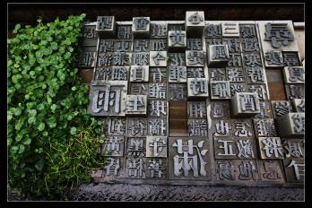
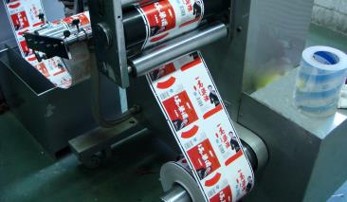
新课讲解
7
Write a passage about traditional printing and its future.
Use the sentences you have written in Activity 5 and 6 to help you.

Slide 23
新课讲解
Possible answer
It’s hard to imagine a world without printing because we have so many printed things now, for example, menus, comics and schoolbooks. Paper was first created about 2,000 year ago,
but books weren’t printed at that time. They were written by hand, so few books were produced, and as a result, few people could read.
Printing was invented during the Sui and Tang Dynasties. After printing developed, books became cheaper, so more people learnt how to read. Today, the Internet is growing
very fast. A much larger amount of information can be stored in more varied forms on the Internet than in book. As a result,
in the future, the Internet will probably be more important than printing.

Slide 24
新课讲解
Language points 1
Point
look through浏览
look through还有“审核，查看”的意思。
eg：My mother looks through the bills before
she goes to bed every night.
我妈妈每晚睡觉前要查看账单。
与look搭配的短语：
look forward to盼望
look into调查；审查 look for寻找
look up查阅；仰视 look out 当心

Slide 25
新课讲解
Language points 2
Point
as a result结果是，因此
as a result表示结果，可作为插入语，一般 用逗号与其后面的部分隔开。但as a result of...意为“由于……的原因”，其后接名词 或名词性短语。
  eg：He was late as a result of the heavy snow.
  由于大雪他迟到了。

Slide 26
新课讲解
Language points 3
Point
compare/kəm'peə(r)/ v. 比较
难点
compare...to...与compare... with...
compare...with... 把……和……作比较，表示比较两者的异同之处 | We carefully compared the first report with the second.我们仔细比较了第一份报告和第二份报告。
compare...to... 把……比作……，表示比喻 | The ancient Egyptians compared the rising of the sun to the beginning of life.古埃及人把日出比作生命的开始。

Slide 27
新课讲解
Language points 4
Point
introduction /ˌɪntrə'dʌkʃn/ n. 介绍，采用，引进
introduce v.介绍
introduce sth. to sb.向某人介绍某物
introduction n.介绍
eg：The factory is developing very quickly with the
introduction of new technology.
随着新技术的引进，这个工厂正快速地发展。

Slide 28
新课讲解
Language points 5
Point
an amount of 大量的
an amount of, a (huge, large) amount of, amounts of，其后通常接不可数名词。 the amount of意为“……的量”，其后通常接不可数名词，谓语动词用单数。
eg：There is a large amount of work for us
to do. 有大量的工作在等我们去做。

Slide 29
新课讲解
Language points 6
Point
direction /dɪ'rekʃn/ n. 方向
eg：I heard news about the matter from all
directions.我听到了来自四面八方的关于这
件事的消息。
in all directions(＝in every direction)四面八方；
in the direction of 向……方向

Slide 30
当堂小练
一、根据句意及首字母或汉语提示完成句子
amount
1.It is best to cook vegetables in a small （数量）
of water.
2.Uncle Wang is a successful businessman. He does a lot of
__________ （买卖；交易） with many foreigners.
3.Li Na got a gold medal again. The good news________
（传播） all over the country.
4.I want to have a trip to Qingdao. Can you help me book
a_______（单人的） room on the Internet？
5.When the policemen arrived，all the thieves ran in all
____________（方向）.
trade
spread
single
directions

Slide 31
当堂小练
二、单项选择
6.（中考·南宁）The subway in Nanning in a few years.
A. will completed B. will be completed
C. was completed D. completes
7.The floods have many thousands of deaths.
A. result in B. resulted in
C. result from D. resulted from
8.Take the medicine three times a day and three pills .
A. at a time B. at one time
C. at time D. at all times
B
B
A

Slide 32
当堂小练
9.We have got a large help from people.
A. plenty of B. amount of
C. number of D. bit of
10.I went to the park on yesterday afternoon.
A. one's way home
B. my way home
C. one's way to home
D.my way to home
B
B

