Slide 1
Unit 3 Health
What’s wrong with you?
WWW.PPT818.COM

Slide 2
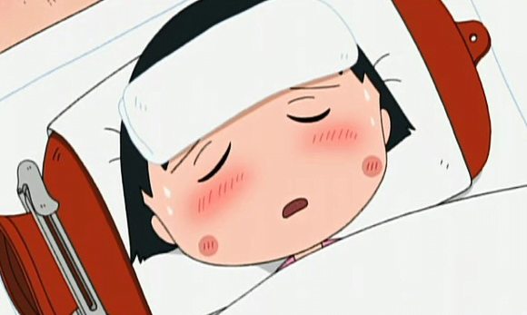
sad

Slide 3
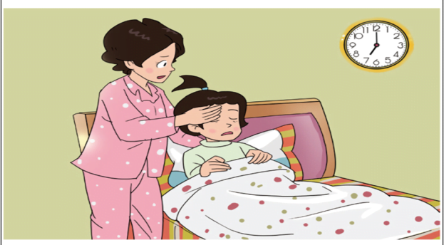
Watch and answer
What’s wrong with Wang Hong?
（怎么啦？）

Slide 4
1.读课文划出Wanghong的病症
2.试着读出这些病症的句子.
3.尝试完整地读出课文.

Slide 5
Listen and fill
I don’t ____ well, mum. I feel cold.
feel
fever
Oh, you have a _____.

Slide 6
fever
I have a _____.
fever
I have a _____.
Let's go and see the doctor.

Slide 7
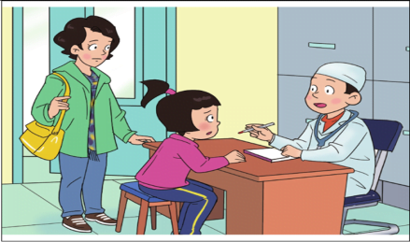
Read and find
Doctor 是怎么询问王红病情的？
What’s wrong with you?
Do you have a headache?
I cough and feel cold.
Yes,I have a very bad headache.

Slide 8
Read in roles.
What’s wrong with you?
I cough and feel cold.
Do you have a headache?
Yes. I have a very bad headache.
Let me have a look.

Slide 9
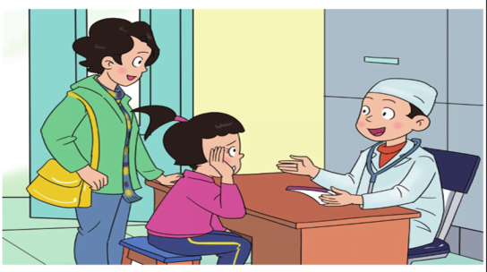
Read and find
Doctor 诊断的结果是什么？
You have a bad cold.

Slide 10
Read and find
At last, what did the doctor say?
Don’t worry. Take some medicine. You’ll be all right.

Slide 11
medicine

Slide 12
Listen and repeat

Slide 14
cough
have a fever
have a headache
feel cold
A: What’s wrong with you?
B: I __________.
A: Go and see the doctor, please.
B: OK.

Slide 15
cough
have a fever
have a headache
feel cold
A: What’s wrong with you?
B: I __________.
A: Go and see the doctor, please.
B: OK.

Slide 18
Do you _____?
Yes, I do/No, I don't.

Slide 19
Homework:
听音跟读L1，读熟签字。
L1新单词3，重点句型1，汉。
预习L2。
一起作业网。

