Slide 1
Module 7 My past life
Unit 2 I was born in Quincy.
WWW.PPT818.COM

Slide 2
Yesterday Once More
Warming-up
When I was young I’d listen to the radio
Waiting for my favorite songs
When they played I’d sing along It made me smile
Those were such happy times and not so long ago
How I wondered where they’d gone
But they’re back again just like a long lost friend
All the songs I love so well Every sha-la-la every wo-wo still shines
Every shing-a-ling-a-ling that they’re starting to sing so fine

Slide 3
Warming-up
Free talk: My past life
1. Where were you born?
2. When were you born?
3. What was the name of your first teacher?
4. What was he/she like?
5. Who were your first friends?
6. Were they naughty?

Slide 4
Pre-reading
New words and expressions
bathroom
n. 浴室
n. 卧室
n. 花园
起居室
adj. 东面的；东部的 n. 东方
n. 海岸
bedroom
garden
living room
east
coast

Slide 5
Pre-reading
New words and expressions
ago
adv. 以前
n. 商店
电影院
adj. 厌烦的；厌倦的
n. 总统
adj. 舒适的；舒服的
n. 湖
adj. 最近过去的；紧接现在的
store
movie theater
bored
president
comfortable
lake
last

Slide 6
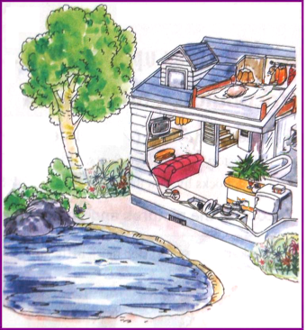
Pre-reading
Look at the picture and answer the questions.
1. What can you see in the picture?
2. How many rooms are there on the first floor?
3. Where is the bedroom?

Slide 7
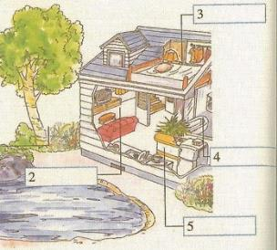
Pre-reading
1 Label the picture with the words from the box.
bathroom bedroom garden kitchen living room
bedroom
garden
1
bathroom
living room
kitchen

Slide 8
While-reading
2 Read the passage and choose the correct answer.
(1) Betty was/wasn’t happy when she was in Quincy.
(2) Two/Three US presidents were born in Quincy.
(3) There were/weren’t pictures on Betty’s bedroom walls.
(4) There was/wasn’t a small lake in the garden.
(5) Betty was/wasn’t in Quincy last year.
√
√
√
√
√

Slide 9
While-reading
Read Paragraph 1 carefully and choose the best answer.
1. Where is Quincy?
A. On the west coast of America.
B. On the east coast of America.
C. On the south coast of America.
2. There are _______ movie theaters in Quincy.
A. two B. three C. four
3. How was the writer’s feeling in Quincy?
A. Sad. B. Bored. C. Happy.

Slide 10
While-reading
Read Paragraph 2 carefully and mark T (true) or F(false).
1. Two presidents of the US were born in Quincy. ( )
2. You can’t visit their old family house if you’re in Quincy. ( )
T
F

Slide 11
While-reading
Read Paragraph 3 and 4 carefully and answer the questions.
1. Was Betty’s house big and comfortable?
2. What was on Betty’s bedroom walls?
3. What was behind the house?
Yes, it was.
There were pictures of her favorite movie stars.
There was a big garden with lots of trees and there was
a small lake with fish in it.

Slide 12
While-reading
Read Paragraph 5 carefully and answer the questions.
1. Were there a few children in Quincy?
2. When was the writer’s last time in Quincy?
No, there were not.
In 2010.

Slide 13
While-reading
3 Answer the questions.
Were there a lot of things to do?
Was anyone famous born there?
Who were they?
What was Betty’s house like?
Yes, there were.
Yes. Two presidents of the US were born there.
John Adams and John Quincy Adams.
It was big and comfortable.

Slide 14
While-reading
How many rooms were there?
What was Betty’s bedroom like?
Was there a garden?
Were there lots of children?
Six.
On her bedroom walls there were pictures of her favorite movie stars.
Yes, there was.
Yes, there were.

Slide 15
Post-reading
Fill in the blanks and then retell the passage.
Betty
born in Quincy, a town 1.________________________, twelve years ago, happy
on the east coast of America
Two presidents
born in Quincy, visiting 2.__________________
their old family houses
Betty’s house
in the house: one big living room, one kitchen, 3._________________________
behind the house: 4.____________ and a small lake
one bathroom and three bedrooms
a big garden
Last home in the US
looking forward to 5.________________
seeing friends again

Slide 16
Post-reading
4 Complete the passage with the correct form of the words from the box.
ago bored coast comfortable east president store
Quincy is a small town on the (1) _______, in the _______ of the US. John Adams and his son John Quincy Adams, both (3) ____________ of the US, were born in Quincy. Betty was also born there twelve years (4) ______.
coast
east
presidents
ago

Slide 17
Post-reading
ago bored coast comfortable east president store
She lived in a (5) _____________ house with several rooms. There were lots to do there, with many (6) ________, so Betty wasn’t (7) _________.
comfortable
stores
bored

Slide 18
Post-reading
Language points
1. There were lots of things to do in Quincy…
这里的to do是动词不定式用作定语，置后修饰名词things，意思是“要做的事情”。
注意：
动词如果是不及物动词，后面的介词不能省略。如：
I have nothing to worry about.
我没有什么可担心的事。

Slide 19
Post-reading
2. There was a big living room with a TV, a kitchen, a bathroom and three bedrooms.
with是介词，意思是“带有”，如：
I forgot to take money with me. 我忘了带钱。
另外，with还有其他用法，请看：
(1) 与……一道，跟……一起，如：
Would you like to go swimming with us?
你愿意和我们一起去游泳吗？

Slide 20
Post-reading
(2) 用……，以……，如：
We listen with ears.
我们用耳朵听。
(3) 在……下，如：
With his help, I do it better and better.
在他的帮助下，我做得越来越好。

Slide 21
Post-reading
3. I am looking forward to seeing my friends again.
这句中为什么用seeing而不用see？
这里有个很重要的短语look forward to，意思是“渴望，渴求”，其中to是介词， 所以后面要用动词-ing形式。
如：
We look forward to going to Beijing.
我们非常希望去北京。

Slide 22
Post-reading
5 Look at the sentences.
There were lots of things to do in Quincy. There were many stores…
There were lots of things to do in Quincy with many stores…

Slide 23
Post-reading
Now join the sentences using “with”.
1. There was a big living room. There was a TV.
There was a big living room with a TV.
2. There was a big garden. There were lots of trees.
3. There was a small lake. There were fish in it.
There was a big garden with lots of trees.
There was a small lake with fish in it.

Slide 24
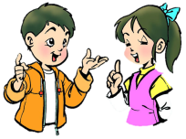
Post-reading
6 Answer the questions.
When and where were you born?
(1) When and where were you born?
(2) Were you happy there?
(3) What was your house like?
(4) What was your bedroom like?
(5) Were there lots of things to do?
I was born in…

Slide 25
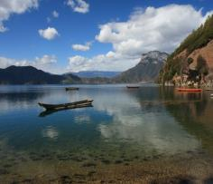
Post-reading
7 Describe your past life with the answers from
Activity 6.
写作思路点拨——介绍某人过去的生活
【思路点拨】
Step | Idea | Expression
1 | 开篇点题，介绍姓名 | My name is…
2 | 介绍出生时间、地点、家乡房子、生活感受等等 | I was born in… There were many things to do… We were happy to play… I lived in a house with … My bedroom was…
3 | 结尾：总结自己过去的生活 | This is my past life. It was simple but happy.

Slide 26
Post-reading
Sample writing
My name is Lucy. I was born in London in 1995. I was very happy there. My house was small but comfortable. My bedroom had blue walls with lots of posters. There were lots of things to do in London. It has many shops, parks and museums.

Slide 27
Post-reading
Test
I. 根据汉语和提示，完成句子。
bathroom
bedroom
1. This is our _________ (浴室) and that is a _________ (卧室).
2. This is a _______ (花园) and that is a ___________ (客厅).
3. This is a _____ (湖) and that is a river.
4. This is a new _____ (商店) and that is an old
_______________________ (电影院).
garden
living room
lake
store
movie theater/theatre

Slide 28
Post-reading
5. I lived at the ______ ______ (东部海岸) ten years _____ (以前).
6. Did their _________ (总统) live there _____ (最近过去的) year?
7. Was your bed ____________ (舒服的), Lingling?
8. The man was _______ (厌倦的) at the computer games.
east coast
ago
president
last
comfortable
bored

Slide 29
Post-reading
II. 翻译下列短语。
1. 一个有许多树的大花园
2. 参观他的故居
3. 期待着见到你
4. 在美国东海岸
5. 返回我的家乡
a big garden with many trees
visit his old family house
look forward to seeing you
on the east coast of America
go back to my hometown

Slide 30
Post-reading
III. 用be动词的适当形式填空。 1. I _____ a middle school student and I am 15 years old. 2. —What _____ your father? —He is a doctor. 3. —Where _____ you born? —In Hong Kong. 4. Linda _____ my first friend in my primary school when I
was young. 5. Tony with his father _____ at home last night.
am
is
were
was
was

Slide 31
Summary
Betty was born in ________.
Quincy
on the east coast of America
Quincy
there were lots of things to do
two presidents of US were born in Quincy
big and comfortable
Our house
Behind the house, there was a big garden with lots of trees. There was a lake with fish in it.

Slide 32
Homework
1. Read the passage fluently and correctly.
2. Preview Unit 3.

Slide 33
Goodbye!

