Slide 1
Unit 6
When was it invented?
Section B (第1课时)
WWW.PPT818.COM

Slide 2
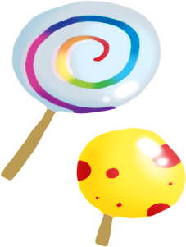
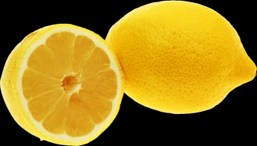
How can the food taste?

Slide 3
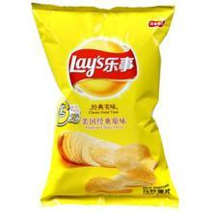
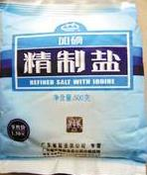

Slide 4
The words in the box describe how food can taste.
Write them under the correct pictures. Some pictures have more than one word.
1a
crispy
sweet
sweet
salty
sweet crispy
salty sour
salty
sour

Slide 5
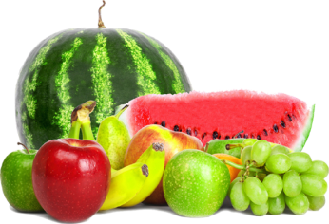
1b
Write the name of a different food after each word.
French fries
sweet______________ crispy_________________
salty_______________ sour__________________
banana
pizza
lemon

Slide 6
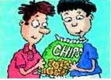
1c
Listen and circle T for true or F for false.
1. Potato chips were invented by mistake. T F
2. They were invented in 1863. T F
3. The customer thought the potatoes were not thin
enough. T F
4. The customer said they were not salty enough. T F
5. George wanted to make the customer happy. T F
6.The customer was happy in the end. T F

Slide 7
1d
Listen again. Complete the sentences.
The History of Potato Chips
Do you know how potato chips were invented ? Potato chips ______________
by a cook called George Crum. They were invented in ______. George Crum cut the potatoes really, really _____ and then cooked them for a long time until they were ______. Finally he put lots of salt on them so they were __________.
were invented
1853
thin
crispy
really salty

Slide 8
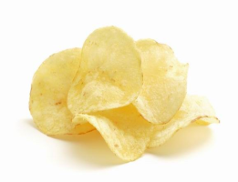
Make a conversation about the invention of potato chips. Use the information in 1c and 1d.
1e
A: Did you know potato chips were invented by
mistake?
B: Wow, I didn't know that. Who invented them?
A: ...

Slide 9
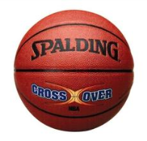
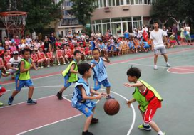
Do you like basketball? Do you watch basketball games? How much do you know about this sport?
Discuss the sport with your partner and share your ideas with the class.
2a

Slide 10
Read the passage quickly.What is the main idea of each paragraph?
2b
MIND-MAPPING
Changing the information you read into a mind map may help you remember it more easily.
Do You Know When Basketball
Was Invented?
Basketball is a much-loved and active sport that is enjoyed by many for fun and exercise. It is over 100 years old and is played by more than 100 million people in over 200 countries. It is believed that the first basketball game in history was played on December 21,1891.Then in 1936 in Berlin,it became an event at the Olympics.
Basketball was invented by a Canadian doctor named James Naismith, who was born in 1861.

Slide 11
When he was a college teacher,he was asked to think of a game that could be played in the winter. Dr. Naismith created a game to be played inside on a hard floor. Dr. Naismith divided the men in his class into two teams and taught them to play his new game. Players on the same team must work together to get the ball in the other team's basket. At the same time, they need to stop the competing team from getting the ball into their own basket.
Today, the popularity of basketball has risen around the world, with many young people dreaming of becoming famous players. In China, you can sometimes see people playing basketball in parks, schools and even factories. Basketball has not only become a popular sport to play, but it has also become a popular sport to watch.

Slide 12
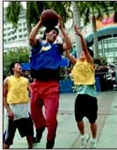
Although America’s NBA games are the most
famous, the CBA games are becoming more popular in China. The number of foreign players, including Chinese players, in the NBA has increased.There are also more and more foreign players in the CBA. Many young people look up to these basketball heroes and want to become like them. These stars encourage young people to work hard to achieve their dreams.

Slide 13
Complete the mind map with the information in the passage. What else can you add to the mind map?
2c
Game
Development
James Naismith
invented by ______________
first game on _______________________
became Olympic event in
_______ in the year
_______
most famous games:______
popular games in China:______
played inside on a hard ______
_____ teams
get __________ into other team's _________
floor
December 21,1891
two
Popularity
the ball
Berlin
1936
basket
NBA
more than 100 million
played by ___________________ people
over ______ countries
CBA
200

Slide 14
Use the mind map to summarize what you and your partner remember about the development of basketball. Use the following questions to help you.
2d
1. Who invented basketball and how is it played?
2. When was the first basketball game in history played?
3. Why were the Berlin Olympics important for basketball?
4. What are the professional basketball groups in America
and China?
5. How popular is basketball?

Slide 15
2e
What do you think of famous basketball players? Make a list of good and difficult things about being a famous basketball player.

Slide 16
Language Points
1.salty
salty 形容词，意为“咸的；含盐的”，是由名词salt“盐，食盐”加-y构成的形容词。
e.g.:He didn't have much for dinner because the dishes were too salty.
【拓展】“名词+-y”构成形容词：在英语中，很多名词后加-y可以构成形容词，如：cloud—cloudy,wind——windy,rain——rainy,sleep——sleepy等。

Slide 17
2.Potato chips were invented by mistake.薯条是无意中被发明的。（教材第45页）
by mistake介词短语，意为“无意中，错误地”。mistake还可以构成如下常用短语：make a mistake/make mistakes犯错误；mistake ...for...把……错认成……
e.g.:I took your pen by mistake.
Don't make mistakes any more.
I mistook Lily for Lucy yesterday.

Slide 18
3.The customer was happy in the end.最后顾客高兴了。（教材第45页）
in the end意为“最后；最终”，相当于at last,finally,其后不接of短语，本短语强调虽然最初……，最后还是产生了一个……的结果。
e.g.:They were out of danger in the end.他们最后脱险了。
He did one experiment after another and in the end he succeeded.他做了一个又一个实验，最后成功了。
【拓展】①at the end of... 后接地点名词时，表示“在……尽头”；后接表示时间的名词时，表示“在……结束时”。

Slide 19
e.g.:Walk along the street and you'll find the hospital at the end of the street.
We'll have an English test at the end of this week.
②by the end of... 意为“在……以前，到……为止”，常用于将来时态和过去完成时态的句子中。
e.g.:We will finish the work by the end of this year.

Slide 20
Exercise
一、单项选择。
( )1.The woman went into the men’s toilet _____ mistake.
A.for B.at C.of D.by
( )2.This heated ice-cream scoops were invented by a man ____ Lanmon.
A.was called B.called C.to call D.is called
( )3.—The soup tastes ______.
—Maybe I added too much ______ just now.
A.salt;salt B.salty;salty C.salt;salty D.salty;salt
( )4.Did the police catch the thief _____?
A.on the end B.by the end C.at the end D.in the end
D
B
D
D

Slide 21
二、根据汉语提示填空。
1.He met his parents on Christmas in the ________ (结束).
2.We must make the ________ (顾客) happy.
3.The child took the medicine as sweet by ________ (错误).
4.The milk is ________ (酸的). You must throw it away.
5.The potato chips ________ (卖) well at that time.
end
customers
mistake
sour
sold

Slide 22
Homework
Read the article and recite key words.

Slide 23
Thank you!

