Slide 1
Unit 2 Topic 2
What does she look like?
Section C
WWW.PPT818.COM

Slide 2
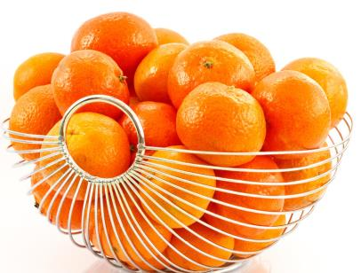
What’s this?
What color is it?
What are these?
What color are they?

Slide 3
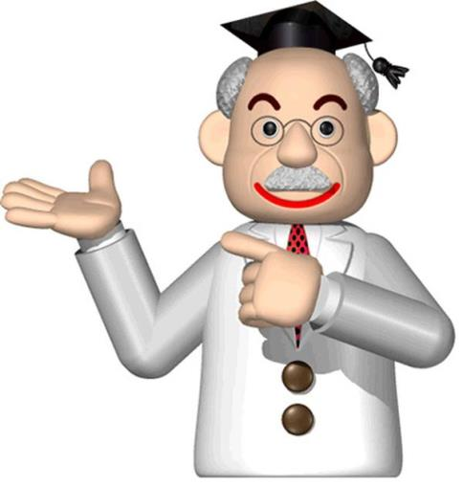
What does he look like?

Slide 4
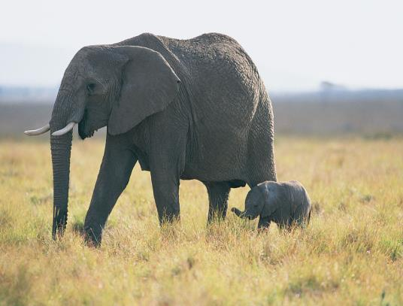
look at
photo
strong
Look at the photo.
The elephent is strong.

Slide 5
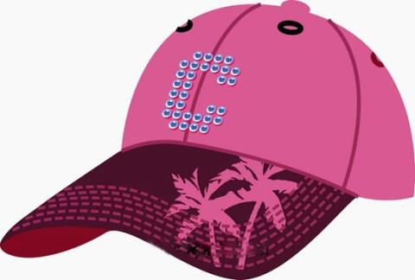
cap
This is a pink cap.

Slide 6
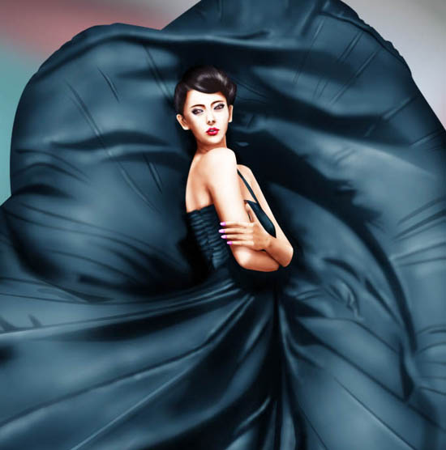
dress
Her dress is very beautiful.

Slide 7
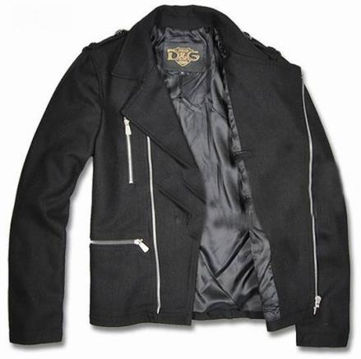
coat
The coat is black.

Slide 8
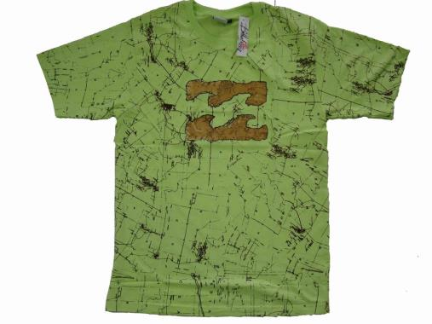
T-shirt
I want to buy a blue T-shirt.

Slide 9
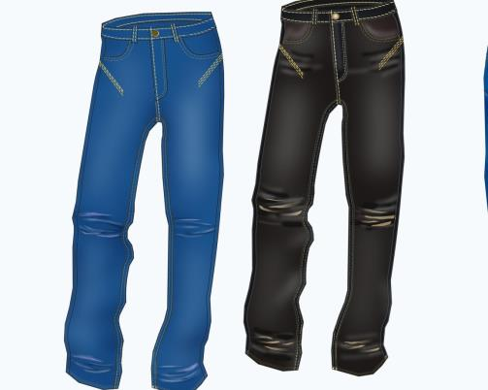
pants
Are these pants yours?

Slide 10
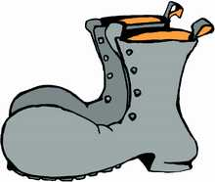
shoes
Whose shoes are these?

Slide 11
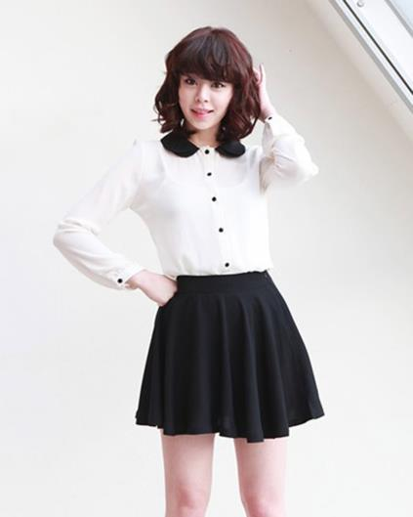
skirt
She often wears a black skirt.

Slide 12
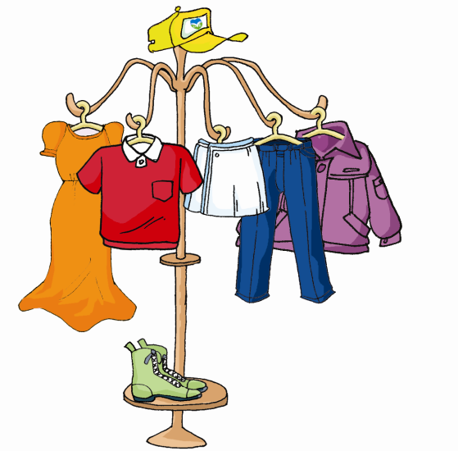
1a
Look, listen and say
cap
coat
T-shirt
skirt
dress
pants
shoes

Slide 13
Match the two columns according to 1a.
T-shirt green
cap red
shoes yellow
连连看！

Slide 14
1b
Pair work
Talk about your own clothes with your partner,
using What color is/are ...?
A: What color is/are your…
B: It’s\They’re … How about yours?
A: My …
A: I have (a) new …
B: What color …

Slide 15
1c
Pair work
Fill in the blanks. Then practice the conversations
with your partner.
is
A: What color ______ this skirt?
B: It’s _______.
A: What color ______ that ______?
B: It’s ________.
yellow
is
dress
orange

Slide 16
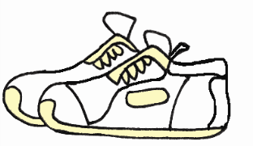
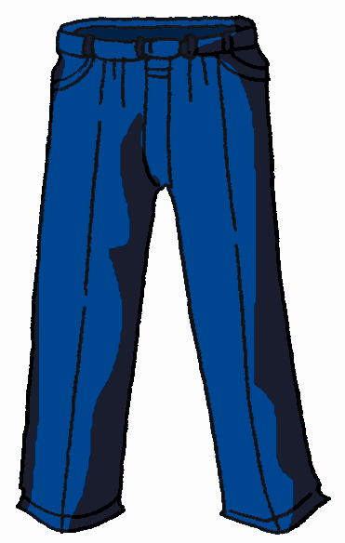
are
A: What color ______ these shoes?
B: They’re ______.
A: What color ______ those ______?
B: They’re ______.
white
are
pants
blue

Slide 17
in + 颜色：穿着......颜色的衣服。
in: 意为“穿着，戴着”。
The girl in white is Alice.
The girl in a white skirt is Alice.

Slide 18
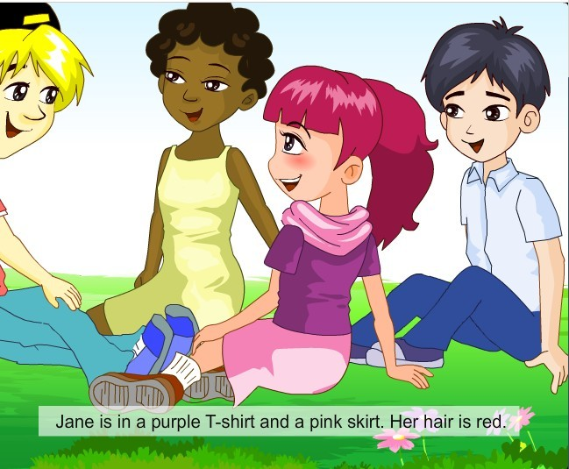
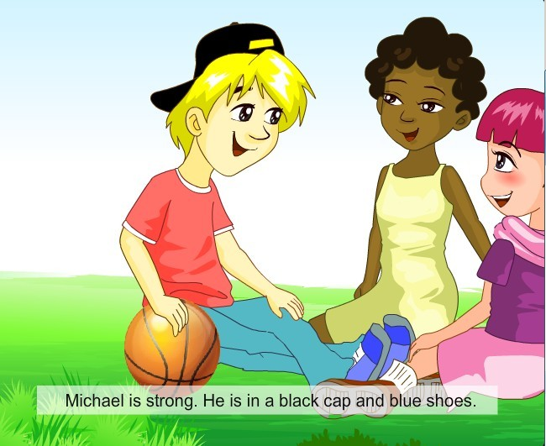
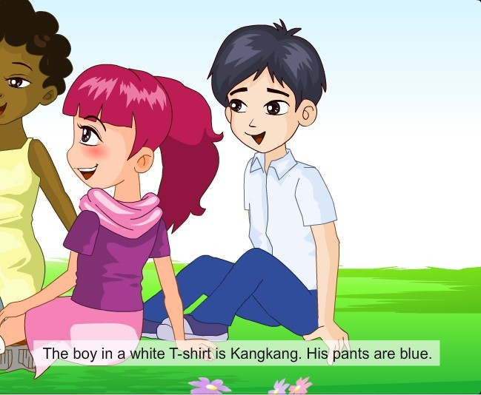
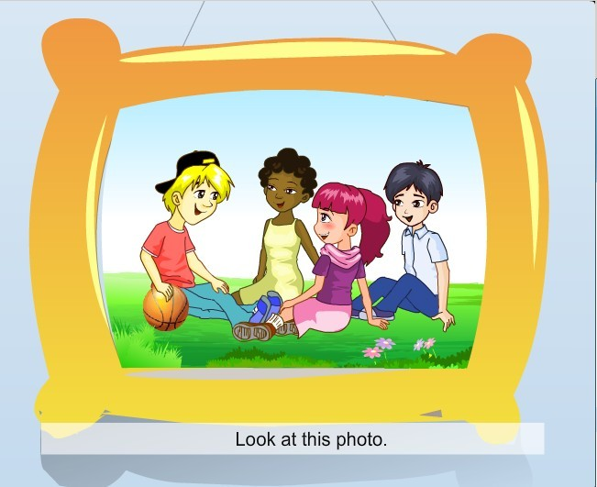
Read and understand

Slide 19
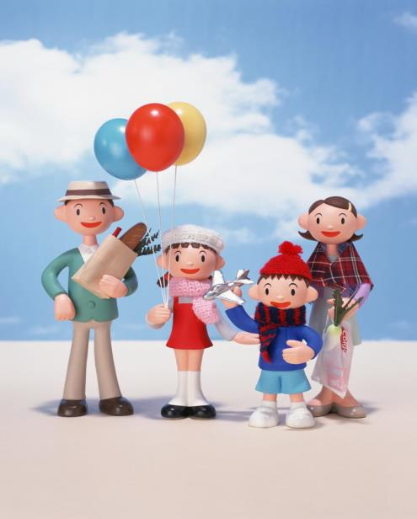
Can you describe “ The Happy Family” according to 2?

Slide 20
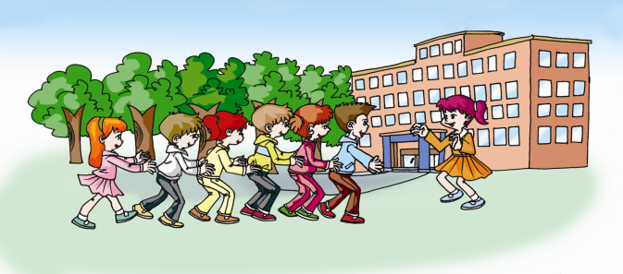
3
Work alone
Listen to the conversations and find the children in the
picture. Then listen again and complete the sentences.
Peter
Lisa
Bill
Helen
pink
The girl in _____ is Helen.
The girl in _______ is Lisa.
3. The boy in a _____ coat is Bill.
4. The boy in _______ pants is Peter.
yellow
white
brown

Slide 21
4
Class activity
Let’s chant.

Slide 22
Summary
学习表示服装的名词：
cap coat T-shirt skirt
dress shoes pants
学习描述人的着装：
The girl is in white.
She is in a white coat.
Tom is in black pants.

Slide 23
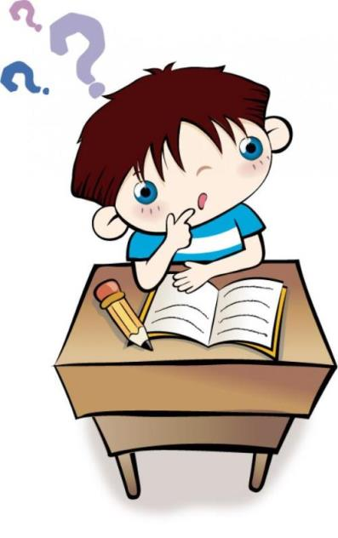
Homework
Try to write a short passage
to describe your families.

