Slide 1
Unit 2 In Beijing
Lesson 9 The Palace Museum
WWW.PPT818.COM

Slide 2
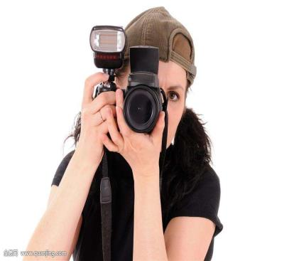
Warming up
What’s the girl doing in the picture?
She is taking pictures.

Slide 3
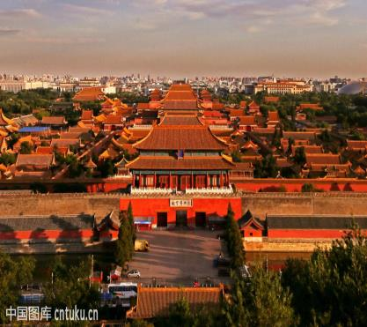
Warming up
What can we see in the picture?
We can see the Palace Museum.

Slide 4
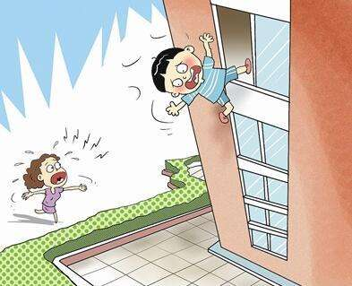
Warming up
What happens to the boy?
He is falling.

Slide 5
Leading in
What building can you see?
1
2
What is it like?
3
How old is it?

Slide 6
Presentation
Read
1
What colour is the Palace Museum?
2
How old is it?

Slide 7
Presentation
听录音回答问题。
1
What can Jenny see?
She sees somes chairs and tables.
Can Danny take pictures in the Palace Museum?
2
Yes, he can.
Listen
3
What happens to Danny at last?
He hurts his tail.

Slide 8
see chairs and tables
Consolidation and extension
take pictures
找一找
stand beside…
hurt his tail

Slide 9
Summing up
1
How old is…?
重点句型
2
It’s about…years old.
3
May I…?
4
Be careful!

Slide 10
Evaluation
内容 | 学生A | 学生B | 学生C | 学生D
积极发言
乐于合作
完成情况

Slide 11
Homework
用英语讲述今天所见的事情（使用课本句式）
完成Let’s do it!中的练习

Slide 12
参考答案
1.Six hundred years old.
2.Red and yellow.
3.Yes, there are.
4.Yes, he does.
5.Yes, he does.

Slide 13
谢 谢

