Slide 1
Module 5 Museum
Unit 2 If you ever go to London, make sure you visit the Science Museum.
WWW.PPT818.COM

Slide 2
Warm up
Free Talk
When we visit a museum, what should we pay attention to?

Slide 3
Museum rules
Lead in
Turn off your mobile phones.
Please keep quiet in the museum.
Stay a safe distance (距离) from the works of art.
Move carefully and slowly in the museum.
No touching. Touching can spoil (损坏) the exhibits (展品).

Slide 4
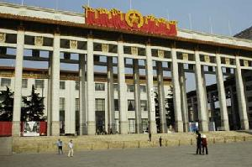
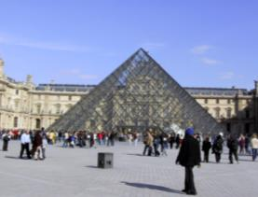
Have you ever been to a museum?
The National Museum of China
Musee du Louvre (卢浮宫)

Slide 5
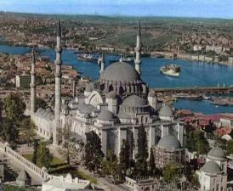
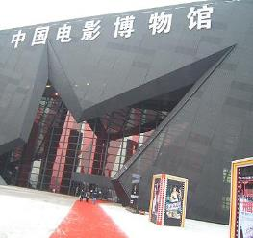
Hagia Sophia
(圣索非亚大教堂)
China National Film Museum (中国电影博物馆)

Slide 6
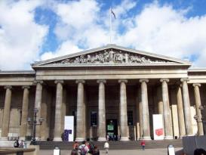
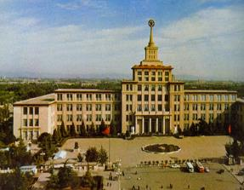
The British Museum（大英博物馆）
the Military Museum of the Chinese People’s Revolution

Slide 7
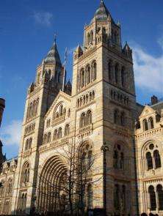
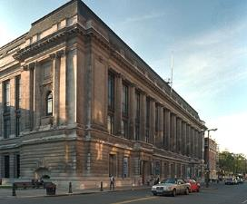
Look at some pictures of the Science Museum in London and talk about them.
Before reading

Slide 8
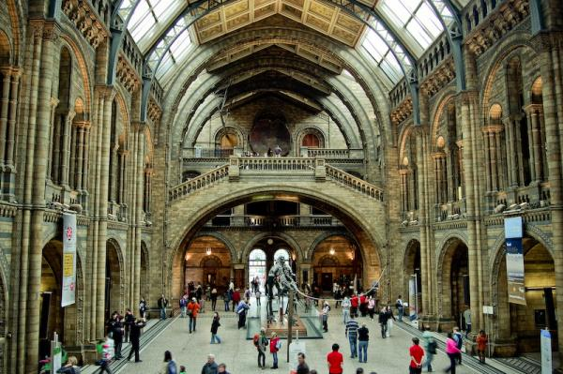

Slide 9
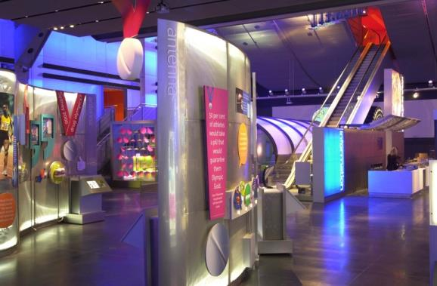

Slide 10
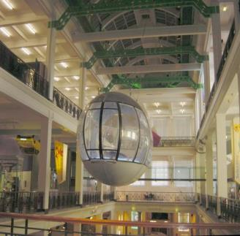
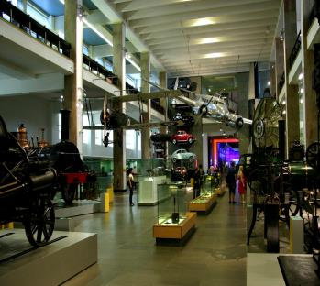

Slide 11
Fast reading
Listen to the passage and answer question. Then read the passage and check your answer.
How is the Science Museum different from
other museums?
It’s noisy and you can touch things / do experiments.

Slide 12
Look at the pictures in page 36 and tell differences between the two museum
quiet
noisy
No shouting
talk loudly
No tuching
can see and do
many things
No photos
No entry

Slide 13
Read each paragraph and find out the main idea ( find out some sentences).
Careful reading
But the Science Museum is different
Para 1
Para 2
Para 3
Para 4
Para 5
The rooms on the second and third floors
The Launchpad on the third floor is the most popular room.
The fourth and fifth floors.
The Science Museum is interesting for people of all ages.

Slide 14
Read and complete the table
 | Tony’s favourite museum | Your favourite museum
Name
Place
Favourite room
Opening hours
Price
The Science Museum
London
The Launchpad
10 am – 6 pm
free

Slide 15
After reading
Answer the questions.
1. What can you learn about in the rooms on the second and third floors?
2. What allows you to see inside your body?
You can learn about communications and the environment, as well as maths, physics and chemistry.
X-rays allow you to see inside your body.

Slide 16
3. What can you do in the Lauchpad?
4. What can you learn about on the fourth and fifth floors?
You can do physics experiments and find out how people travel into space and back again.
You can learn about medicine in the past.

Slide 17
Practice
Complete the passage with it, they and there.
There are a lot of museums in London, and one of the most popular is the British Museum. Thousands of people visit (1) ____ every year. (2) ______ they can see lots interesting things from different times and places.
it
There

Slide 18
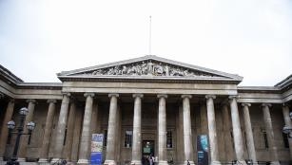
The British Museum is very traditional. Visitors must not make a noise, and (3) _____ must not touch anything or take photos. Entry to the museum is free, so people can visit (4) _____ as often as they like.
they
it

Slide 19
Write a passage about your favorite museum.
Say if there are many museums in your town.
There are only two museums in my town …
Say which one is your favorite.
My favorite museum is …

Slide 20
Say why it is special or unusual.
It’s special because …
Say what you can see and do there.
I can see …

Slide 21
Language points
1. People talk about what they can see and
do here, ...
句中的what they can see and do there 是介词about 的宾语从句。
I’m interested in what you are saying.
Your success will largely depend on what you do and how you do it.

Slide 22
2. …, and there are some very noisy machines as well.
as well 表示“也；还有”，通常位于句尾。如：
I write my own songs and play the guitar as well.
我唱自己谱曲的歌，也弹吉他。
He is eloquent and humorous as well.
他口才好又幽默。

Slide 23
知识链接
also, too, as well, either 这些词均含“也”之意。
also比too正式一些，语气较重，只用于肯定句，一般紧靠动词。
too语气较轻，多用于口语，在肯定句中使用，通常位于句末，或作为插入语放在句中。
as well一般不用否定句，通常放在句末，强调时可放在句中。
either用于否定句，放在句末，之前加逗号。

Slide 24
用 too，also，either 或 as well 填空
1) I’ll go to see the film, _______.
2) If you don’t come here, I shouldn’t,
______.
3) I, _____ , will help him.
4) Jack can speak Chinese, and his brother
can ______ speak Chinese.
5) He knows Chinese ________．
too
either
too
also
as well

Slide 25
3. You can learn about communications and the environment as well as maths, …
as well as表示“(除...之外)也, 既...又”
The child is lively as well as healthy.
这孩子既健康又活泼。
I have to feed the animals as well as look after the children.
我不但要照顾 孩子们，而且还要喂那些马。
Tom as well as his parents is going to London.
汤姆和他的父母要去伦敦。

Slide 26
注意：
1) 在A as well as B 的结构里，语意的重点在 A，不在 B。as well as和 not only … but also …同义，但前者的语意重点和后者的语意重点恰好颠倒。
He can speak Spanish as well as English．
= He can not only speak English but also Spanish.
他不但会说英语，而且会讲西班牙语 。
2)当 as well as 连接两个成分作主语时, 其后的谓语通常要与前面一个主语保持一致。

Slide 27
知识链接
as well as可视为as … as结构与well的搭配，其意为“与……一样好”，在否定句中可用not so well as代替not as well as。如：
He speaks English as well as she．
他说英语说得跟她一样好。
He doesn’t play so well as his sister.
他演奏的水平不及他姐姐。

Slide 28
1) Helen learns to dance three times a week. Now she dances ______ Anita does.
A. so good as B. as well as
C. as good as D. so well as
2) Don’t believe the advertisement. That kind of camera is ____ it says. You can try _____ kind. A. as good as; the other
B. not as good as; another C. as well as; the other
D. not as well as; another
B
B

Slide 29
4. …, you can find out how people dig coal from the ground …
find out 发现；找出来
You should tell her, because she'll find out sooner or later.
你还是告诉她吧，因为她迟早会发觉的。
Did you ever find out why he left his last job?
你弄清他辞去最近这份工作的原因吗?

Slide 30
知识链接
辨析find, find out, look for & discover
look for是find之前的寻找过程。
What are you looking for? 你在找什么？
find是look for的结果。
They finally found a way. 他们终于找到了办法。
find out指经过一番努力最终找到。
I found out she was wrong. 我发现她错了。

Slide 31
discover意为“发现”，表示“偶然”或“经过努力”发现客观存在的事物、真理或错误，即指发现原来客观存在但不为人所知的事物，也可表示发现已为人所知的事物的新的性质或用途。
Columbus discovered America in 1492．
哥伦布1492年发现了美洲。
We soon discovered the truth．
我们很快就弄清了真相。

Slide 32
用 find, find out, look for 或 discover填空。
1) I lost my necklace last night. I _______ it．
2) Who ____________ America first？
3) Can you ___________ what time the train
leaves？
4) I ___________ my pen everywhere, but I
haven't _________ it.
found
discovered
find out
looked for
found

Slide 33
5. … because there are lots of physics experiments.
experiment n. 实验
The students will have an experiment in the laboratory tomorrow.
学生们明天要在实验室里做实验。
We have just tried an experiment in chemistry.
我们刚才试做了一个化学实验。
Some people learn by experiment.
有些人是从试验中学习 。

Slide 34
知识链接
experiment vi. 尝试；做实验
Some scientists experiment on animals.
有些科学家用动物做试验。
He experimented in painting at home.
他在家中试着作画。
She is experimenting with different typewriters to see which one suits her best.
她正在试用各种不同的打字机，看哪一种最适合。

Slide 35
读句子，根据所给汉语或首字母提示写出单词。
Just now we did an ___________ (实验) in the laboratory.
Professor Li gave us a very useful _______ on how to prepare for the exam. A. advice B. information
C. experience D. suggestion
experiment
D

Slide 36
6. …, and you have to control a kind of truck on wheels …
control v. 操作；操控；控制
She is skillful enough to control the machine now.
现在她已有了足够的技术可以操纵这台机器了。
I couldn't control myself, and I hit him.
我气得不得了，就打了他。

Slide 37
知识链接
control n. 掌控；控制；管制；克制
Don't worry, we have everything under control.
别担心,一切都在我们掌控之中。
The event is not within the control of human power. 这件事是人力无法控制的。
He has no control over his emotion.
他无法抑制自己的情感。

Slide 38
The roof of the house needs repairing. It’s raining now; you’d better get something to ______ rain drops. A. control B. cover C. carry D. catch
Yuki loves wearing strange hats because she wants people to _____ her.
A. believe B. control
C. notice D. visit
D
C

Slide 39
7. If you compare the medicine of the past with the medicine of today, …
compare v. 对照；对比；比较
Compare this with that, and you'll see which is better.
把这个和那个相比,你就会看出哪个好。
compare … with … 把……跟……比较
compare … to … 把……比作……
The teacher compared the poet to a bird.
老师把那诗人比作一只小鸟。

Slide 40
When you visit a museum, you should ________ the instructions and don’t be against them.
A. compare with B. look forward to
C. pay attention to D. try out
--- Why don’t you choose the red tie?
--- For me, it doesn't _______ my shirt very well.
A. fix B. accept C. compare D. match
C
D

Slide 41
8. The museum is free to enter, ...
free 表示“免费的”。如：
Workers enjoy free medical care.
工人享受免费医疗。
Are the drinks free?
这些饮料免费吗?
He got a free ticket to the play.
他得到一张免费票看这出戏。

Slide 42
习惯上用be free to do sth. 表示“自由地去做某事”
You are free to go or to stay.
去还是留, 由你自己决定。
Everyone is free to express himself.
每个人都可以畅所欲言。

Slide 43
知识链接
free作形容词还表示“自由的；畅通的；没有…的；未使用的；空闲的；随意的” The prisoners wish to be free again.
囚犯们希望重获自由。
They like living in a village, free of crowds and noise.
他们喜欢住在乡村里, 远离人群和噪音。
I have only one free evening every week.
我每周只有一个晚上有空。

Slide 44
一、根据提示完成单词。
The ______________ (实验) we did this
morning made me puzzled. 2. I prefer chemistry to __________ (物理学). 3. Plants absorb ________ (能量) from the sun. 4. This is our ________________ (通讯) center. 5. C____________ your answers with those
at the back of the book to see if they are right.
Exercise
experiment
physics
energy
communications
ompare

Slide 45
二、用所给词的适当形式填空。
1. He is free ________ (do) what he likes to do.
2. In most museums, there is no ________ (shout) and ________(run).
3. No one visiting in the Science Museum is allowed __________ (touch) the exhibits.
4. It takes a lot of work _________ (dig) a deep well (井).
5. Tell the _______ (noise) boys to stay away.
to do
shouting
running
to touch
to dig
noisy

Slide 46
三、完成句子。
人们谈论着他们在哪儿能看到什么、能做什么，还有些非常吵闹的机器。 People talk about ______ _____ _____ ______ and do there, and there are some very noisy machines _______ ______.
2. 参观科学博物馆很有趣，并且这也是了解科学的一个方法。 ________ the Science Museum is fun and it’s great way _____ ______ _______ science.
what they can see
as well
Visiting
to learn about

Slide 47
Homework
Write a passage about your favourite museum.

