Slide 1
Art
第二课时
WWW.PPT818.COM

Slide 2
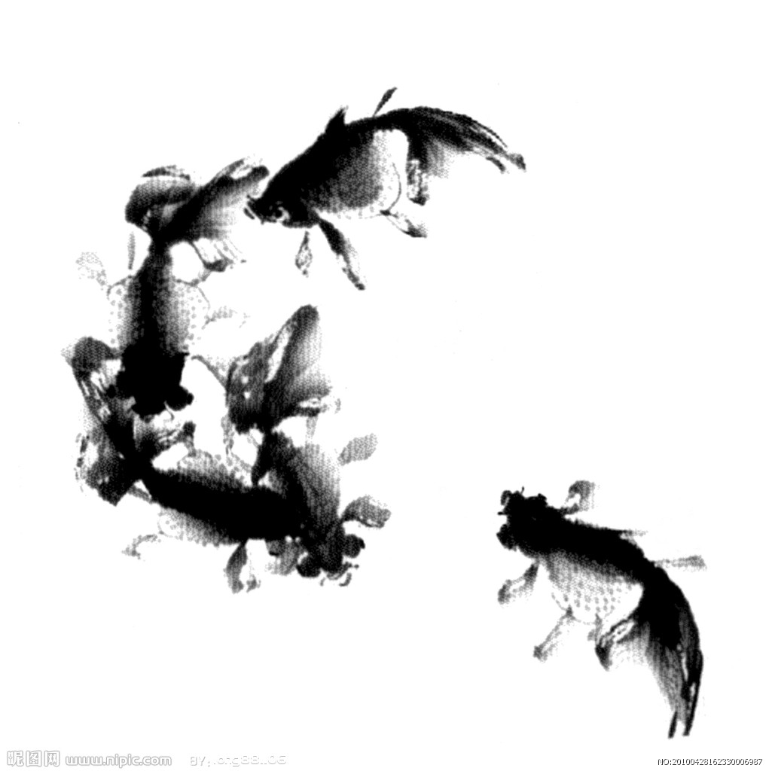
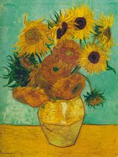
Revision
Which picture do you like?

Slide 3
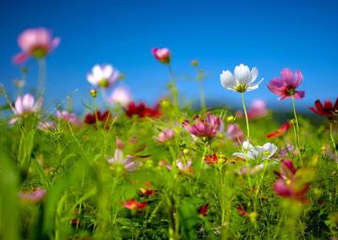
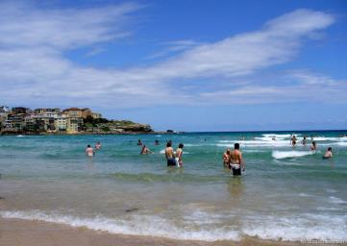
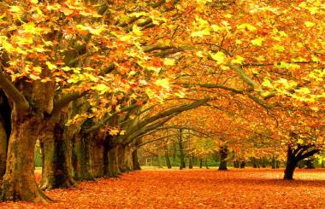
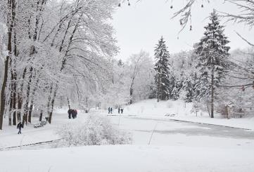
Which
Season
do
you
like
?

Slide 4
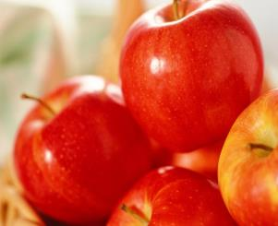
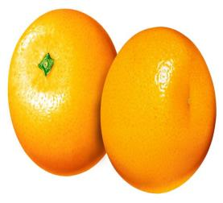
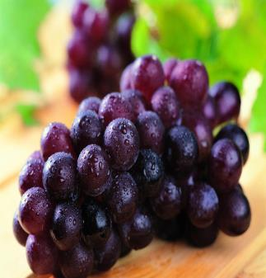
Which fruit do you like?
PPT模板：www.1ppt.com/moban/ PPT素材：www.1ppt.com/sucai/
PPT背景：www.1ppt.com/beijing/ PPT图表：www.1ppt.com/tubiao/
PPT下载：www.1ppt.com/xiazai/ PPT教程： www.1ppt.com/powerpoint/
资料下载：www.1ppt.com/ziliao/ 范文下载：www.1ppt.com/fanwen/
试卷下载：www.1ppt.com/shiti/ 教案下载：www.1ppt.com/jiaoan/
PPT论坛：www.1ppt.cn PPT课件：www.1ppt.com/kejian/
语文课件：www.1ppt.com/kejian/yuwen/ 数学课件：www.1ppt.com/kejian/shuxue/
英语课件：www.1ppt.com/kejian/yingyu/ 美术课件：www.1ppt.com/kejian/meishu/
科学课件：www.1ppt.com/kejian/kexue/ 物理课件：www.1ppt.com/kejian/wuli/
化学课件：www.1ppt.com/kejian/huaxue/ 生物课件：www.1ppt.com/kejian/shengwu/
地理课件：www.1ppt.com/kejian/dili/ 历史课件：www.1ppt.com/kejian/lishi/

Slide 5
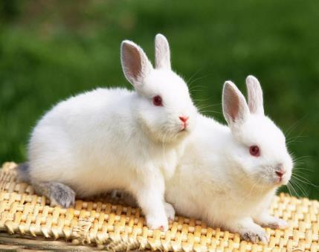
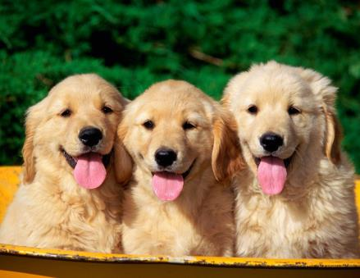
Which animal do you like?

Slide 6
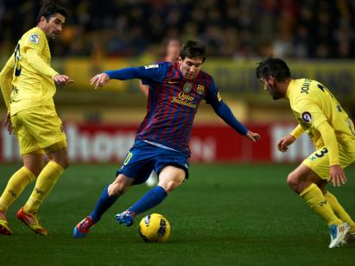
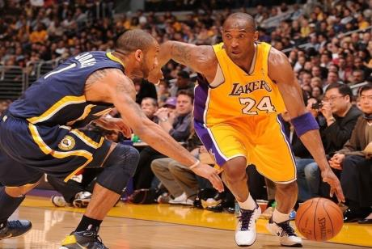
Which sport do you like?

Slide 7
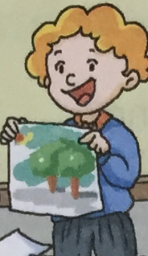
Lead-in
Do you know this boy?
He is Little Leo. And he likes drawing very much.
Do you want to know the story about him?

Slide 8
Read Para.1 and complete the sentences
Little Leo shows his picture to his friends.
Leo: Look at my picture.
Boys: Wow, it’s nice. You’re________________, Leo.
Leo: I hope so, I like____________________.
going to be an artist
drawing very much

Slide 9
Read Para.2 and complete the sentences
drawing lesson
Little Leo is in a _____________.The teacher is putting
________ on the table.
Leo: What are we going to draw today, sir?
Teacher: We’re going to___________________.
Leo: That’s easy. I can do it quickly.
an egg
draw an egg

Slide 10
Read Para.3 and complete the sentences
Little Leo is in another lesson. The teacher is putting an egg on the plate.
Leo: It’s an egg again, sir. Why do we draw eggs
all the time?
Teacher: In the first lesson, the egg was____________.
Now this egg is________________. Look
carefully! It looks ___________!
Leo: I see.
on the table
on the plate
different

Slide 11
Show time
Role play
Students act the story in groups.

Slide 12
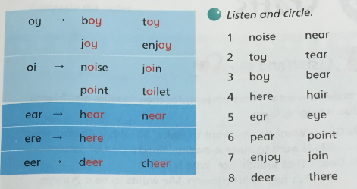
Learn the sound

Slide 13
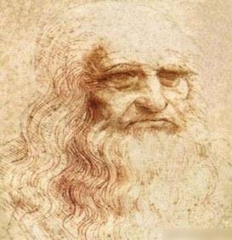
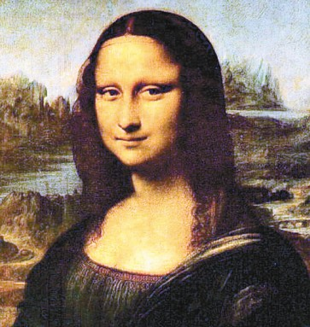
Culture corner
Leonardo da Vinci (1452-1519) was a great artist. He painted the Mona Lisa.

Slide 14
Homework.
Tell the story to your friends or parents.

Slide 15
The End

