Slide 1
Unit 3 Topic 2
What sweet music?
Section A
WWW.PPT818.COM

Slide 2

Do you like listening to music ?
Let’s know something about it.
singers
concert
bands
musical instruments

Slide 3
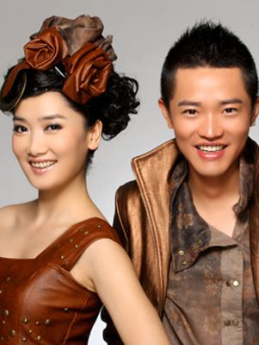
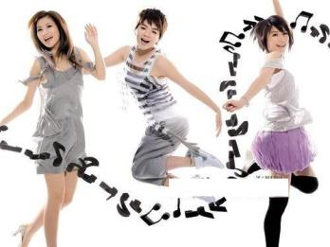
band
band

Slide 4
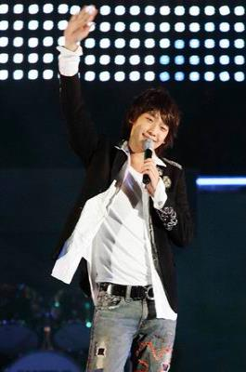
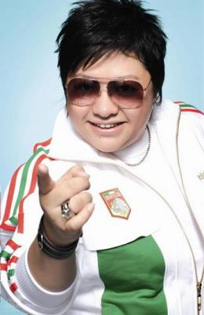
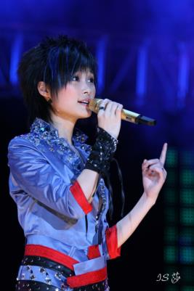
singers

Slide 5
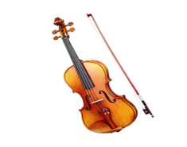
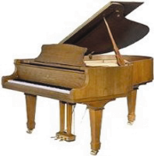
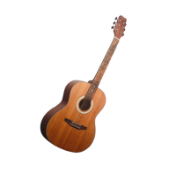
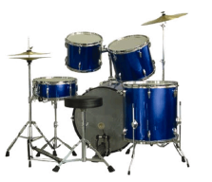
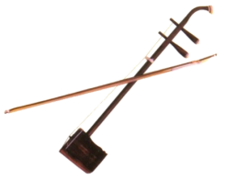
2
Match the words of the musical instruments with the pictures. Then listen to the conversations and number the pictures.
piano, violin, erhu, guitar, drums
1
3
4
violin
piano
guitar
__________
__________
__________
2
5
Musical
Instruments
drums
erhu
____________
________

Slide 6
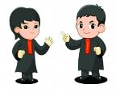
Pair Work
Ask and answer the following questions
in pairs.
What kind of musical instruments do you know ?
2. Which is your favorite? Why?
3. What musical instruments can you play ?
4. What other musical instruments are you
going to learn?

Slide 7
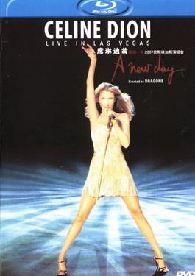
Did you hear the song My Heart Will Go On ?
Do you know who sang this song ?
Celine Dion

Slide 8

Listen, look and say.
1
Jack: What are you going to do this Sunday
evening?
Sally: I’m going to a concert.
Jack: How exciting! Who is going to sing at this
concert?
Sally: Celine Dion. Do you know the song My
Heart Will Go On?
Jack: Yes. Is that her song?
Sally: Right. And it sounds beautiful!
Jack: Where is she going to give the concert?

Slide 9
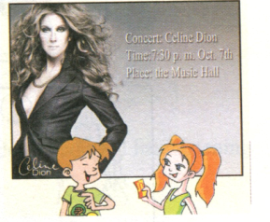
Sally: At the Music Hall.
Jack: Oh, wonderful! What time is it going to
start?
Sally: At 7:30 p.m. Why not come with me?
Jack: I’d like to, but I’m going to watch movies
with Steve.
Sally: What a pity! Hmm… I can lend you some
CDs of her songs. I think you will enjoy them.
Jack: Thanks a lot.
Sally: You're welcome.

Slide 10

1b
Listen to 1a, and answer the following questions.
What is Sally going to do this Sunday evening ?
What is Jack going to do ?
Which singer will sing at the concert ?
When and where will she give the concert ?
She is going to a concert.
He is going to watch movies with Steve.
Celine Dion.
At at 7:30 p.m，the Music Hall.

Slide 11


Listen, read 1a and find the expressions which show Jack’s and Sally’s feelings. Then draw for a good feeling and for a bad one.
1c
It sounds beautiful！
How exciting !
______
______
Expressions
What a pity！
Wonderful！
______
______

Slide 12

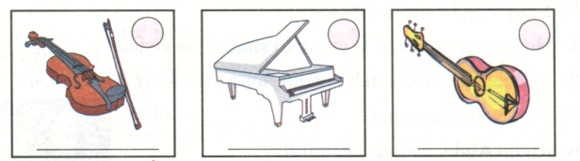
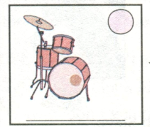
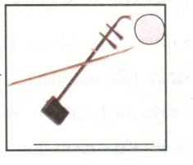
2 Match the words of musical instruments with the pictures. Then listen to the conversations and number the pictures.
Piano violin erhu guitar drums
1
3
4
violin
piano
guitar
2
5
drums
erhu

Slide 13


Key points
Hmm … I can lend you some CDs of her songs.
呣，我可以借给你一些她的歌曲光盘。
lend sb. sth. = lend sth. to sb. 借某东西给某人
反义：borrow … from … 从……借来……
Eg: 你能把铅笔借给我吗？
Can you ___________ your pencil?
= Can you _______ your pencil ________?
昨天我向他借了5元钱。
I ____________ five yuan ____________ yesterday.
lend me
lend
to me
borrowed
from him

Slide 14
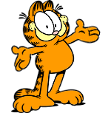
3
Do you like collecting posters ?
Can you get any information from a poster ?
Read the following posters. You choose one and your partner chooses the other poster. Then make a conversation similar to 1a.

Slide 15
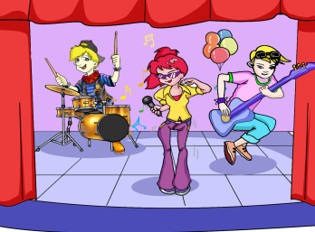
SCHOOL CONCERT
Welcome to Our Music Lessons Want to become a musician? Want to make beautiful music? Want to become happy in life? Just come and join us! Music lessons (guitar, violin, piano and drums ) Only ¥ 100 each Place: Training Room 304, Little Star Building Time: 8:30-9:30 a. m. every Sunday Come to www.mclub.com to learn more !
The Same Song Comes to Dabieshan
Want to spend a wonderful evening?
Want to enjoy exciting hip pop?
Want to see your favorite school singers?
Come and join us !
PLACE: The School Hall
TIME: 7:00 p.m. Nov.7th

Slide 16

Read the posters in 3 and answer the questions about the posters.
When and Where will they hold the concert ?
What time can we have the music lessons ?
Can we learn to dance in the music lessons ?
In the School Hall at 7:00 p.m. on Nov.7th .
From 8:30 to 9:30 a.m. every Sunday.
No, we can’t.

Slide 17
Make conversations with your partner.
You may begin like this :
Example :
A: What are you going to do this Saturday evening?
B: …
A: What lesson are you going to learn?
B: I am going to learn …
A: How much is it for one lesson?

Slide 18

Do the exercises
—Do they speak ____ English _______ ?
—Yes, they do.
A. everyday ; every day B. every day ; everyday
C. everyday ; everyday D. every day ; every day
2. Lily thinks playing ____ is exciting. She always play them in her free time.
A. drums B. the drums C. a drum D. drum
3. — Could you ____ your dictionary ______ me ?
— Of course, here you are.
A. borrow; for B. lend ; to C. lend ; for D. borrow; from

Slide 19
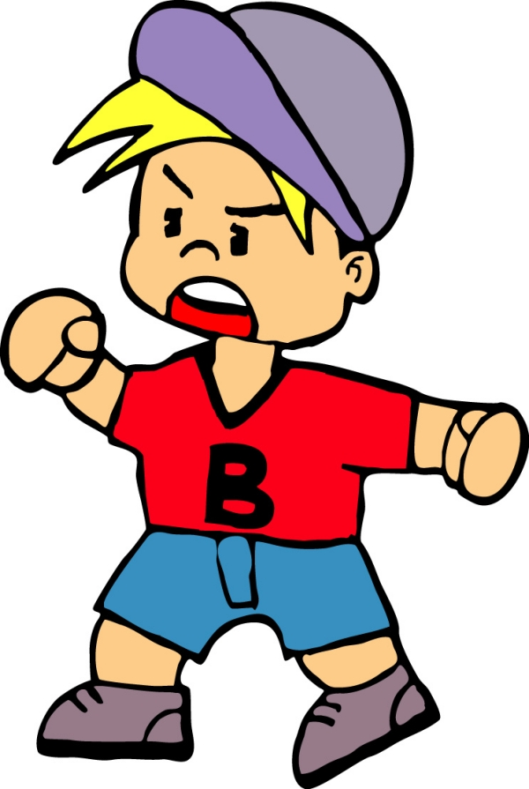
Summary
I know something
about concert.
I know some
useful expressions.
I can make a poster now.

Slide 20
Useful expressions
at the concert
take … lessons
lend sb. sth.
Just come and join us!

Slide 21
Homework
Recite the conversation by yourself.
Make a poster about the basketball game between your class and Class 2 in groups.

