Slide 1
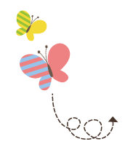
111111111111111111111111111111111111111111111111111111111111111
Unit 1 My Family
五年级上册
Lesson 4 What Do They Like to Do?
WWW.PPT818.COM

Slide 2
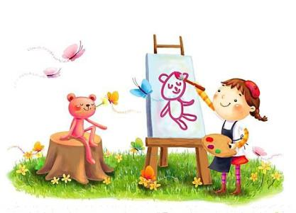
What do you like to do?
Do you like to read English books?

Slide 3
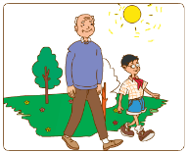
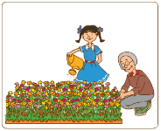
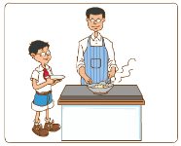
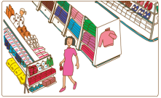
1. What does he/she like to do?
My grandfather likes to go for a walk. I like to go for a walk with my grandfather.
My grandmother likes to plant flowers. Jing likes to water flowers.
My father likes to cook. I like to help him.
My mother likes to go shopping.
This is my aunt Meiping. She likes to read books.
This is my uncle Dachao. He likes to work on his computer.

Slide 4
讲解
What does he/she like to do?
他/她喜欢做什么？
知识点 1
这是一个特殊疑问句，用来询问“他 / 她喜欢做什么？”
用法：
What + do/does + sb. + like to do?
句子结构：

Slide 5
讲解
What do they like to do?
他们喜欢做什么？
What does Li Ming like to do?
李明喜欢做什么？
例句：

Slide 6
讲解
知识点 2
My grandfather likes to go for a walk.
我的爷爷喜欢去散步。
句子结构及含义：Sb. like/likes to do sth.
此句式意为“某人喜欢做的某事。”
例句：
I like to read books.
我喜欢读书。
His brother likes to play football.
他的弟弟喜欢踢足球。

Slide 7
讲解
用所给单词的正确形式填空。
Mr. Li _____(like) to go to the park with his family.
典例
likes

Slide 8
讲解
walk /wɔːk/ v.&n. 步行；走；散步
My friend likes to go for a walk.
我的朋友喜欢去散步。
例句：
go for a walk = take/have a walk 去散步
短语：
I like to go for a walk with my parents.
我喜欢和我的父母去散步。
例句：

Slide 9
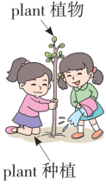
讲解
知识点 3
plant flowers 种花
plant /plɑːnt/ v. 种植
I want to plant vegetables.
我想要种植蔬菜。
例句：
plant flowers 种花 plant vegetables 种菜
短语：
plan 计划 plane 飞机
形近词记忆法：
其他意义：
plant n. 植物

Slide 10
讲解
flower /ﬂaʊə(r)/ n. 花；花朵
The flowers are very beautiful. 这些花很美丽。
例句：
字母组合 ow 发的是 /aʊ/。
发音：
短语：
a bunch of flowers 一束花 flower bed 花坛
同音异义词：
flour 面粉
tower 塔 power 力量
形近词记忆法：

Slide 11
讲解
water /wɔːtə(r)/ v. 给……浇水
知识点 4
字母 a 发的是 /ɔː/。
发音：
例句：
I like to water flowers.
我喜欢浇花。
其他意义：
water n. 水
构成短语：
throw cold water 泼冷水
By water 由水路；乘船

Slide 12
讲解
cook /kʊk/ v. 烹饪；烹调
知识点 5
My mum likes to cook for me.
我的妈妈喜欢为我做饭。
例句：
cook lunch 做午饭 cook dinner 做晚餐
短语：
look 看 book 书 cool 凉爽的
形近词记忆法：
过去式：
cooked

Slide 13
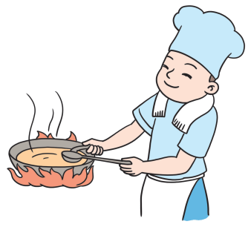
讲解
cook n. 厨师
其他意义：
魔法记忆：
The cook is cooking.
这位厨师正在做饭。

Slide 14
讲解
go shopping 去购物；去买东西
知识点 6
“go + v. ing”是一种动词短语类型，表示“去……”，
类似的动词短语还有：
go fishing 去钓鱼 | go skating 去滑冰
go skiing 去滑雪 | go hiking 去徒步旅行
go hunting 去打猎 | go swimming 去游泳

Slide 15
讲解
My brother likes to go fishing.
我的哥哥喜欢去钓鱼。
例句：
My dad usually goes _____ on weekends (周末).
A. swimming B. swim C. swims
典例
A

Slide 16
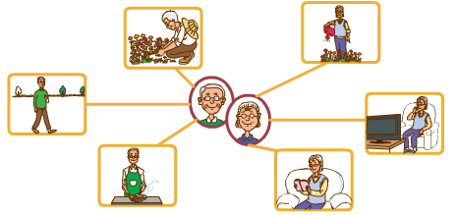
2. Let’s do it!
Look and write.
go for a walk read books water flowers plant flowers watch TV cook

Slide 17
2. Let’s do it!
He likes to plant flowers. She likes to water flowers. ____________________________________________________
____________________________________________________
____________________________________________________

Slide 18
习题
一、单项选择。
1. What ____ your parents ____ to do?
A. do；likes B. does；like C. do；like
2. I like to go _____ a walk.
A. to B. for C. at
C
B

Slide 19
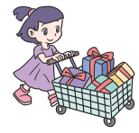
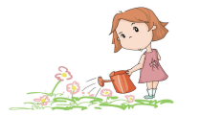
习题
二、将短语写在相应的图片下面。
water flowers read a book go for a walk plant trees go shopping cook meals
(1)
(2)
go shopping
water flowers
_____________ ______________

Slide 20
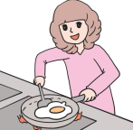
习题
(3)
(4)
plant trees
cook meals
____________ ______________

Slide 21
本节课我们学习了以下知识，请同学们一定加强巩固，以便能和同学们进行灵活交流哦！
重点词汇：walk plant flower water cook
重点短语：plant flowers go shopping
重点句式：What does he/she like to do?
My grandfather likes to go for a walk.

Slide 22
Thank you!

