Slide 1
Unit 4 Do you like candy?
WWW.PPT818.COM

Slide 2
Language Goals
Letter Goals:
Enable students to listen, speak, read, write the capital and the lower-case letters, Ee and Ff and grasp the link between these letters and their pronunciations in words.
Word Goals:
Enable students to listen, speak, read and write the words, egg, coffee, and fruit.
Sentence Goals:
Enable students to listen, speak and read the sentences, Do you like fruit? Yes, I do.

Slide 3
Let's review.

Slide 4
Group Division
In this lesson, our class will be divided into three groups. Two rows form a group. Every correct answer will be rewarded a score. At the end of this lesson, we'll see which group has the most scores.

Slide 5
Let's read and write.

Slide 6
Let's read and write.

Slide 7
Let's talk.
Do you like fruit?
Yes, I do.

Slide 8
Let's watch.

Slide 9
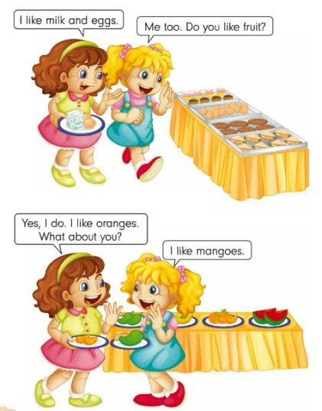
Let's watch.
How many people are there in the dialogue?
Who are they?
What do they talk about?

Slide 10
Let's learn.
- I like milk and eggs.
- Me too. Do you like fruit?
- Yes, I do. I like oranges. What about you?
- I like mangoes.

Slide 11
Let's read.
- I like milk and eggs.
- Me too. Do you like fruit?
- Yes, I do. I like oranges. What about you?
- I like mangoes.

Slide 12
Let's act.

Slide 13
Let's conclude.
What do we learn today?
Ee, egg, coffee
Ff, fruit
Do you like fruit? Yes, I do.
Which group has the most stars?
( Clap hands )
Homework
Write down the dialogue we make in class.

Slide 14
See you!

