Slide 1
Unit 14
I remember meeting all of you in Grade 7.
Section B 第1课时
R·九年级下册
WWW.PPT818.COM

Slide 2
Lead-in
点击画面 播放视频

Slide 3
nurse
dancer
cook
police
manager
What do you hope to do in the future?
Guess the job according to
pictures
photographer
programmer
singer
director

Slide 4
Write about what you would like to do in the future.
1a
1. get a business degree and become a manager
2. ______________________________________
3. ______________________________________
sing beautiful songs and become a muscian
learn English well and teach kids English

Slide 5
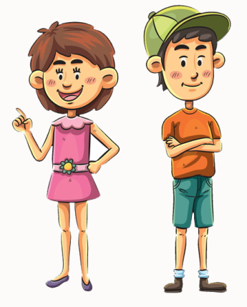
1b
Talk about what you hope to do in the future.
I hope to get a
business degree
and become a
manager.
What do you
hope to do
in the future?

Slide 6
I hope to sing beautiful
songs and become a
muscian.
What about you?

Slide 7
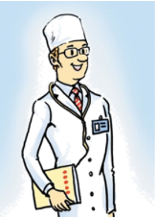
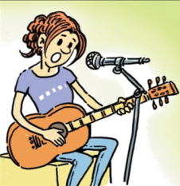
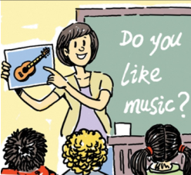
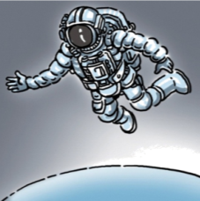
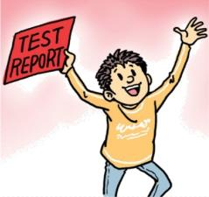
Listen to a class discussion. Check (√) the hopes you hear.
1c
√
√
√
√

Slide 8
1d
Listen again. Complete the passage.
Today is the students’ last class. Bob feels _______ about it and thinks Mrs. Chen’s classes have been _______. The students talk about what they want to
do in the future. Bob hopes to______ the exam to get into senior high school. Shirley wants to get into a ______ school.
sad
great
pass
music

Slide 9
Ken is good at _______and he won a ______for it. So he wants to be a(n) _________.Mrs. Chen believes in all of them and tells them to “_________”. To celebrate the end of junior high, they are having a ______. They ask Mrs. Chen to come, and she is happy to accept the invitation.
science
prize
astronaut
go for it
party

Slide 10
Listen again and Finish the column.
Person
Hopes to …
Bob
pass the exam to get into senior high school
Shirley
get into a music school, play in a band
Ken
be an astronaut, go into space
improve her English to teach kids English in the future
Anna

Slide 11
听力原文：
Class: Good morning, Mrs. Chen.
Mrs. Chen: Morning, everyone! Well, today is our last class
together.
Bob: That makes me sad, Mrs. Chen. Your classes
have been great.
Mrs. Chen: I’m glad to hear that. But the future will be
exciting, too. What do you hope to do in the
future, Bob?
Bob: I hope to pass the exam to get into senior high
school.

Slide 12
Shirley: I’m going to try to get into a music school. I want to
play in a band.
Mrs. Chen: I think you can do it, Shirley. And you, Ken? I
remember you won a prize for science...
Ken: Yes, last year. I’d like to be an astronaut and go into
space. It would be so exciting if I could do that.
Anna: I’m going to improve my English so that I can teach
kids English in the future.

Slide 13
Mrs. Chen: That’s an excellent plan, Anna. All of you should go for
it. I believe in you, all of you.
Shirley: Thank you, Mrs. Chen. Oh, this weekend we’re
celebrating the end of junior high school. We’re having
a party…
Ken: …and we’d like you to come!
Mrs. Chen: Why, of course, I’d love to! I’ll bring a graduation cake.

Slide 14
Discussion in Pairs
A: —Today is the students' last class. Bob feels sad and thinks Mrs. Chen’s classes have been …
B: —Yeah, and the students talk about what they want to do in the future.
A: —Bob says …
B: —…

Slide 15
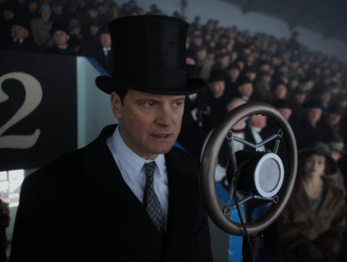
How to make a good speech?
Getting started
1. Choose your topic.
2. What is your purpose?
3. Organize your thoughts and ideas.

Slide 16
The Writing Process
1. Think about your audience.
2. Grab their attention.
3. Focus on your message.

Slide 17
Giving the Speech
1. Practice reading the speech aloud.
2. Review what you’ve written and make any necessary revisions.
3. Present your speech with confidence. Speak in a loud clear voice.

Slide 18
Prepare a speech for your graduation. Use the questions to help you . Present your speech to your group.
1e

Slide 19
How have you changed since you started junior high school?
Who has helped you most?
What advice have your parents given you?
What will you do after you graduate?
What are you looking forward to?

Slide 20
Language points
1. I hope to get a business degree and become a
manager.
manager可以指一个企业、公司、球队的“经理”，也可指演员、运动员等的“经纪人”，还可指“善于理财管家的人”。
例：我想找营业部经理。
I want to speak to the sales manager.

Slide 21
manager 可作动词，意为“管理；应付；完成”
常用短语：manage to do sth.
例：我们设法提前完成任务。
We manage to finish the work ahead of time.

Slide 22
2. Mrs. Chen believes in all of them and tells them
to “_______”.
believe in 意为“相信；信赖； 信仰”。
例句：相信你自己，否则你永远不会成功。
Believe in yourself, or you will never succeed.

Slide 23
Exercise
1. Thank you for your _________(invite).
2. He doesn't _______ ___ (信任) me.
3. 你相信魔术吗？
Do you _______ ____ magic?
invitation
believe in
believe in

Slide 24
4. They appointed a new ______ to coordinate
the work of the team.
A. actor B. scientist
C. manager D. doctor
5. I don't ______ it! What are you doing here?
A. suppose B. agree
C. believe D. believe in

