Slide 1
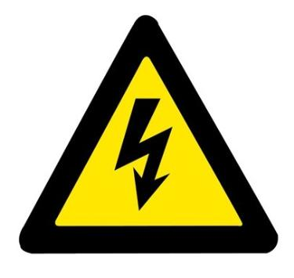
Unit 5
Signs
第二课时
WWW.PPT818.COM

Slide 2
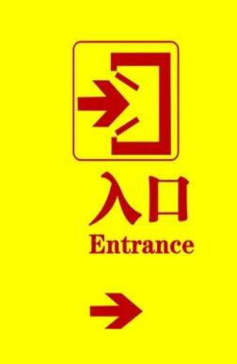
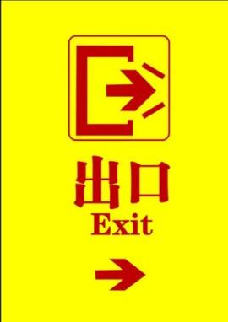
Introduce
What does this sign mean? It means···
What do these sign mean? They mean···

Slide 3
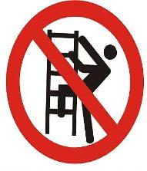
Words
climb
/ klaɪm /
动词,表示“攀登、爬”。
常用短语： No climbing 禁止攀爬
eg ： I have some climbing plants in the garden.
我的花园里长着一些攀缘植物。
小练习： We go to climb mountains every Sunday.
_______________________________
每个星期天我们都去爬山。

Slide 4
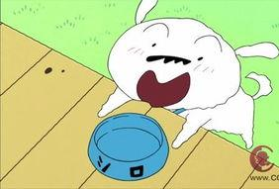
Words
feed
/ fiːd /
动词,表示“喂养、饲养”。
常用短语： mean red 表示红色
eg ： Will you feed my cat for me?
你能帮我喂养猫么？
小练习： Birds feed on worms and grains.
___________________________
鸟以虫和谷物为食。

Slide 5
Expressions
what does it mean？ What do these signs mean?
它表示什么意思？这些标志标示什么意思？
what does it mean？是第三人陈单数的提问;
What do these signs, mean?是用于复数的提问
eg ： It means “No parking.”
小练习 : What do these _____(signs/ sign)mean?
They _____（mean/means）you shouldn’t drink and eat.
signs
mean

Slide 6
Expressions
No smoking.
请勿吸烟。
“No smoking”和“shouldn’t smoke. Don’t smoke” 都表示请勿吸烟。祈使句,表示劝阻。No+动词ing是祈使句的一种表达方式。
eg: You shouldn’t take photos here. It means“No photographing”.
你不应该在这拍照。它表示禁止拍照。
小练习 : That sign means “ __________ ”(禁止扔垃圾)
No littering.

Slide 7
Expressions
What does it mean? It means…
这个标志是什么意思？它表示……
“what +does+主语+ mean?”在 “does”后面 “mean”用动词原形。
回答时用 “ It means···”,用于一个指示牌的询问。
eg: What does that sign mean?
It means you can’t smoke there.
小练习 : you It should on walk not grass the means(.)
___________________________________
It means you should not walk on the grass.

Slide 8
Dialogues
Make conversations about these signs with your classmates!

Slide 9
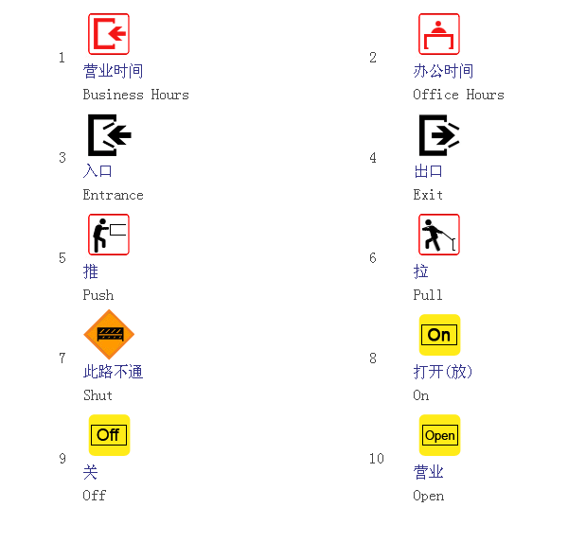
Expand
what do these signs mean?

Slide 10
Expand
what do these signs mean?

Slide 11
Summary
climb feed
what does it mean？ It means···
What do these signs mean?
No smoking！

Slide 12
Exercise
1. It means“No (smoke, smoking)”.
2.We can’t (smoke, smoking) here.
3.What (do, does) these signs (mean, means) ?
smoking
smoke
do
mean

Slide 13
Exercise
4.What (do) “Danger” (mean)?
5.It means “No (litter)”.
6.These signs (mean) “No eating drinking”.
does
mean
littering
mean

Slide 14
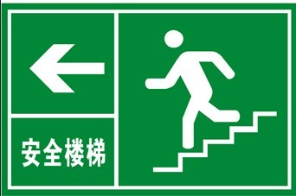
Homework
Tell your parents something about signs.
Using:
What does this sign mean? It means···
What do these sign mean? They mean···

