Slide 1
Unit8 Topic 3
Let’s celebrate!
Section A
WWW.PPT818.COM

Slide 2
Read the following dates in English.
2012
9月10日
2012
12月25日
2013
2月21日
正月十五
It's lunar January 15th.

Slide 3
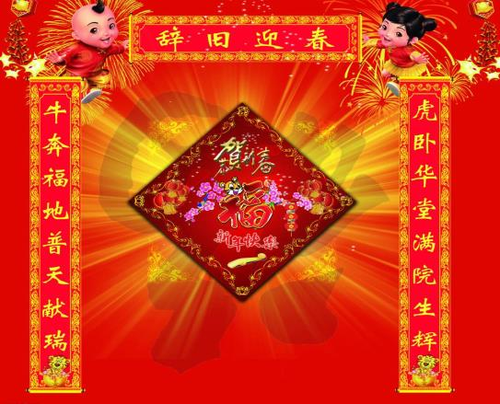
Look at the pictures, and say out the festivals.
The Spring Festival

Slide 4
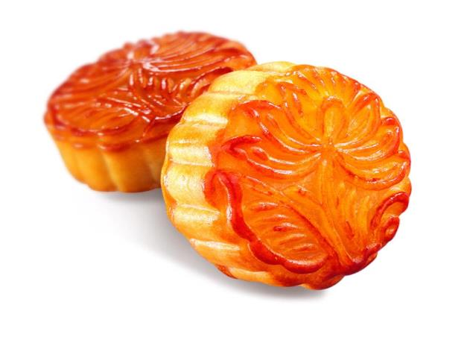
The Mid-autumn Festival

Slide 5
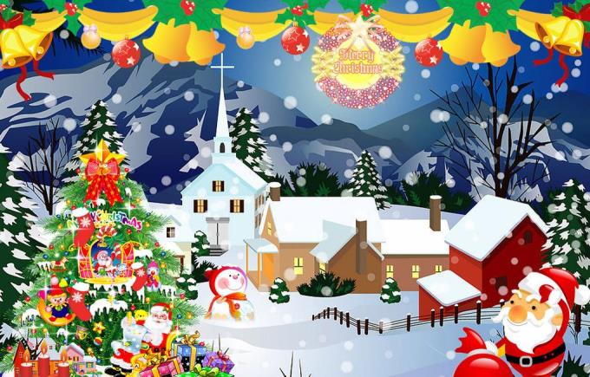
Christmas

Slide 6
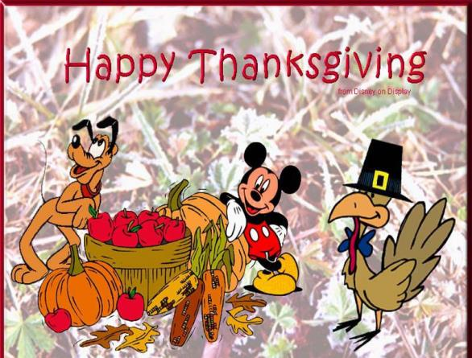
Thanksgiving

Slide 7
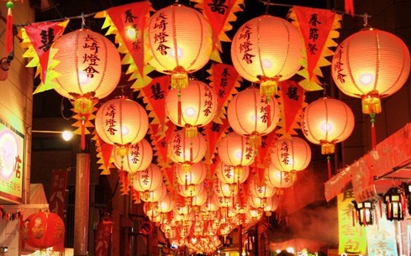
The Lantern Festival

Slide 8
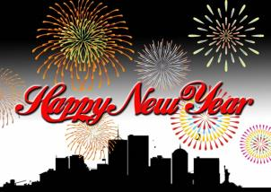
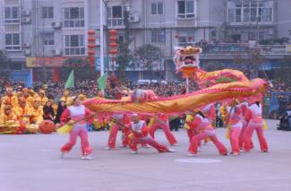
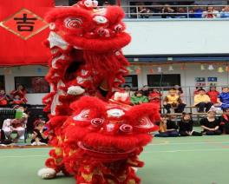
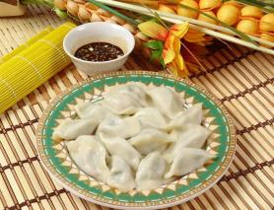
A:What festival is it?
B:It’s the Spring Festival.
A:When is the Spring Festival?
B:It’s in January or February.
A:How do we celebrate the Spring Festival?
吃饺子
B:Chinese people eat dumplings and perform
lion and dragon dances.
舞狮和舞龙

Slide 9
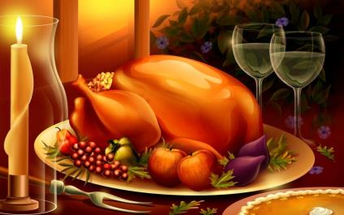
turkey
A: When is Christmas?
B: It’s on December 25th.
A: How do the people celebrate Christmas?
B:They often eat turkey and Christmas cakes and give each other presents.
彼此、相互

Slide 10
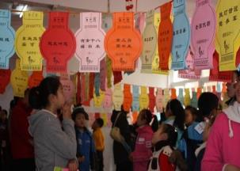
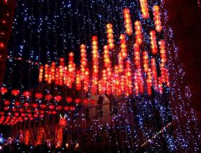
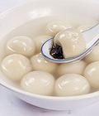
A: What festival is it?
B: It’s the Lantern Festival.
A: When is the Lantern Festival?
B: It’s on lunar January 15th.
吃汤圆
A: How do we celebrate the Lantern Festival?
B: On this day, people eat sweet dumplings
for good luck, watch lantern shows and guess riddles on
lanterns.
赏花灯
猜灯谜

Slide 11
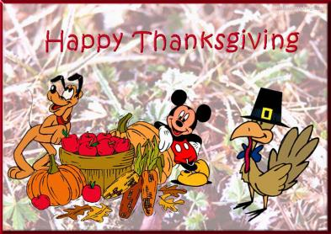
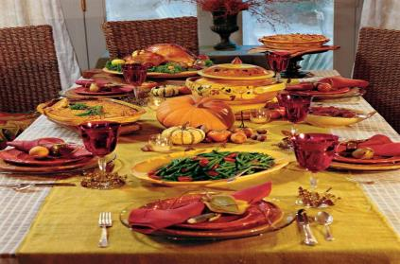
A: When is Thanksgiving?
B: It’s on the fourth Thursday in November.
A: How do the people celebrate Thanksgiving?
B: Families in America get together for a big dinner. Many
people eat turkey and pumpkin pie.
南瓜饼

Slide 12
Listen to 1a and circle the food and underline the activities people do in each festival.

Slide 13
Listen and read 1a aloud.

Slide 14
Complete the table and retell the festivals according to the form.
Festival | Date | Food | Activity
the Spring Festival | lunar January 1st | dumplings
Christmas |  | tukey and Christmas cake | give each other presents
the Lantern Festival | lunar January 15th
Thanksgiving |  | turkey and pumpkin pie | families get together for a big dinner
perform lion and
dragon dances
December 25th
watch lantern
shows and guess riddles
sweet dumplings
the 4th Thursday
in November

Slide 15
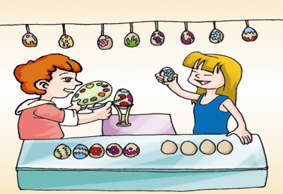
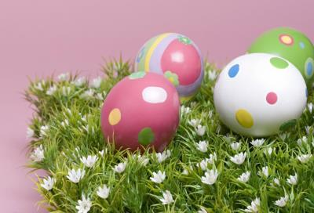
Look, listen and circle the names of festivals. Then listen again and complete the sentences.
Easter (a Sunday in March or April)
Many people believe Christ came back to ___ on Easter Day. People make Easter _____to celebrate the festival.
life
eggs

Slide 16
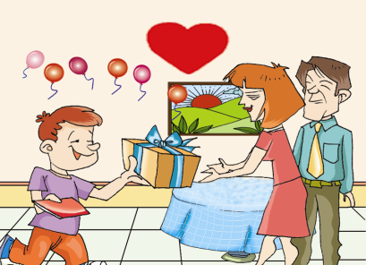
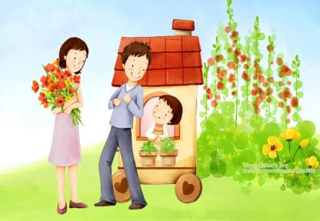
Mother’s Day (the second Sunday in May)
People show their love for their mothers by giving _____ and other _______. And they often go to a restaurant for dinner.
cards
presents

Slide 17
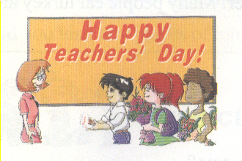
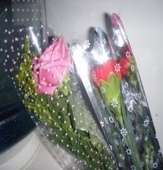
Teachers’ Day (September 10th)
Students give ______ _______ to their teachers.
best
wishes

Slide 18
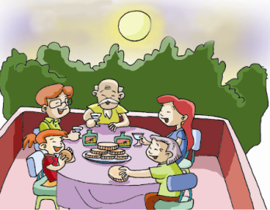
The Mid-autumn Festival (lunar August 15th)
____ this day people eat mooncakes and _____ the bright full moon.
On
enjoy
圆月

Slide 19
Please make a survey about your favorite festival and fill out the form.
Name | Favorite festival | Why
Example:
A: What’s your favorite festival?
B: Christmas.
A: Why?
B: I like presents. And I can send cards to my friends.

Slide 20
Listen and read the following words aloud. Pay attention to the pronunciations of the colored parts.
single little table people middle uncle
often listen lesson cousin basin seven

Slide 21
Summary
1. Learn the names of festivals:
The Spring Festival, Christmas, Lantern
Festival, Thanksgiving, the Mid-autumn
Festival, Easter
2. Learn other new words and phrases.
dumpling, good luck, believe, full moon
3. Talk about holidays and festivals.

Slide 22
Homework
1.Read 1a and 2, try to retell them.
2.Finish Section A in your workbook.

