Slide 1
What did you do last weekend?
Section B 第2课时
WWW.PPT818.COM

Slide 2
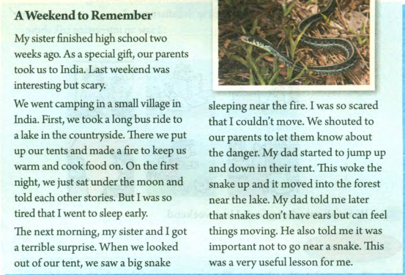

Slide 3
A Weekend to Remember
My sister finished high school two weeks ago. As a special gift, our parents took
us to India. Last weekend was interesting but scary.
We went camping in a small village in India. First, we took a long bus ride to a
lake in the countryside. There we put up our tents and made a fire to keep us warm
and cook food on. On the first night, we just sat under the moon and told each
other stories. But I was so tired that I went to sleep early.
1.两周以前 时间段+ago：表示…以前，做一般过去时的时间状语。
2. make a fire生火
3. 动词不定式表目的 keep sb. warm 取暖 cook food on fire 在火上做饭
4. so… that…的意思是“如此…以至于…“，so+形容词+that+从句，引导结果状语从句。She felt so sad that tears came to her eyes. 她非常悲伤，泪水盈眶。

Slide 4
The next morning, my sister and I got a terrible surprise. When we looked out of
our tent, we saw a big snake sleeping near the fire. I was so scared that I couldn’t
move. We shouted to our parents to let them know about the danger. My dad started
to jump up and down in their tent. This woke the snake up and it moved into the
forest near the lake. My dad told me later that snakes don’t have ears but can feel
things moving. He also told me it was important not to go near a snake. This was a
very useful lesson for me.
1. wake sb. up 意为“把某人叫醒”，是指一方把另一方叫醒或者吵醒，wake 和up之间加表示人的名词或者代词。
2. wake up 意为“醒来”，是不及物动词词组，其后不能接表示人的名词或者代词。
The students usually wake up early. 学生们通常醒的很早。

Slide 5
The next morning, my sister and I got a terrible surprise. When we looked out of
our tent, we saw a big snake sleeping near the fire. I was so scared that I couldn’t
move. We shouted to our parents to let them know about the danger. My dad started
to jump up and down in their tent. This woke the snake up and it moved into the
forest near the lake. My dad told me later that snakes don’t have ears but can feel
things moving. He also told me it was important not to go near a snake. This was a
very useful lesson for me.
1. feel表示“感觉”，属感官动词，其后接不定式的复合结构作宾语时，不定式不能带 to；feel也通常接现在分词的复合结构。
We all felt the house shake. We all felt the house shaking.
2. lesson在本句中意为“教训，经验”，是可数名词。teach sb. a lesson表示“给某人一个教训”。learn a lesson意为“得到一次教训”。

Slide 6
根据汉语提示补全句子
1. They are taking a walk ___ ___ ______. （在湖边）
2. we put up our tents and _____ __ ____ to keep us warm and ____ ____ __.
（生火；在上面做饭）
3. we _____ a big snake _________ near the fire. （看见…睡）
4. He also told me it was important ____ ___ __ _____ _ _______.（不要靠近蛇）
by the lake
made a fire
cook food on
saw sleeping
not to go near a snake

Slide 7
单项选择
1. My uncle went to Nanjing____.
a week before B. a week ago
C. before a week D. ago a week
2. She was_______ afraid ______ she cried.
A. too, to B. so, that C. such, that D. to, too
B
B

Slide 8
短语
区分wake up和wake sb. up
make a fire等
句型
结果状语从句：so…that…

