Slide 1
Unit6 I like hamburgers.
人教精通版三年级上册
WWW.PPT818.COM

Slide 2
Review
Let’s sing

Slide 3
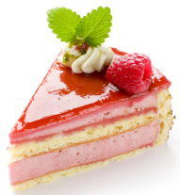
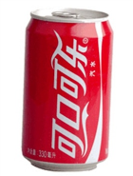
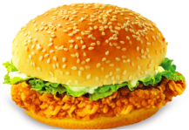
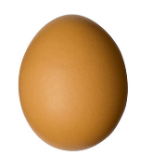
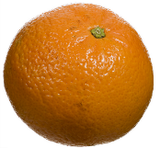
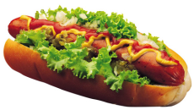
Review
Game
What’s missing?

Slide 4
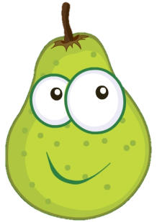
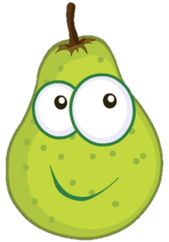
Presentation
Just learn
a
pear
pears

Slide 5
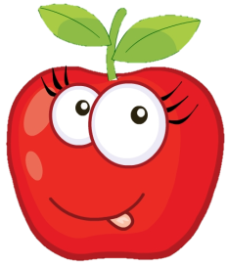
Presentation
Just learn
an
apple
apples

Slide 6
Presentation
Just learn
a
banana
bananas

Slide 7
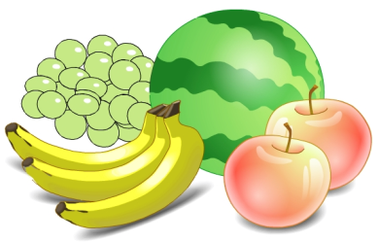
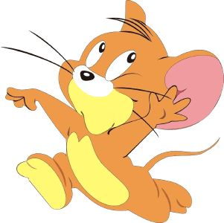
Presentation
Discussion
What fruit do you like?

Slide 8
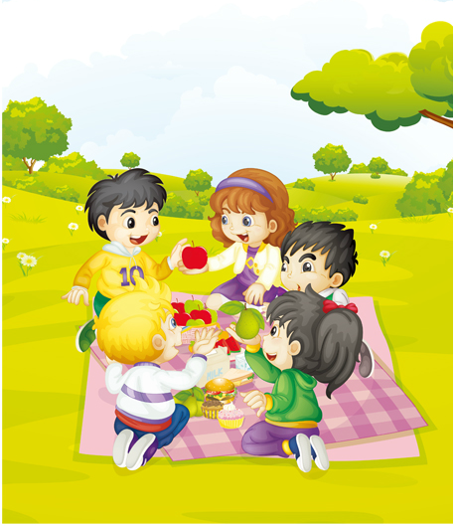
Presentation
Listen and say
Listen! What fruit does Gao Wei like?
He likes pears.

Slide 9
Presentation
Listen and imitate
Have an apple.
No, thanks. I like pears.
OK. Here you are.
Thank you!

Slide 10
Practice
Let’s read
1
2
3
Read together.
(齐读)
Read in roles.
（分角色读）
Read in groups.
(分组读）

Slide 11
Show time
四人一组试着练习对话并表演，其他同学评价。
 | 模仿录音中的语音语调，有感情地朗读。
 | 可以脱离课本，适当改动其中部分，语音地道。
 | 适当添加内容，意思完整，有创新，表演生动。
Good
Great
Excellent

Slide 12
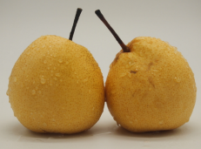
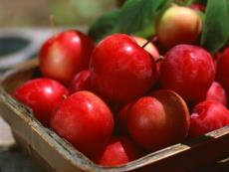
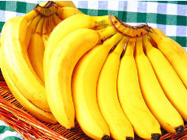
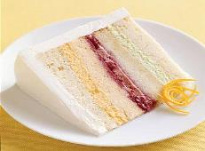
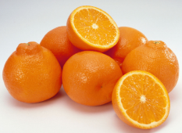
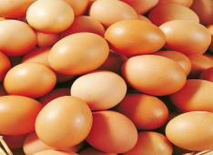
Look and match
eggs oranges cake bananas apples pears

Slide 13
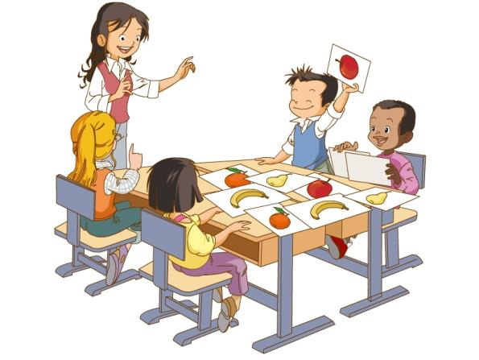
活动1
Listen and do
Show me an apple.

Slide 14
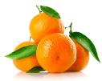
Practice
活动2
Draw and say
I like apples..
I like oranges..

Slide 15
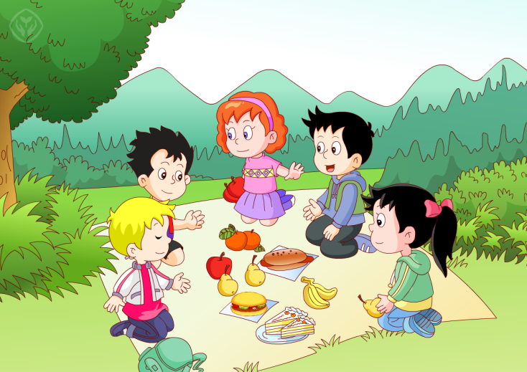
Practice
Let’s chant

Slide 16
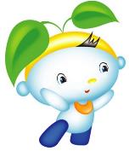
Summary
本课学习的水果类单词有:
pear
apple
banana

Slide 17
Homework
1.观看或跟读Just talk部分的课文动画或录音，并注意语音、语调。
2.学唱本课Let’s chant部分的英文歌曲，并唱给你的父母听。
3.用英文告诉爸爸妈妈自己最喜欢的水果。
4.预习Lesson34。
Close

