Slide 1
Can you swim?
WWW.PPT818.COM

Slide 2
Let's chant
What can you do ? What can you do?
I can sing . I can dance.
What can you sing?
I can sing “la,la,la, la, la, la …”
What can you do? What can you do?
I can run. I can jump.
What can you do? What can you do?

Slide 3
super !
超棒的

Slide 4
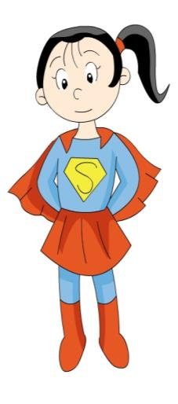
Hi, I’m Supergirl.

Slide 5
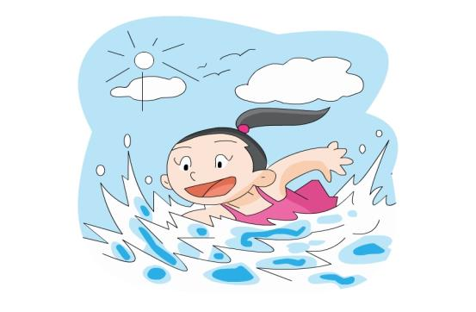
swim

Slide 6
Swim，swim.
I can swim.
I can swim like a fish.
像…一样

Slide 7
I can swim like a fish.
I’m super.

Slide 8
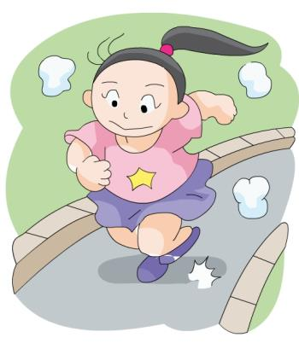
run

Slide 9
Run, run, run.
I can run.
I can run fast.
A ______ can run fast.

Slide 10
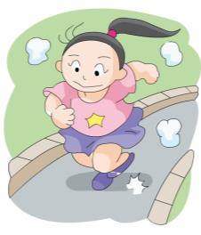
I can run fast.
I’m super.

Slide 11
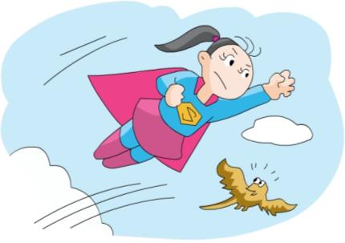
fly
A _____ can fly.

Slide 12
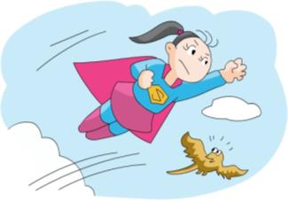
I can fly very high.

Slide 13
Let's sing
I can fly . I can fly.
Fly very high.
I can fly. I can fly.
Fly in the sky.

Slide 14
I can ______.
I can _____.
I can _____,too.
swim run
fly

Slide 15
Supergirl, Supergirl, what can you do?
I can run. I can run. I can run fast.
Supergirl, Supergirl, what can you do?
I can swim. I can swim. Swim like a fish.
Supergirl, Supergirl, what can you do?
I can fly, I can fly. Fly very high.

Slide 16
I can’t fly.
I can’t ____.
不能
A ___ can’t fly.

Slide 17
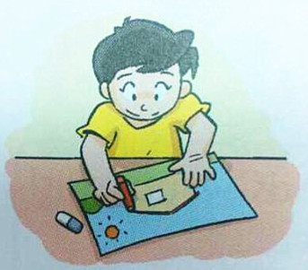
draw

Slide 18
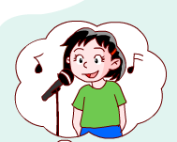
I can sing.
But I can’t draw.
但是

Slide 19
I can ____.
But I can’t ____.
但是

Slide 20
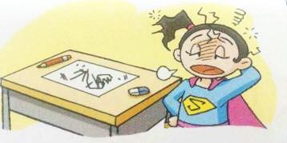
I can ______.
I can _____.
I can _____.
But I can’t ____.
swim run
fly

Slide 21
write

Slide 22
Let's sing
I can write. I can write.
I can write my name.
I can write. I can write .
I can write my name.

Slide 23
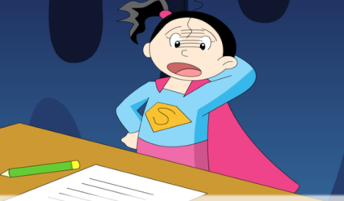
I can ______.
I can _____.
I can _____.
But I can’t ____.
swim run
fly
write

Slide 24
sing

Slide 25
dance

Slide 26
jump

Slide 27
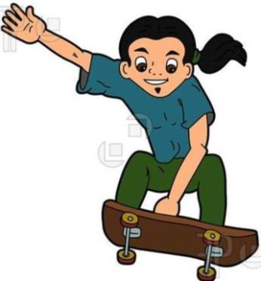
skate

Slide 28
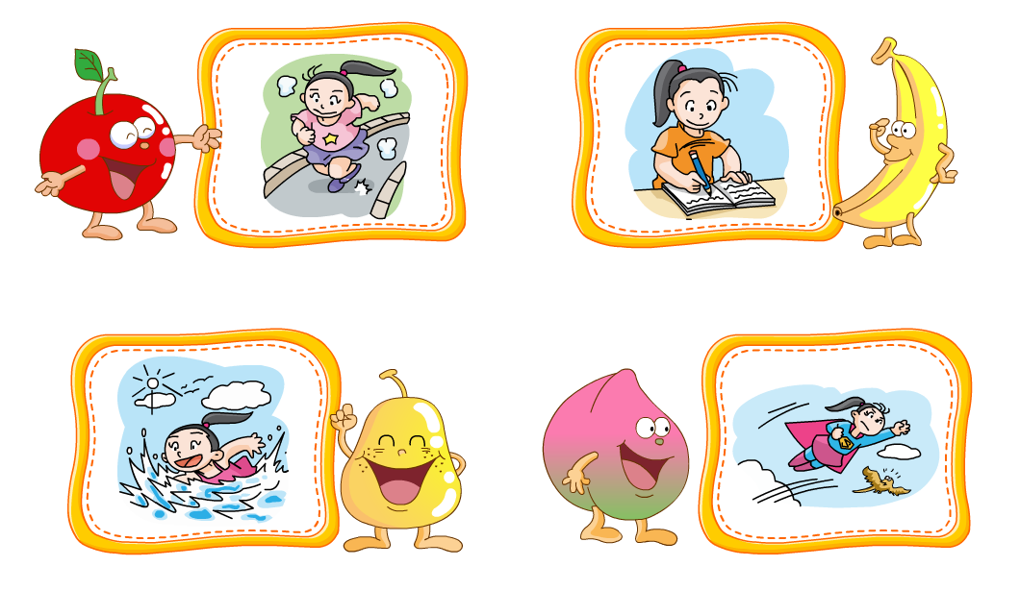
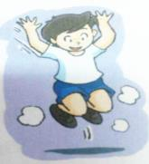
write
run
jump
fly

Slide 29
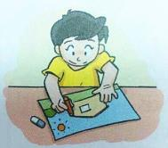
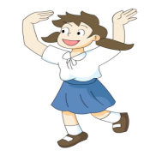
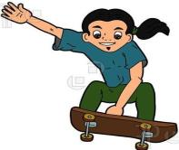
draw
dance
swim
skate

Slide 30
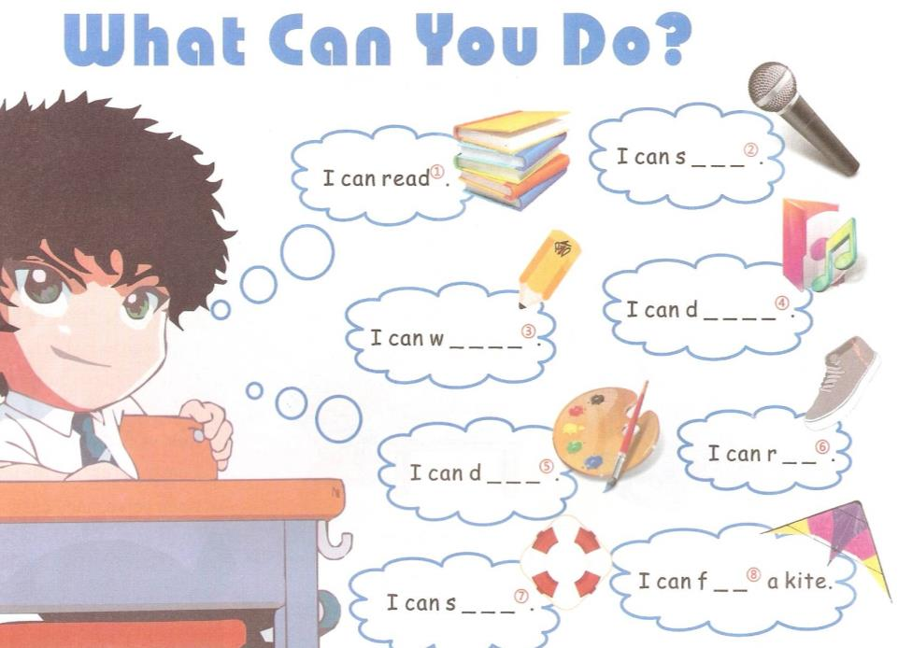
i n g
a n c e
r i t e
un
r a w
l y
w i m

Slide 31
Conan 柯南

Slide 32
Hello, I’m Conan.
I’m a boy.
I’m seven.
I can read and write.
I can run fast.
I can play football.
But I can’t sing.
( ) 1.Conan is a boy.
( )2. Conan is eight.
( )3. Conan can write.
( )4. Conan can’t play
football.
( )5. Conan can sing well.
√
×
√
×
×

Slide 33
Hello, I am _____.
I am a ____.
I am _____.
I can _____.
But I can’t ____.

Slide 34
What can you do ?
I can_____.
run

Slide 35
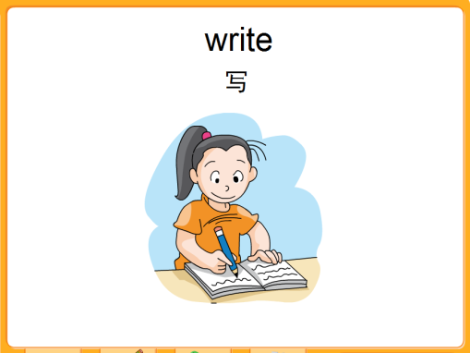
What can you do ?
I can_____.
write

Slide 36
What can you do ?
I can_____.
swim

Slide 37
What can you do ?
I can_____.
fly

Slide 38
What can you do ?
I can___________.
ride a bicycle

Slide 39
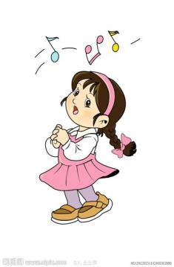
What can you do ?
I can ____.
sing

Slide 40
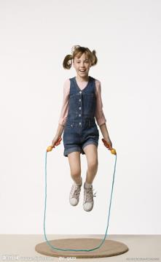
What can you do ?
I can___________.
skip a rope

Slide 41
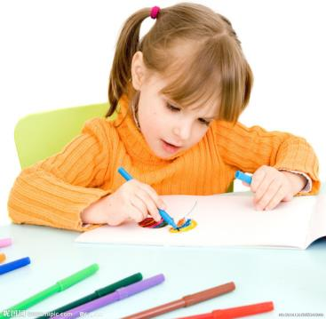
What can you do ?
I can _____.
draw

Slide 42
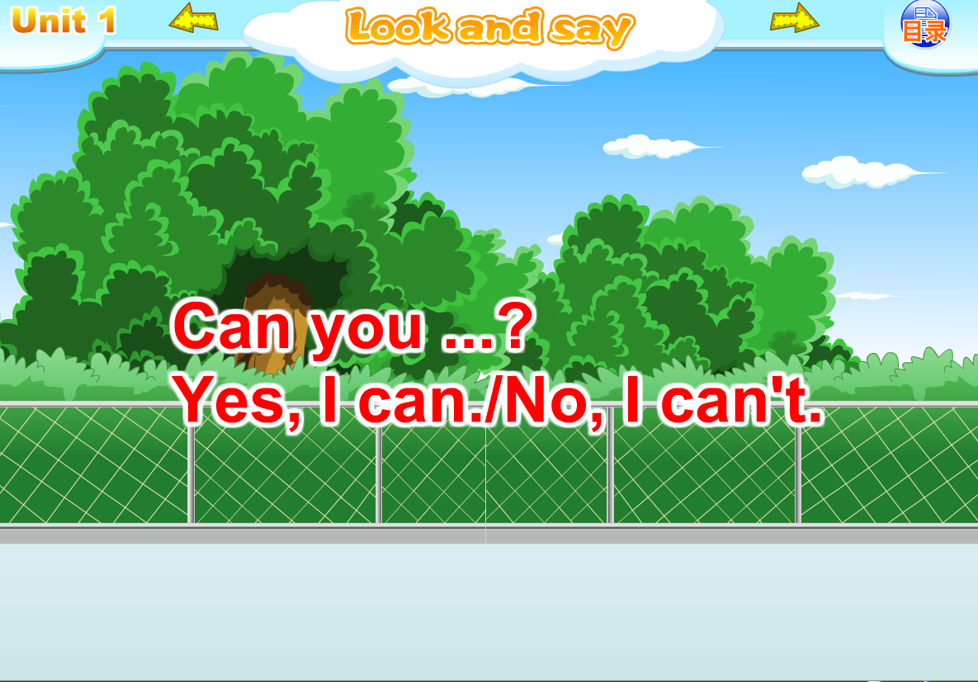

Slide 43
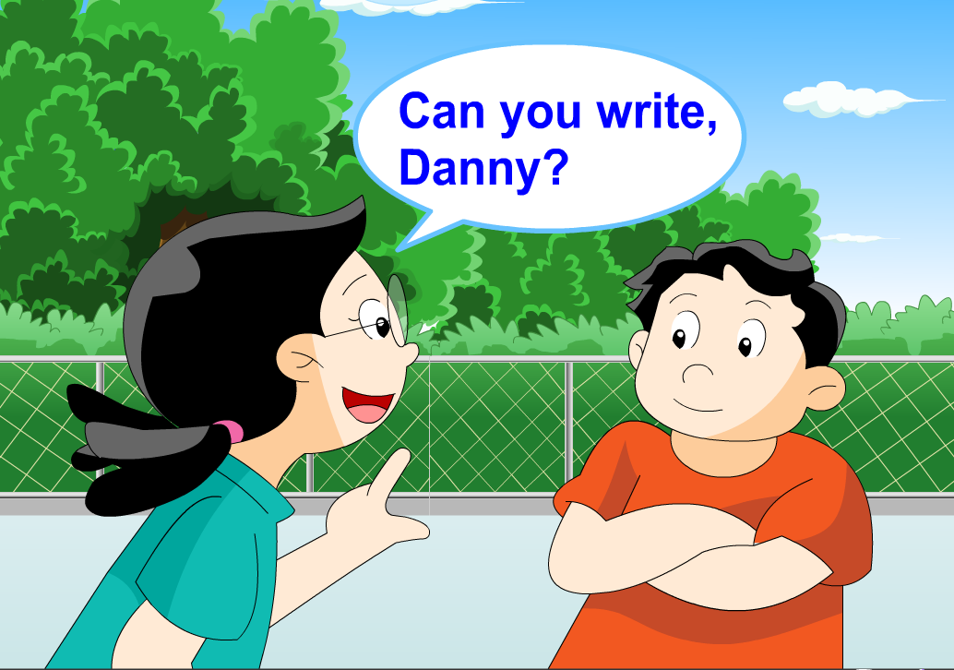

Slide 44
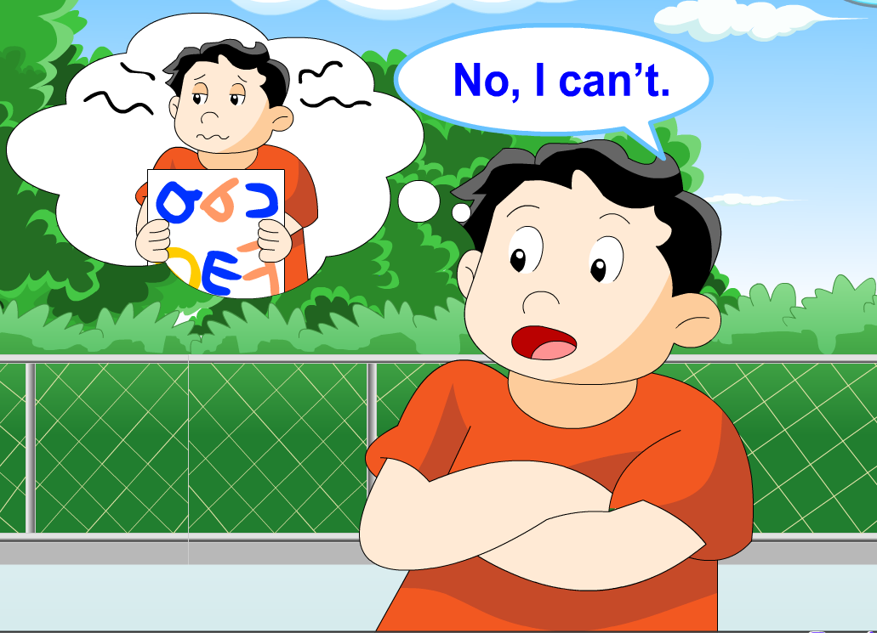

Slide 45
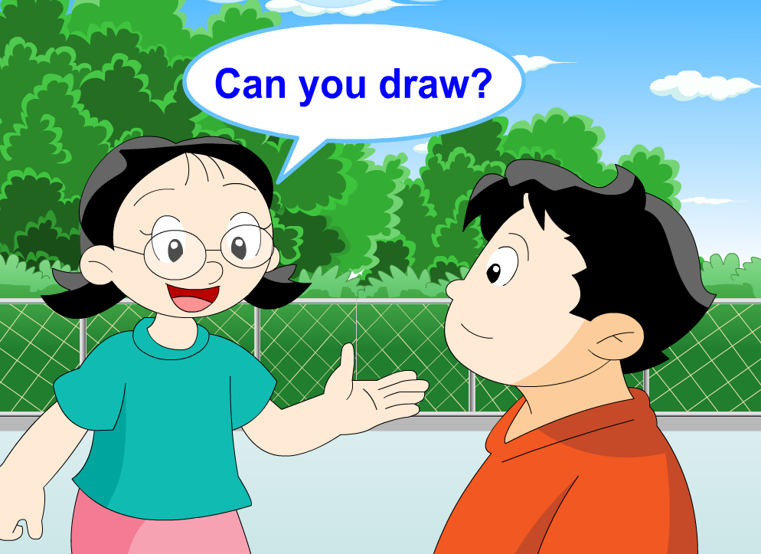

Slide 46
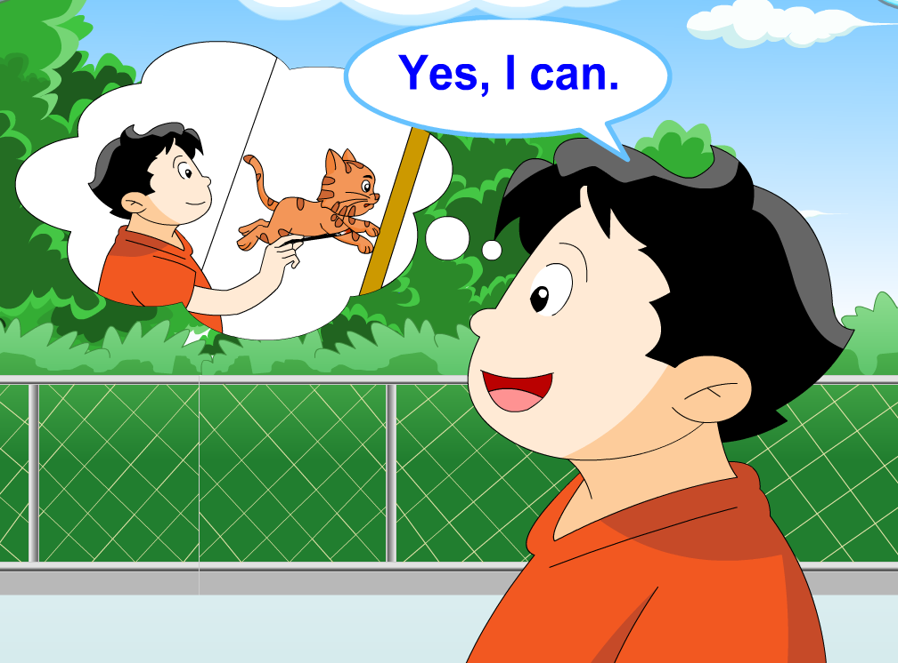

Slide 47
run
Can you _______ ?
Yes, I can. / No, I can’t.

Slide 48
write
Can you _______ ?
Yes, I can. / No, I can’t.

Slide 49
swim
Can you _______ ?
Yes, I can. / No, I can’t.

Slide 50
fly
Can you _______ ?
Yes, I can. / No, I can’t.

Slide 51
Can you sing?
Yes, I can.
Can you ?
run
Yes, I can.

Slide 52
Can you _______?
I can
Yes, ________.
write

Slide 53
Let's chant
Run, run, run. I can run.
Can you run? Yes, I can.
Write, write, write. I can write.
Can you write? Yes, I can.

Slide 54
She can ____.
fly
Can you fly?
No, I can’t.

Slide 55
Look and say
Can you ______?
Yes, _______.
No, _________.
I can
swim
I can’t

Slide 56
Let's chant
Fly, fly, fly. Can you fly?
No, I can’t. No, I can’t.
Swim, swim, swim. Can you swim?
Yes, I can. Yes, I can.
I can swim. I can’t fly.

Slide 57
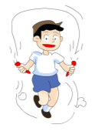
Pair work
Can you …?
Yes, I can.
No, I can’t. I can…

Slide 58
Story Time
Can you swim?

Slide 59
fly
No, I can’t. I can ____.
Bird, bird,
can you swim?

Slide 60
Hen, hen,
can you ____?
No, I can’t. I can ____.

Slide 61
Frog, frog, _____________?
Yes, I can.
Let’s go!
OK.

Slide 62
Can you swim?
Look and act
No, I can’t. I can fly.
Can you swim?
No, I can’t. I can run.
Can you swim?
Yes, I can.
Let’s go!
OK.

