Slide 1
Unit 1 Countries Where’s she from?
WWW.PPT818.COM

Slide 2
Listen and find
Today Li Ming’s friends come to school.
Let’s go and see.
Who are they?

Slide 3
Listen and find
Sam Mary …

Slide 4
Listen and find
Where’s he from?
Where’s she from?

Slide 5
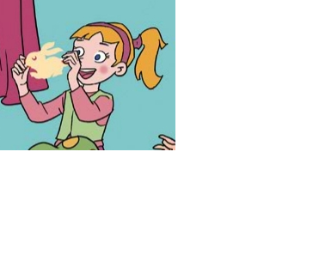
Mary
Where is she from?
She is from ...
She’s

Slide 6
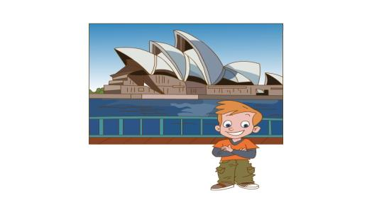
Where is he from?
Australia
He is from ________.
He’s

Slide 7
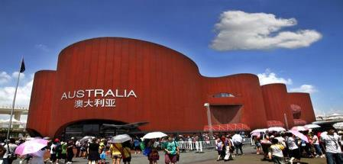
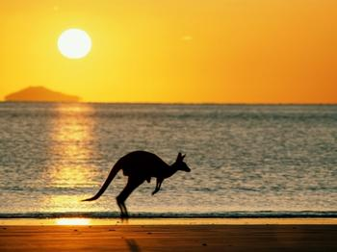
Australia

Slide 8
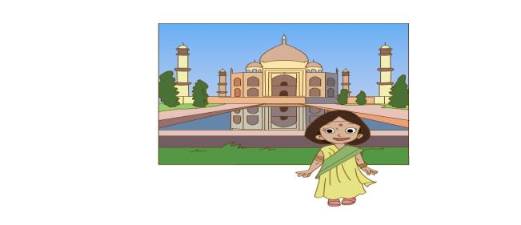
Where is she from?
She is from ________.
She’s
India

Slide 9
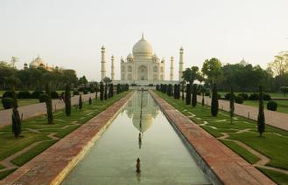
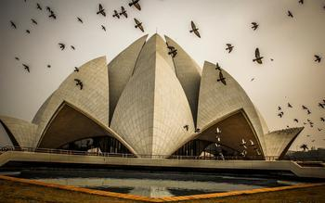
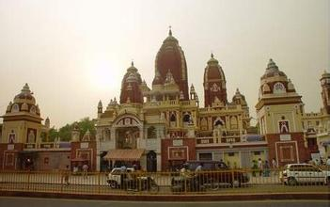
India

Slide 10
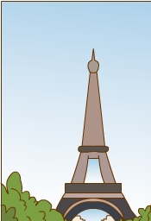
Is he from the U.S?
No, he isn’t.
He’s from__________
France.

Slide 11
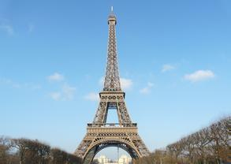
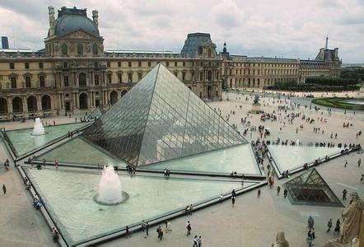
France.

Slide 12
Read and act in groups.
(小组分角色表演课文)

Slide 13
Let’s say.
Mary
Where is she from?
She is from ...
She’s

Slide 14
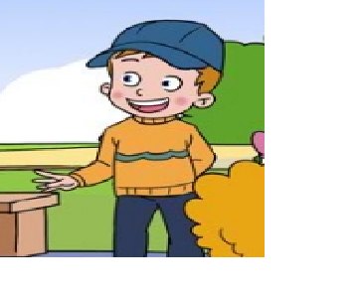
Mike
Where is he from?
He is from ...
(He’s)

Slide 15
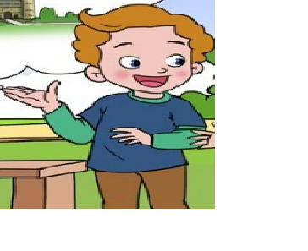
Jim
Where is he from?
He is from ...
(He’s)

Slide 16
Summary
What have you learned?
---Where is she / he from?
---She’s / He’s from….

