Slide 1
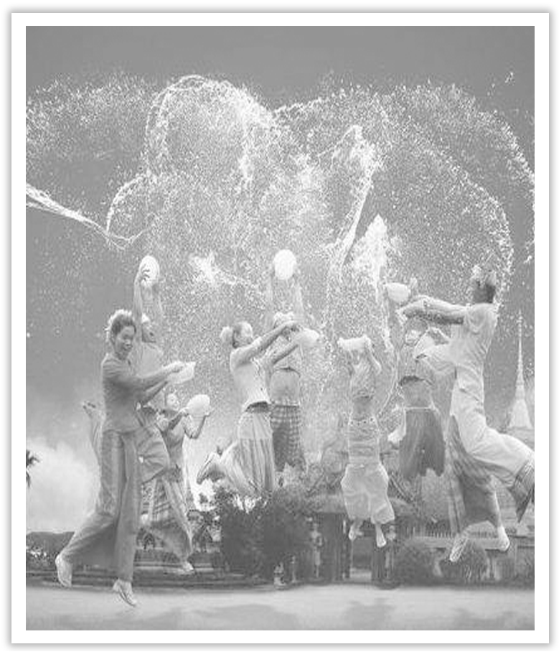
Unit 3 Diverse Cultures
Section Ⅲ Reading and Thinking(2)
WWW.PPT818.COM

Slide 2
Ⅰ.单词语境记忆——根据英汉提示写出单词的适当形式
1.He freely ____________(承认) that he had taken bribes.
2.The word “gratitude” did not ____________(出现) in his words.
3.We ____________(寻找) long and hard but found no answer.
4.He is paid less than he really ____________(赚得).
admitted
occur
sought
earns

Slide 3
5.Which place in the world would you ____________(挑选) as your perfect home?
6.He kept a ____________(日记) during his visit to Japan.
7.They ____________(声称) to have discovered a cure for the disease.
8.She attended all the lectures in the ____________(一系列).
9.There was no ____________(逃脱) the fact：it was all his fault.
10.The team will ____________(definite) lose if he doesn’t play.
select
journal
claimed
series
escaping
definitely

Slide 4
Ⅱ.短语语境填空——根据汉语提示写出适当的短语
1.He ________________(走向) the bathroom to wash up.
2.He left the farm to ________________(闯天下) in the city.
3.Nowadays it is very easy to ________________(谋生).
4.The centre of the city is a ________________(一系列的) ancient squares.
5.________________(除了) some spelling mistakes，the composition is fairly good.
headed to
seek his fortune
earn a living
series of
Apart from

Slide 5
Ⅲ.句式语境仿写
1.I have to admit that it definitely feels good to be back in the city again.
我不得不承认，再次回到这个城市的感觉确实很好。
[仿写] 在我伤心的时候，有人能在我身边，这种感觉很好。
_____________________________________ when I’m sad.
2.There were so many good cafès and restaurants to choose from.
有这么多好的咖啡馆和餐馆可供选择。
[仿写] 她有一个孩子要照顾。
She has a child ________________________.
It feels good to be close to someone
to take care of

Slide 6
记单词
Ⅰ.语境串记多义词
Tom had a narrow escape in the traffic accident，while his fellows failed to escape being killed.
汤姆在这次交通事故中死里逃生，而他的同伴们却没能逃脱。

Slide 7
Ⅱ.构词法助记派生词
名词后缀：－ity
minor(adj.)→minority(n.)
副词后缀：－ly
definite(adj.)→definitely(adv.)
Ⅲ.合成词一族
down＋town→downtown(n./adj./adv.)
after＋wards→afterwards(adv.)

Slide 8
句型公式
1.“it＋系动词＋形容词＋to do...”结构中，it作形式主语，不定式是真正的主语。
2.动词不定式作后置定语时，与其所修饰的词之间往往有动宾关系，如果该不定式是不及物动词，其后应有必要的介词。

Slide 9
Understanding in context
Wednesday，21 June
Today was my first day back in San Francisco after camping in the Redwood Forest and visiting the wine country of Napa Valley.I have to admit that it definitely feels good to be back in the city again.And what a city—a city that was able to rebuild itself after the earthquake that occurred in 1906.There are so many beautiful old buildings—many sitting on top of big hills，offering great views of the city，the ocean，and the Golden Gate Bridge.

Slide 10
[文化视窗]
旧金山(San Francisco)，又译“三藩市”、“圣弗朗西斯科”，美国加利福尼亚州太平洋沿岸港口城市，是世界著名旅游胜地、加州人口第四大城市。也是联合国的诞生地。

Slide 11
1.admit vt.& vi.承认 vt.准许进入(或加入)；容许；接纳 admission n.承认；坦白；入场费；准入；录用
[合作探究] 体会admit的用法和意义
①As was expected，he was admitted to/into Beijing University.
正如所预料的一样，他被北京大学____________了。
②She was admitted as/to be a member of the trade union.
她被接纳为工会会员。
③He admitted (to) breaking/having broken the school rules and willingly accepted punishment.
他____________违反了校规，愿意接受惩罚。
录取
承认

Slide 12
[自主发现]
④admit sb ____________... 承认某人是；接纳某人为……
⑤admit (to) _________________ sth 承认做过某事
⑥admit...____________... 允许……加入/进入……
[巩固内化] 单句语法填空
①As a matter of fact，we all admit him ____________ (be) an honest man.
②Only athletes who have reached the agreed standard for their event will be admitted ____________ competitors.
[特别提醒] admit作“承认，招认”讲时，admit (to) doing sth中的to可有可无，切记不可将to当作不定式符号。
to be/as
doing/having done
to/into
to be
as

Slide 13
2.I have to admit that it definitely feels good to be back in the city again.
我不得不承认，再次回到这个城市的感觉确实很好。
【句式解读】 句中it为形式主语，真正的主语为后面的不定式短语to be back。
【用法总结】
(1)it＋系动词＋形容词＋to do...
(2)it＋系动词＋名词＋to do...
(3)it＋系动词＋介词短语＋to do...
(4)it＋动词＋宾语 (＋形容词)＋to do...

Slide 14
①It is better to get up early.
早起会更好。
②It takes a lot of effort to recover the system.
恢复系统不是一件容易的事情。
③It is against the law to steal.
偷窃是犯法的。

Slide 15
[巩固内化] 补全句子
①_________________________ before dark.
天黑以前赶到那里很困难。
②__________________________ this matter.
处理这个问题是他的责任。
③__________________________ that you have to go away.
听说你一定要走，我很难过。
[特别提醒] 用it作形式主语的好处是避免句子由于主语太长而显得头重脚轻。
It is difficult to get there
It was his duty to attend to
It makes me sad to hear

Slide 16
3.occur vi.发生；出现；(想法、念头等)想起，浮现
[合作探究] 体会occur的用法和意义
①A good idea occurred to me all at once.
突然间我____________一个好主意。
②I suppose it didn’t occur to you to phone the police.
我想你根本就没想到打电话报警吧。
③It occurs to me that he might be interested in the problem we had discussed.
____________他也许对我们讨论过的那个问题感兴趣。
想到
我突然想起来

Slide 17
[自主发现]
④occur ____________ sb 某人想到；发生在某人身上
⑤It occurs to sb ____________ 某人想起做某事
⑥____________/strikes/hits sb that... 某人突然想起……
[巩固内化] 单句语法填空
①I hope no accident has occurred ____________ him.
②Didn’t it occur to you ____________(close) the window?
③____________ occurred to me that I had left the door unlocked.
[特别提醒] occur结构中主语不能是人，而是想到的事情或it。
to
to do sth
It occurs to
to
to close
It

Slide 18
Understanding in context
My hotel is near downtown，in the Mission District，one of the oldest parts of the city.Many of the people living here are from Mexico or Central America.This district used to be a poor area of town，but is now a centre for art，music，and food.In fact，an art movement called the “Mission School” started here.It’s influenced by graffiti art and comic art.I walked around looking at the street art for a few hours.It was quite modern and lively.Afterwards，I ate some delicious Mexican-Chinese noodles from a food truck.A real mix of cultures here！

Slide 19
[文化视窗]
旧金山湾区从20世纪起一直是美国嬉皮士文化、近代自由主义和进步主义的中心之一，还有全美最大艺术院校旧金山艺术大学。

Slide 20
4.I walked around looking at the street art for a few hours.
【句式解读】 句中looking at the street art为现在分词短语，在句中作状语，表示伴随的情况。
【用法总结】 现在分词短语作伴随状语，表示伴随情况，所表示的动作与谓语同时发生，且与句子的主语是主动关系。另外，现在分词在句中还可作时间、原因、结果状语。

Slide 21
①Gathering around the fire，the tourists danced with the local people.
那些旅行者们聚在篝火周围和当地人一起跳舞。
②She lay in bed staring at the last leaf on the tree.
她躺在床上，眼睛盯着那棵树上最后一片叶子。
③The poor old man died，leaving nothing to his children.
那位可怜的老人去世了，什么也没给他的孩子们留下。

Slide 22
[巩固内化]
单句语法填空/补全句子
①____________(hear) the news，they all jumped with joy.
②My train leaves at six，____________(arrive) in Chicago at ten.
③Not ____________(know) her address，I can’t write to her.
④All night long he lay awake，____________________.
他整夜躺在床上睡不着，思考着那个问题。
Hearing
arriving
knowing
thinking of the problem

Slide 23
Understanding in context
In the afternoon，I headed to a local museum that showed the historical changes in California.I learnt that America got California from Mexico in 1848.In the same year，gold was discovered near San Francisco，which started a gold rush.Over 300，000 people came from all over the world to seek their fortune，and San Francisco quickly became a big city.Many Chinese arrived during this period.To earn a living，some opened up shops and restaurants in Chinatown.Many others found jobs on farms，joined the gold rush，or went to build the railway that joined California to the eastern region of the country.The museum did a really good job of showing how America was built by immigrants from different countries and cultures.When these immigrants left their countries，they carried a bit of home in their hearts，and built a new home here.

Slide 24
[文化视窗]
1769年西班牙人发现此地，1848年加入美联邦。19世纪中叶旧金山在淘金热中迅速发展，华侨称之为“金山”，后为区别于澳大利亚的墨尔本，改称“旧金山”。截止到2014年7月，全市人口约85万，其中华人18万 ，是西半球华人人口密度最高的地区之一，华人总数量仅次于纽约。

Slide 25
5.head to(朝……)前进；(朝……)去
①She and her child boarded a plane heading to where her family lived.
她带着孩子登上了一架回家的飞机。
[短语记牢] 记牢下列短语
head...to 把……引至或领到
head up 走在前头；当头；领导
②The girl headed her little sister to the school.
姐姐把小妹妹领到学校。
③A band headed up the parade.
一个乐队走在游行队伍的前面。

Slide 26
[词块积累]
head to trouble引起麻烦
head up the Student Union 主管学生会的工作
[巩固内化] 单句语法填空
①They spent the holiday with family in Seattle and then headed ____________ Portland to visit friends.
②Who is the best person to head ____________ the special committee？
to
up

Slide 27
6.seek vt.& vi.(sought，sought)寻找；寻求；争取；(向人)请求；探索
[合作探究] 体会seek的用法和意义
①They are seeking for/after solutions to the problems.
他们正在____________这些问题的解决方法。
②How can we seek out a really good person for the job?
我们怎样才能____________一个真正适合的人来做这项工作？
③We are always seeking to improve working conditions.
我们一直设法改善工作条件。
寻找
找到

Slide 28
[自主发现]
④seek ____________ 寻找；追求
⑤seek sb/sth ____________ 找出某人/某物
⑥seek ____________ 试图做某事
for/after
out
to do sth

Slide 29
[词块积累]
seek shelter from rain寻找避雨的地方
seek(after) fame 求名
seek help from a neighbour 向一位邻居求助
[巩固内化] 单句语法填空
①We shouldn’t seek ____________ comfort，personal fame，or gain.
②I have never sought ____________(hide) my views.
for/after
to hide

Slide 30
7.earn vt.赚得；挣得；博得；赢得 earnings n.所得；收入；工资
[合作探究] 体会earn的用法和意义
①He earned his/a living by selling newspapers when he was young.＝He made a living by selling newspapers when he was young.
他年轻时靠卖报____________。
②Your efforts will earn you a good reputation.
你的努力将会为你赢得佳誉。
[自主发现]
③________________(＝make one’s/a living) 谋生
④earn sb sth 使某人赢得/获得……
谋生
earn one’s/a living

Slide 31
[词块积累]
earn money(＝make money) 挣钱
earn success 获得成功
earn one’s own living 自食其力
[巩固内化] 补全句子
__________________________，you have to work hard.
为了谋生，你必须努力工作。
To earn a/your living

Slide 32
Understanding in context
This evening，I went to Chinatown.There were so many good cafès and restaurants to choose from.I selected a Cantonese restaurant that served food on beautiful china plates.What great food!
That’s enough for today.Tomorrow evening，I’m going to a jazz bar in the Richmond District.Can’t wait！
[文化视窗]
旧金山的中国城是唯一一个可以和纽约唐人街相媲美的地方，在这里可以看到很多的华人华侨，这里完全就是一个城中之国，异国情调十足。

Slide 33
8.select vt.挑选；选择；选拔
[合作探究] 体会select的用法和意义
①We selected him as/to be our monitor because he was very responsible.
我们____________我们的班长，因为他很负责任。
②Simon has been selected to make a speech at the opening ceremony.
西蒙被推选出在开幕式上致辞。
③After a long walk，we selected a good place for our camp.
走了很长的路后，我们选了一个露营的好地方。
选他当

Slide 34
[自主发现]
④select...____________... 挑选……作为……
⑤select sb ____________ 挑选某人做某事
⑥select...____________... 为……挑选……
[词块积累]
select a diamond ring挑选钻石戒指
select goods from our catalogue 从我们的目录中选择商品
[巩固内化] 单句语法填空
①Daff was selected from the whole class ____________ (go) on the trip.
②She has been selected ____________ the England team.
as/to be
to do sth
for
to go
for

