Slide 1
Unit 2
Waiting for Another Hare
WWW.PPT818.COM

Slide 2
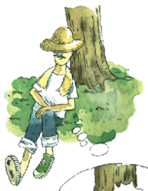
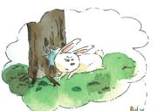
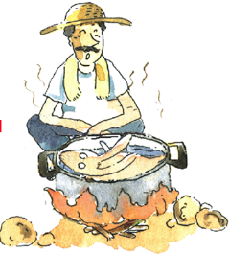
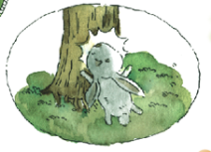
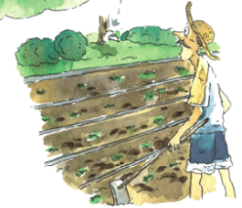
Waiting for Another Hare
Do you know the story in Chinese?
③
①
②

Slide 3
_________（从那时起），the farmer
didn’t work _________（再）.
_________ （整天）he sat in the
fields and _________ （等候…… ）a
hare to appear.
From then on
any more
All day long
waited for

Slide 4
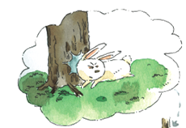
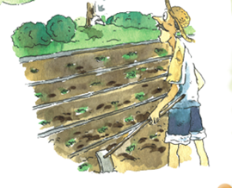
One day, a farmer was working in the field. Suddenly a hare ran very fast and crashed into a tree. It fell to the ground and died.
(run)
(fall)
crash into sth: 撞上....
fall to the ground : 掉在地上
die: 死亡

Slide 5
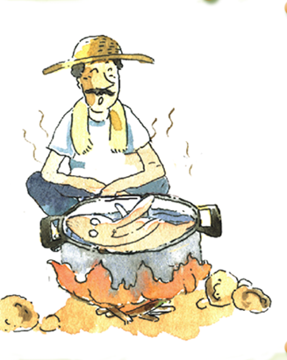
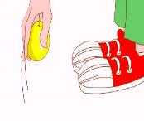
The farmer was happy.
He picked up the hare and took it back home. He cooked it and had a delicious meal.
(take)
(have)
pick up : 捡起
take sth back home: 带回家

Slide 6
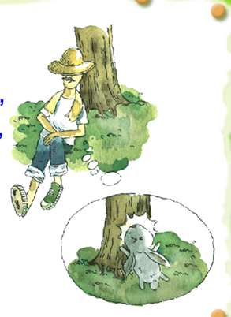
“Working in the field every day is hard work. But picking up a hare is so easy," he said to himself. From then on, the farmer stopped working. All day long, he sat in the field and waited for a hare to appear.
V-ing放句首，动名词做主语
easy: 容易的-- hard
himself: 他自己
from then on: 从那时起 from now on: 从现在起

Slide 7
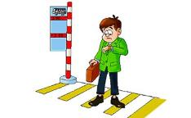
“Working in the field every day is hard work. But picking up a hare is so easy," he said to himself. From then on, the farmer stopped working. All day long, he sat in the field and waited for a hare to appear.
stop
sit
stop : 停止 stop + V-ing : 停止做某事
all day long : 整天
wait for : 等待
appear : 出现

Slide 8
All his vegetables died. All his animals ran away. But another hare never came, so the farmer had nothing to eat.
run away: 跑走，逃跑
another: 另一个

Slide 9
What do you learn from the story?
Don't be like the farmer. Don't wait for another hare. Go for it!
加油，努力！
给某人建议： Don't + V原

Slide 10
(1) Where was the farmer when he saw the hare ?
(2) How did the hare die ?
(3) What did the farmer do with the hare ?
(4) Why did the farmer sit in the field all day ?
(5) What happened to the farmer's vegetables and animals ?
He was working in the field.
It ran very fast and crashed into a tree. It fell to the ground and died.
He picked up the hare and took it back home. He cooked it and had a delicious meal.
Because he wanted to wait for another hare to appear.
All his vegetables died. All his animals ran away.

Slide 11
Let's recite.
One day, a farmer was working in field. Suddenly a hare ran very fast and crashed into a tree. It fell to the ground and died. The farmer was happy. He picked up the hare and took it back home. He cooked it and had a delicious meal.

Slide 12
Let's recite.
"Working in the field every day is hard work. But picking up a hare is so easy," he said to himself. From then on, the farmer stopped working. All day long, he sat in the field and waited for a hare to appear. All his vegetables died. All his animals ran way. But another hare never came, so the farmer had nothing to eat.

Slide 13
Let's recite.
Don't be like the farmer. Don't wait for another hare. Go for it.

Slide 14
3
Read and do:
working in the field
run very fast
crash into a tree
fall to the ground
pick up
have a delicous meal
sit in the field

Slide 15
2
规则动词过去式
1.crash—crashed 2.die---died
3.wait—waited
4.cook---cooked 5.pick---picked
不规则动词过去式
1.run—ran 2.fall----fell (倒下，落下）
3.take ----took 4.sit---sat
5.has/have ----had

Slide 16
Retell the story
Waiting for another hare
worked in the field crashed into a tree fell to the ground
picked up the hare took it home had a delicious meal
from then on stopped working all day long
wait for go for it

